Slide 1
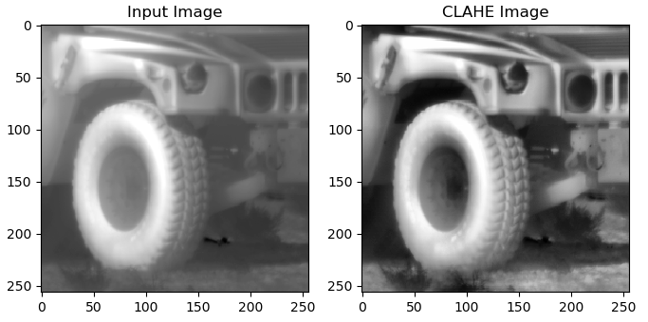

Slide 2
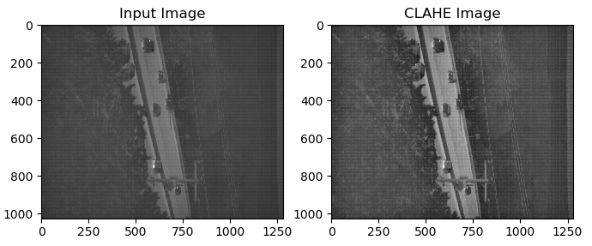

Slide 3
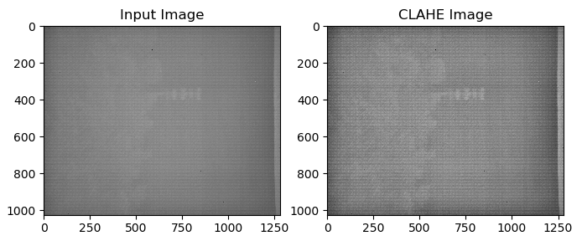

Slide 4
Preparing image
Make histogram
Clipping Histogram
Distribute histogram
Distribute the part of the histogram which exceeded the limit equally over all histogram bins.
To reduce noise amplification, remove the number of pixels that exceed the clip limit.
Make histograms of each block (16 histograms).
Divide the image into small blocks (64x64, 16 blocks)
If the size of image is not divisible by the size of the block, use zero padding.
Set upper value (difference between clip limit and distribution amount) because the distribution pushes some bins over the limit.
Transformation and Interpolation
Each pixel is transformed from CDF
For interpolation, use four surrounding CDFs.

Slide 5
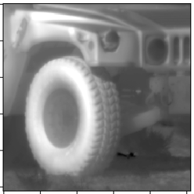
1. Image preparation
ysz = 64
w,h : size of image
xsz, ysz : size of block
nrx, nry : number of blocks in x and y direction
(256/64 = 4 blocks, 4 blocks x 4 blocks)
h = 256
xsz = 64
w = 256

Slide 6
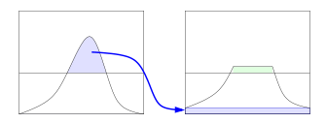
2. Clipping Histogram
nrExcess
65536 0
count
upper
clipLimit
binIncr
0 255
pixel value
nrExcess : number of pixels that exceed the clip limit.
clipLimit : contrast limit
Binlncr : nrExcess / 256
Upper : clipLimit – Binlncr

Slide 7
3. Interpolation
Input image
Map_
[0,0,255]
Map_
[0,1,255]
Contrast enhanced image
Map_
[1,0,255]
Map_ : array of CDFs
UL : CDF of upper left
UR : CDF of upper right
BL : CDF of lower left
BR : CDF of lower right
For this block, UL is map_[0,0,255], UR is map_[0,1,255]
BL is map_[1,0,255], and BR is map_[1,1,255]
Interpolation :
Val = image[I,j]
inverseI = 64-i, inverse=J = 64-j
(I,j) = (inverseI * (inverseJ * LU[val] + j * RU[val]) + i * (inverseJ * LB[val] + j * RB[val])) / num)

Slide 8
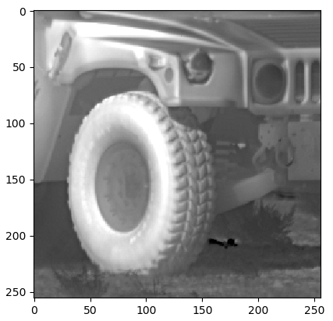
Unsharp masking

Slide 9
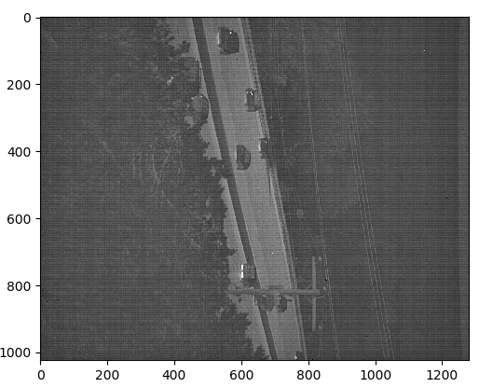
Unsharp masking

