Slide 1


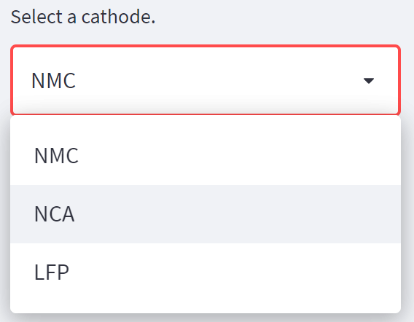
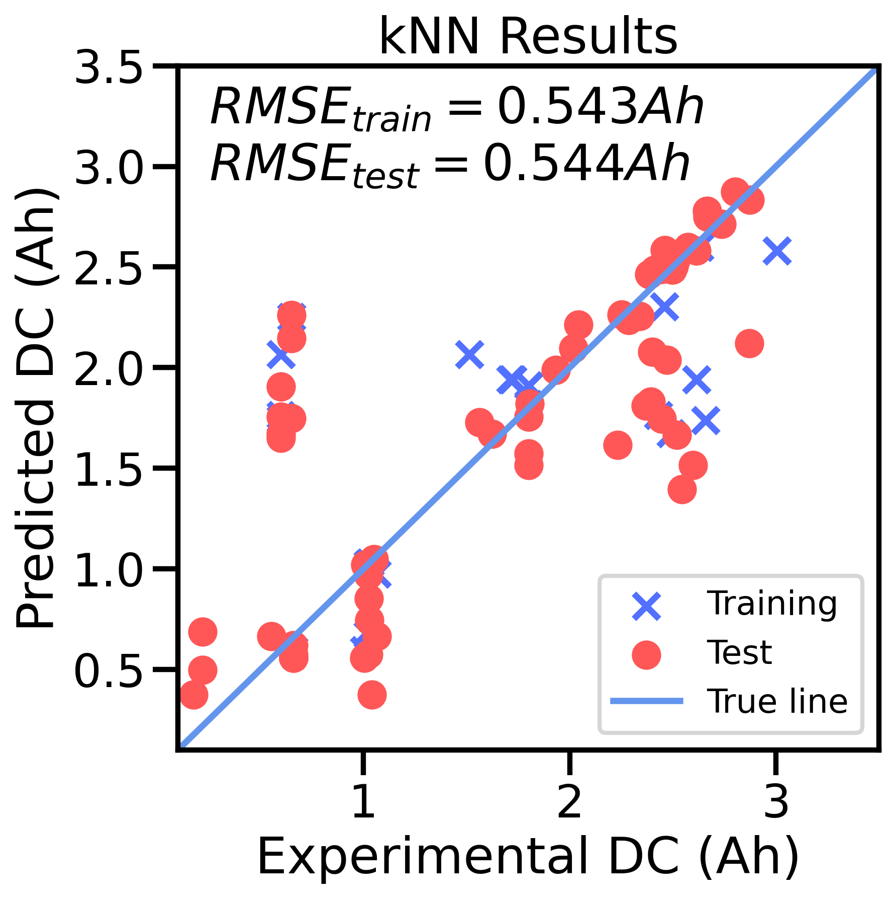
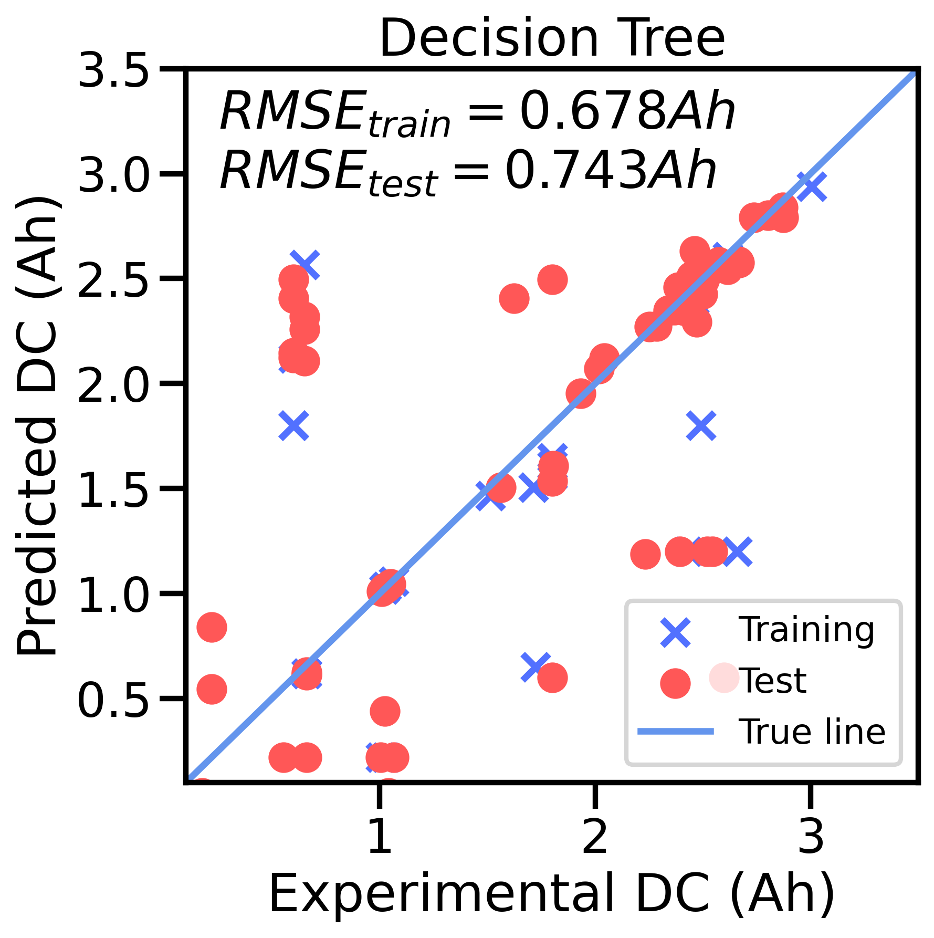
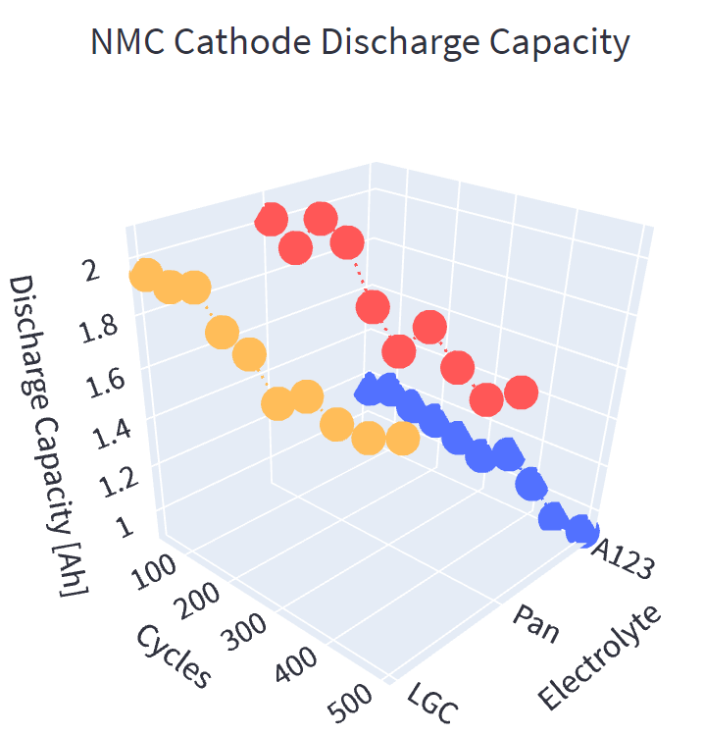
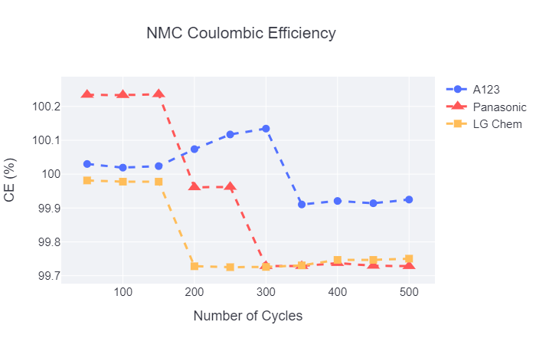
SELEC: Selection of Battery Electrolytes Driven by Machine Learning
Rose Yesl Lee, Karen Li, Bella Wu, Shuyan Zhao
Introduction
Battery Components and Performance
Motivating Use Case
Over the past 25 years, the energy throughput of lithium-ion batteries have increased while the production costs have significantly decreased¹, leading to a rising demand in better batteries. In this expanding electric economy, battery scientists face several challenges when designing a higher energy battery.
Anode
Battery performance is heavily affected by external operating conditions such as temperature, applied load (e.g. C-rate), and intrinsic and aging characteristics of the anode, cathode, and electrolyte material. Electrolyte research is a hot topic due to safety concerns.
Models save us time, money, and safety
User: Experimental battery scientist
The user, who may be unfamiliar with programming languages, will specify a battery system and be able to see the performance of the battery prior to conducting an experiment.
Electrolyte
Cathode
Graphical User Interface
Machine Learning
Data Visualization
A GUI was developed for SELEC using Streamlit.
Machine Learning Models
Comparisons of the available electrolytes is facilitated through data visualization, which was achieved using Plotly. An interactive 3D visualization of the predicted charge and discharge energy and capacity with respect to cycle number, in addition to a 2D visualization of coulombic and energy efficiency is shown on the GUI.
The user chooses:
Six different regression models were fitted and tested to a training and validation set prior to a train and testing set, with the loss function being root mean squared error (RMSE).
Anode
Cathode
Temperature
C-rate
Cycle number
from a dropdown menu, which feeds into the data preparation algorithm.
Data Management
Open-source battery cycling studies from Sandia National Labs² via Battery Archive were processed in preparation of being used in computing.
The k-NN model displayed good results for most performance metrics and less computationally expensive. Most validation and test RMSE are similar, indicating the model is not overfitting.
Metadata and cycle data:
Obtain and compile data into project database
Train
Validation
k-NN Regression Predictions
GridSearchCV showed consistent results while searching for the best hyperparameters for each metric.
Conclusion
Training
Test
A program to compare battery electrolytes based on predicted battery performance gauged by capacity, energy, and efficiency was created. Open-source data was processed through one hot encoding, a k-NN model was developed and optimized, and results were presented on a GUI. The validation and test RMSE were similar for the k-NN model. Average predicted values are within one standard deviation from dataset values.
Design Space
k-NN Regression | Charge Capacity (Ah) | Discharge Capacity (Ah) | Charge Energy (Wh) | Discharge Energy (Wh) | Coulombic Efficiency (%) | Energy Efficiency (%)
Hyper parameter Algorithm | auto | auto | auto | auto | ball tree | auto
n-neighbors | 11 | 11 | 11 | 12 | 46 | 4
Validation RMSE | 0.544 | 0.542 | 2.097 | 1.857 | 0.520 | 2.142
Test RMSE | 0.538 | 0.539 | 2.105 | 1.858 | 1.372 | 2.891
Data set mean | 1.479 | 1.479 | 5.513 | 4.826 | 100.060 | 90.044
Data set std | 0.688 | 0.687 | 2.857 | 2.375 | 0.161 | 4.712
Design space mean | 1.626 | 1.627 | 6.153 | 5.324 | 100.044 | 89.406
Design space std | 0.875 | 0.875 | 3.553 | 2.968 | 0.989 | 5.848
Split data into test, train, and validation sets
Cathode
LFP
NCA
NMC
C1 | C2 | C3
1 | 0 | 0
0 | 1 | 0
0 | 0 | 1
Future Implementations
One hot encode:
Convert categorical data into numerical values
Describe cathode input with physically meaningful features (ex: tortuosity, porosity, conductivity)
Predict battery mechanisms for different systems
User uploads their own data
Capacity has lowest RMSE, while energy and efficiency had higher RMSEs
Predictor overestimates capacity and energy values and underestimates efficiency values
Acknowledgements
Standardize:
Scale numerical data
The SELEC team graciously thanks the instructors, Dave Beck and Stephanie Valleau, for their guidance. We also acknowledge Evan Komp and Nisarg Joshi for their time and constant big brain advice.
[1] 1. J. Liu et al., Nat. Energy, 4, 180–186 (2019). [2] Yuliya Preger et al 2020 J. Electrochem. Soc. 167 120532

