Slide 1


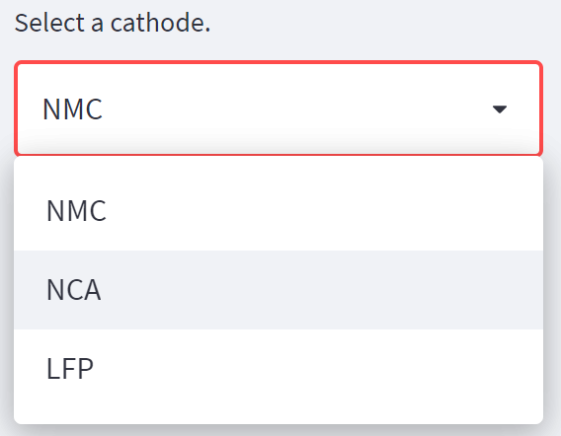
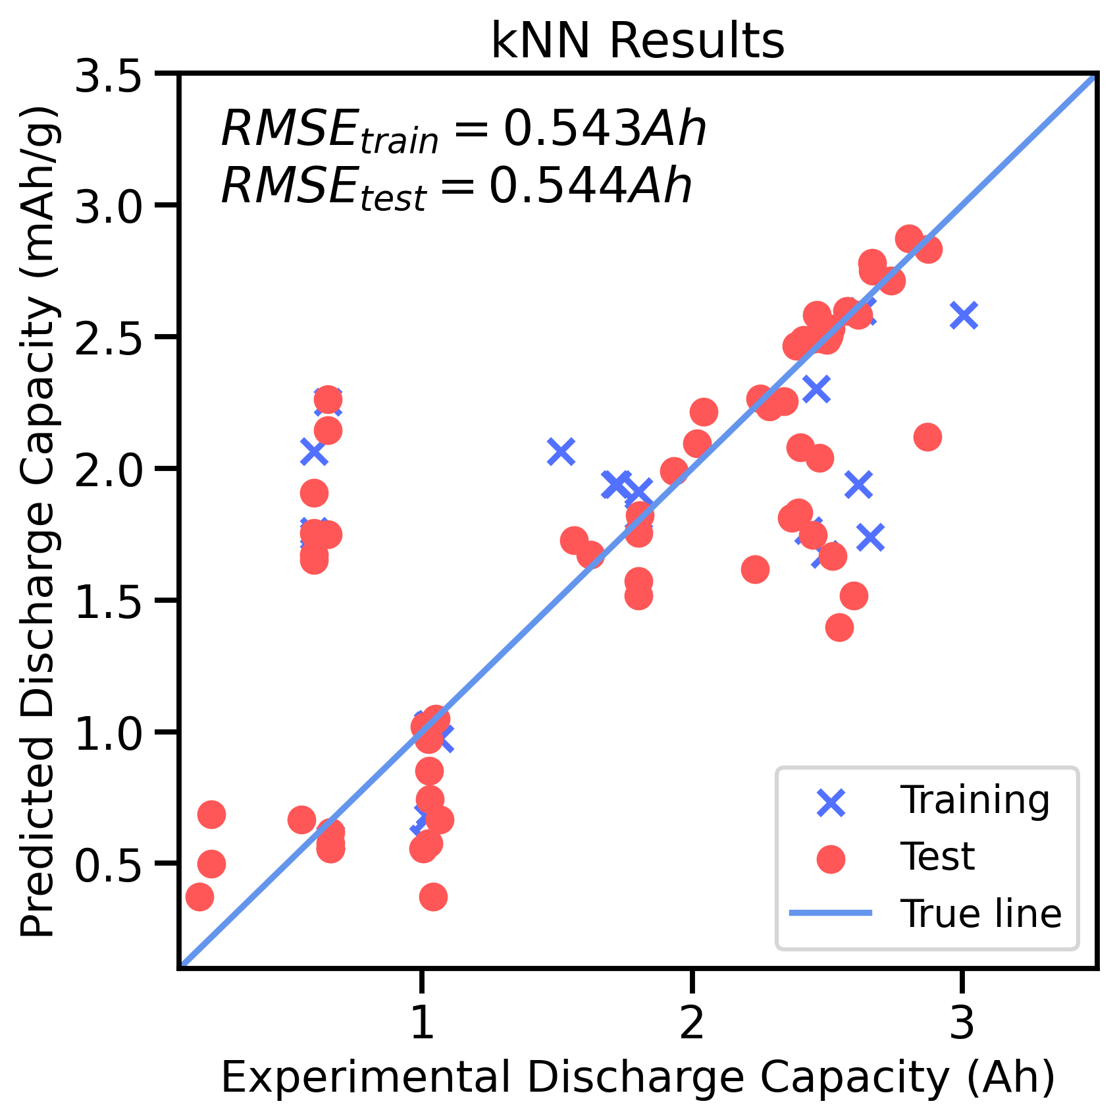
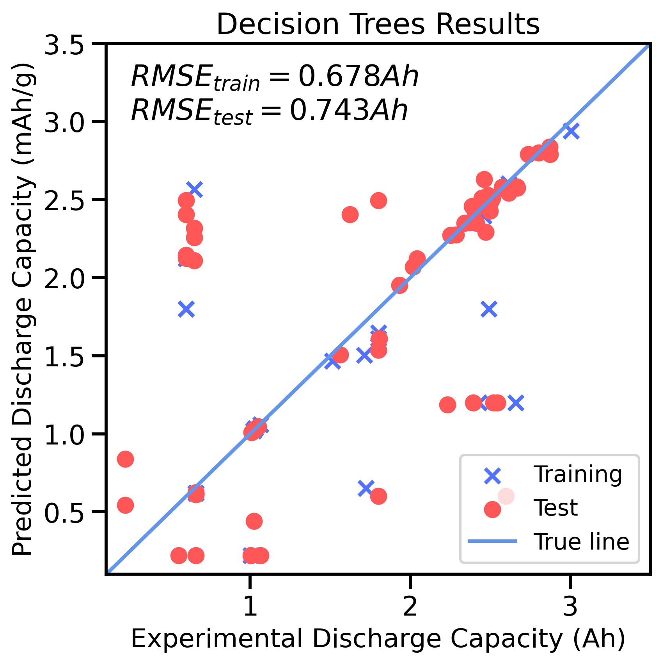
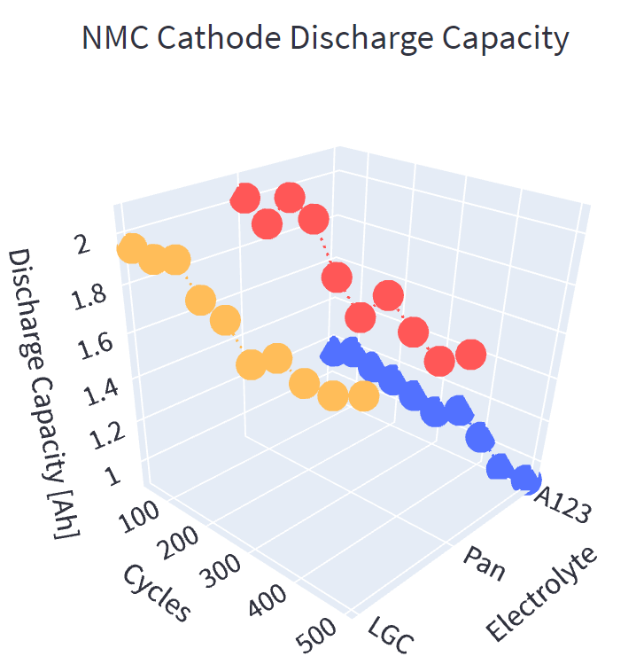
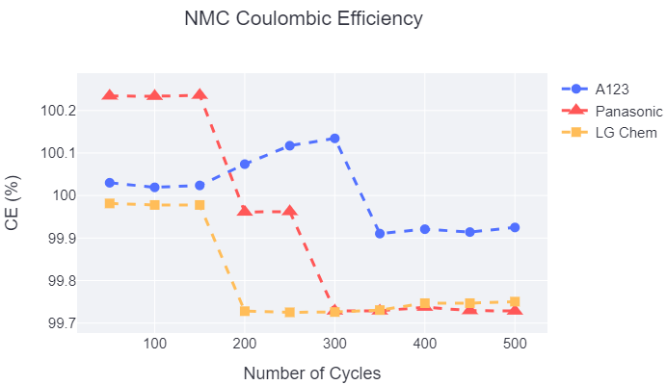
SELEC: Selection of Battery Electrolytes Driven by Machine Learning
Rose Lee, Karen Li, Bella Wu, Shuyan Zhao
Introduction
Project Goals:
- Take input
(will have generic “batteries are important” info)
(will have battery diagram here, will explain why researching various parts of batteries is OP)
Graphical User Interface
Machine Learning
Data Visualization
To facilitate the user experience, a GUI was developed for SELEC using Streamlit.
Machine Learning Models
Comparisons of the available electrolytes is facilitated through data visualization, which was achieved using Plotly. An interactive 3D visualization of the predicted charge and discharge capacity with respect to cycle number, in addition to a 2D visualization of coulombic and energy efficiency is shown on the GUI.
Five different regression models was fitted and tested to a training and validation set prior to a train and testing set, with the loss function being root mean squared error (RMSE).
The user chooses the desired anode, cathode, temperature, C-rate, and cycle number from a dropdown menu, which feeds into the data preparation algorithm.
Add the other plots
Data Management
Open-source battery cycling studies from Sandia National Labs¹ via Battery Archive were processed in preparation of being used in computing.
Add the other plots
Metadata and cycle data:
Obtain and compile data into project database
Train
Validation
Conclusion
Training
Test
K-NN Regression Predictions
A program to compare battery electrolytes based on predicted battery performance gauged by capacity, energy, and efficiency was created. Open-source data was processed for a optimized k-NN regression model, and results were presented on a GUI. Most of the validation RMSE and test RMSE are similar for the k-NN model. Predictor seems to overestimate charge and energy values and underestimates efficiency values.
GridSearchCV showed consistent results while searching for the best hyperparameters for each metric.
Split data into test, train, and validation sets
Design Space
k-NN Regression | Charge Capacity (Ah) | Discharge Capacity (Ah) | Charge Energy (Wh) | Discharge Energy (Wh) | Coulombic Efficiency (%) | Energy Efficiency (%)
Hyper parameter Algorithm | auto | auto | auto | auto | ball tree | auto
n-neighbors | 11 | 11 | 11 | 12 | 46 | 4
Validation RMSE | 0.544 | 0.542 | 2.097 | 1.857 | 0.520 | 2.142
Test RMSE | 0.538 | 0.539 | 2.105 | 1.858 | 1.372 | 2.891
One hot encode:
Convert categorical data into numerical values
Cathode
LFP
NCA
NMC
C1 | C2 | C3
1 | 0 | 0
0 | 1 | 0
0 | 0 | 1
Future Implementations
Results for battery performance metric predictions
Describe cathode input with physically meaningful features (ex: tortuosity, porosity, conductivity)
Predict battery mechanisms for different systems
User uploads their own data
k-NN Regression | Charge Capacity (Ah) | Discharge Capacity (Ah) | Charge Energy (Wh) | Discharge Energy (Wh) | Coulombic Efficiency (%) | Energy Efficiency (%)
Data set mean | 1.479 | 1.479 | 5.513 | 4.826 | 100.060 | 90.044
Data set std | 0.688 | 0.687 | 2.857 | 2.375 | 0.161 | 4.712
Design space mean | 1.626 | 1.627 | 6.153 | 5.324 | 100.044 | 89.406
Design space std | 0.875 | 0.875 | 3.553 | 2.968 | 0.989 | 5.848
Standardize:
Scale numerical data
Acknowledgements
Capacity has lowest RMSE, energy and efficiency had higher RMSEs
Coulombic efficiency had greatest difference between validation and test RMSE possible due to very similar values in the data set and possible high variance
[result on battery performance]
The SELEC team graciously thanks the instructors, Dave Beck and Stephanie Valleau, for their guidance. We also acknowledge Evan Komp and Nisarg Joshi for their time and constant big brain advice.
[1] Yuliya Preger et al 2020 J. Electrochem. Soc. 167 120532
White space here doesn’t match

