Slide 1
SELEC: Machine Learning-Driven Selection of Battery Electrolytes
Rose Lee, Karen Li, Bella Wu, Shuyan Zhao

Slide 2

SELEC: Selection of Battery Electrolytes Driven by Machine Learning
Rose Lee, Karen Li, Bella Wu, Shuyan Zhao

Slide 3
SELEC: Selection of Battery Electrolytes Driven by Machine Learning
Rose Lee, Karen Li, Bella Wu, Shuyan Zhao

Slide 4

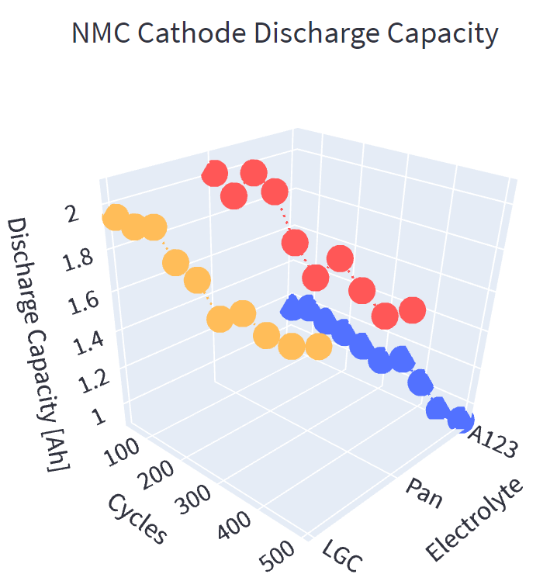
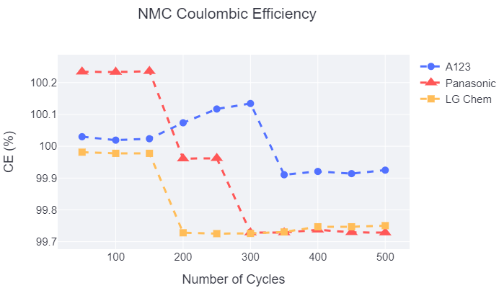
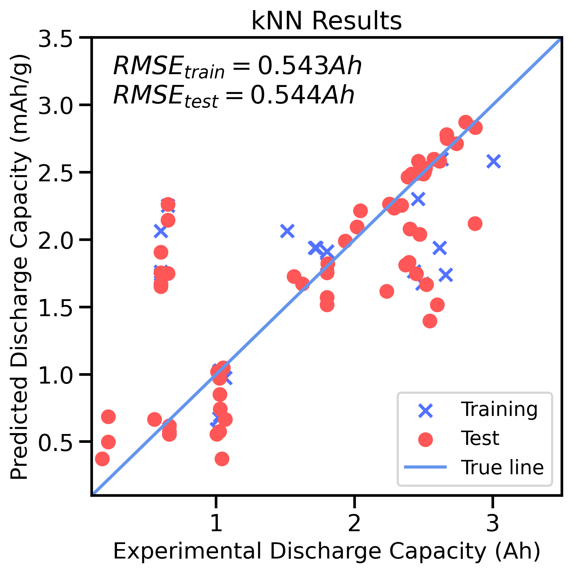
SELEC: Selection of Battery Electrolytes Driven by Machine Learning
Rose Lee, Karen Li, Bella Wu, Shuyan Zhao
Introduction
Project Goals:
- Take input
(will have generic “batteries are important” info)
(will have battery diagram here, will explain why researching various parts of batteries is OP)
Data Management
Machine Learning
Visualization
Open-source battery cycling studies from Sandia National Labs¹ via Battery Archive were processed in preparation of being used in computing.
Machiiiineeee learningggggggg
Alll the machine learning!
To broaden the audience, a GUI was developed for SELEC using Streamlit. The user chooses desired parameters(will list) from a dropdown menu.
Metadata and cycle data:
Obtain and compile data into project database
Placeholder for example of encoder (or even text! Any content will really do! If no content, I’ll center the flow chart
Split data into test, train, and validation sets
One hot encode:
Convert categorical data into numerical values
Results are visualized using Plotly. A 3D visualization of the predicted charge and discharge capacity with respect to cycle number, in addition to a 2D visualization of coulombic/energy efficiency is shown on the GUI.
Standardize:
Convert categorical data into numerical values
Conclusion and Future Outlook
We achieved this, and we want to do that.
[1] Yuliya Preger et al 2020 J. Electrochem. Soc. 167 120532
Design Space
Validation
Training
Test
Can we have a quick schpeal about design space here?
Acknowledgements
Design Space
The SELEC team graciously thanks the instructors, Dave Beck and Stephanie Valleau, for their guidance. We also acknowledge Evan Komp and Nisarg Joshi for their time and constant big brain advice.

