Slide 1
SELEC: Machine Learning-Driven Selection of Battery Electrolytes
Rose Lee, Karen Li, Bella Wu, Shuyan Zhao

Slide 2

SELEC: Selection of Battery Electrolytes Driven by Machine Learning
Rose Lee, Karen Li, Bella Wu, Shuyan Zhao

Slide 3
SELEC: Selection of Battery Electrolytes Driven by Machine Learning
Rose Lee, Karen Li, Bella Wu, Shuyan Zhao

Slide 4

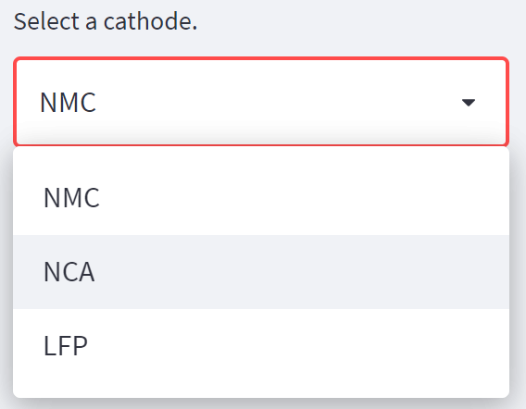
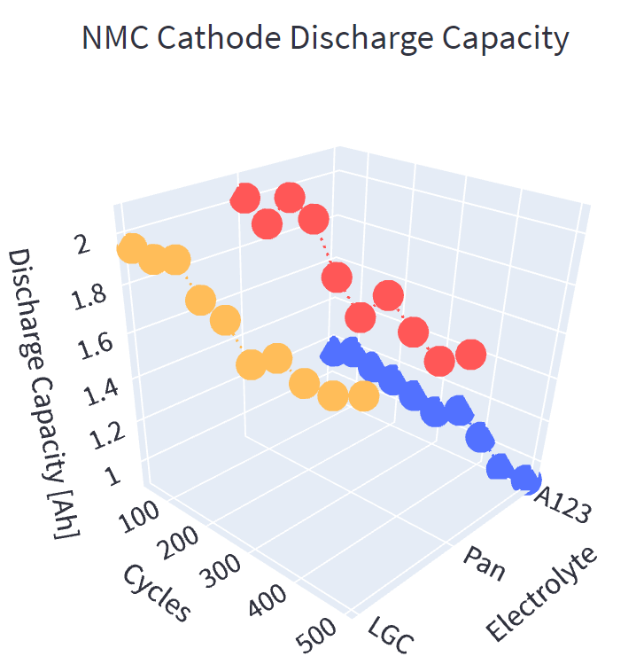
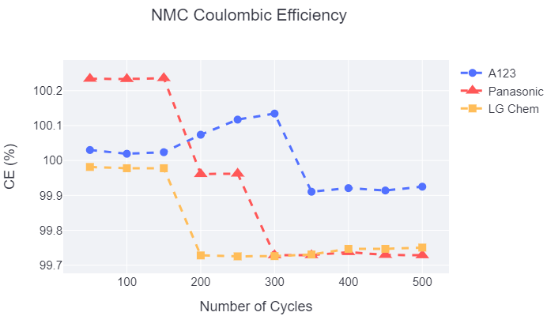
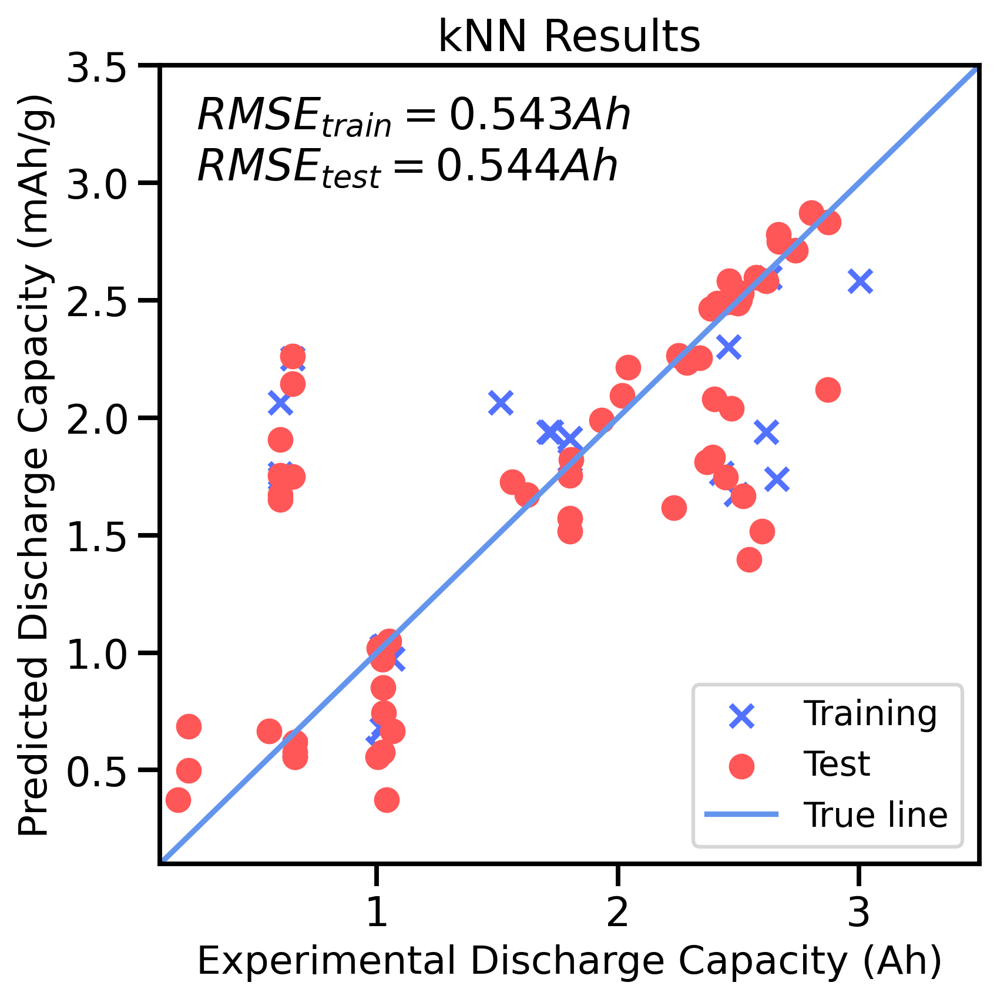
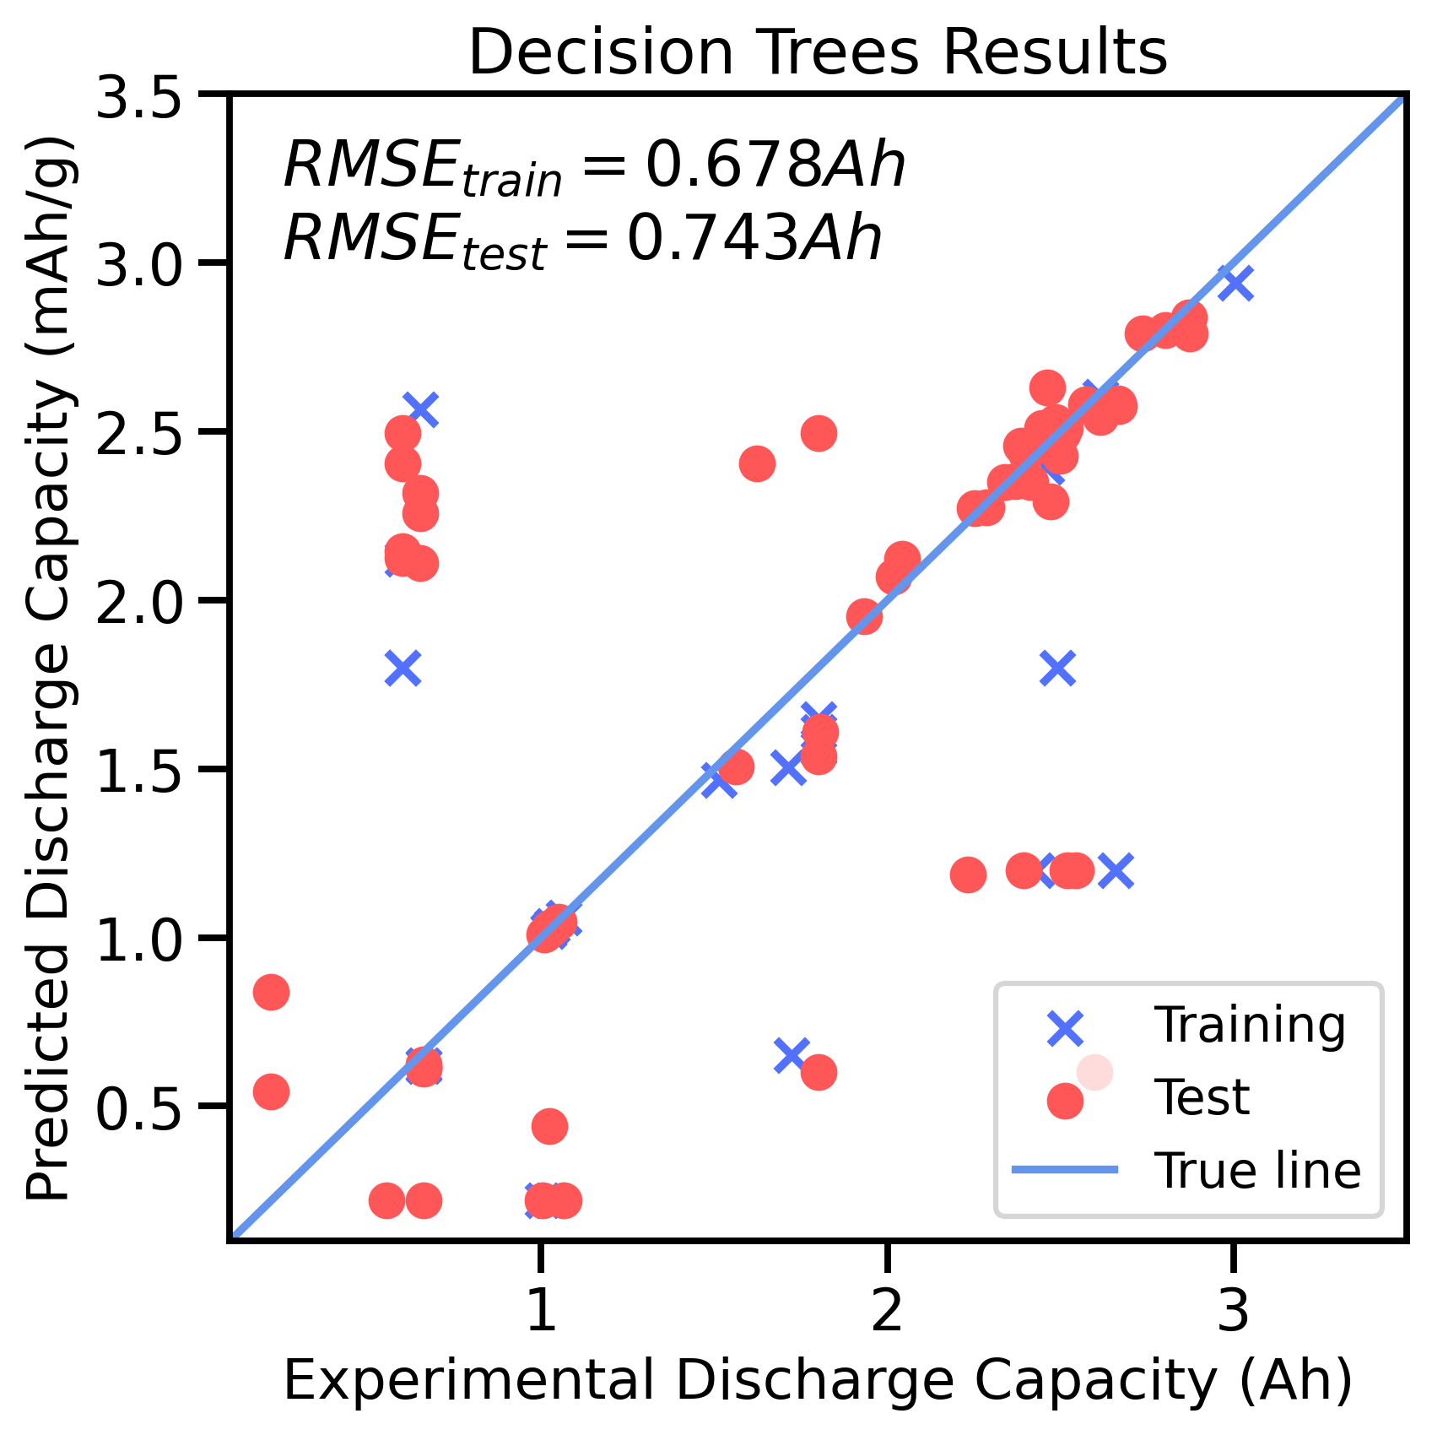
SELEC: Selection of Battery Electrolytes Driven by Machine Learning
Rose Lee, Karen Li, Bella Wu, Shuyan Zhao
Introduction
Project Goals:
- Take input
(will have generic “batteries are important” info)
(will have battery diagram here, will explain why researching various parts of batteries is OP)
Graphical User Interface
Machine Learning
Data Visualization
To facilitate the user experience, a GUI was developed for SELEC using Streamlit.
Technology Review
Comparisons of the available electrolytes is facilitated through data visualization, which was achieved using Plotly. An interactive 3D visualization of the predicted charge and discharge capacity with respect to cycle number, in addition to a 2D visualization of coulombic and energy efficiency is shown on the GUI.
The user chooses the desired anode, cathode, temperature, C-rate, and cycle number from a dropdown menu, which feeds into the data preparation algorithm.
To find the right fit for SELEC, five different regression models (k-NN, decision tree, random forest, support vector, Gaussian process) were compared. Each model was fitted and tested to a training and validation set prior to a training and testing set, with the loss function being root mean squared error (RMSE).
The k-NN model displayed the best results for most performance metrics. The validation and test RMSE are similar, indicating the model is not overfitting.
Data Management
Open-source battery cycling studies from Sandia National Labs¹ via Battery Archive were processed in preparation of being used in computing.
Metadata and cycle data:
Obtain and compile data into project database
Placeholder for example of encoder (or even text! Any content will really do! If no content, I’ll center the flow chart
Can we have a quick schpeal about design space here?
Conclusion
Hyperparameter Optimization
A program to compare battery electrolytes based on predicted battery performance gauged by capacity and efficiency was created. Open-source data was processed through one hot encoding, a k-NN model was developed and optimized, and results were presented on a GUI. [add specific numbers here, ex: RMSE]
GridSearchCV was used to find the best hyperparameters for each metric. [two methods used, statement here, will highlight info on table]
Split data into test, train, and validation sets
k-NN Regression | Charge Capacity (Ah) | Discharge Capacity (Ah) | Charge Energy (Wh) | Discharge Energy (Wh) | Coulombic Efficiency (%) | Energy Efficiency (%)
Hyper parameter Algorithm | auto | auto | auto | auto | ball_tree | auto
n-neighbors | 11 | 11 | 11 | 12 | 46 | 4
Validation RMSE | 0.5440 | 0.5424 | 2.0969 | 1.8568 | 0.5201 | 2.1423
Test RMSE | 0.5378 | 0.5390 | 2.1046 | 1.8581 | 1.3717 | 2.8914
Future Implementations
One hot encode:
Convert categorical data into numerical values
Describe cathode input with physically meaningful features (ex: tortuosity, porosity, conductivity)
Predict battery mechanisms for different systems
User uploads their own data
Validation
Standardize:
Convert categorical data into numerical values
Training
Test
Acknowledgements
Design Space
The SELEC team graciously thanks the instructors, Dave Beck and Stephanie Valleau, for their guidance. We also acknowledge Evan Komp and Nisarg Joshi for their time and constant big brain advice.
[1] Yuliya Preger et al 2020 J. Electrochem. Soc. 167 120532

