Slide 1

December 15, 2020
Reinforcement Learning project in:
Duckietown
Created by team AICU:
Márton Moró
Balázs Zsolt Ungvárszky (final semester)
Bence Szabó (final semester)

Slide 2


Team AICU
1
What’s Duckietown?
2
Reinforcement Learning
3
Simulation Environment
In this presentation…
4
Limitations and Solutions
5
Frameworks, Algorithms
6
Hyperparameter Tuning
7
What’s next?

Slide 3

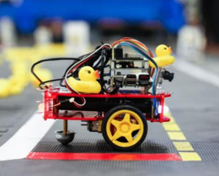
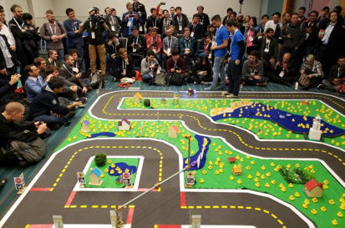
Team AICU
1
What’s Duckietown?
Educational and Research framework:
Machine Learning technologies
Mobile robots, equipped with camera
Autonomous driving simulation environment
AI Driving Olimpics (AIDO)
Challenges (e.g.: LF,LFP,LFV)
Multiple solutions (e.g.: RL, ML, IL)
DuckieBot
DuckieTown

Slide 4
Let’s train agents!
But how do we do that?

Slide 5
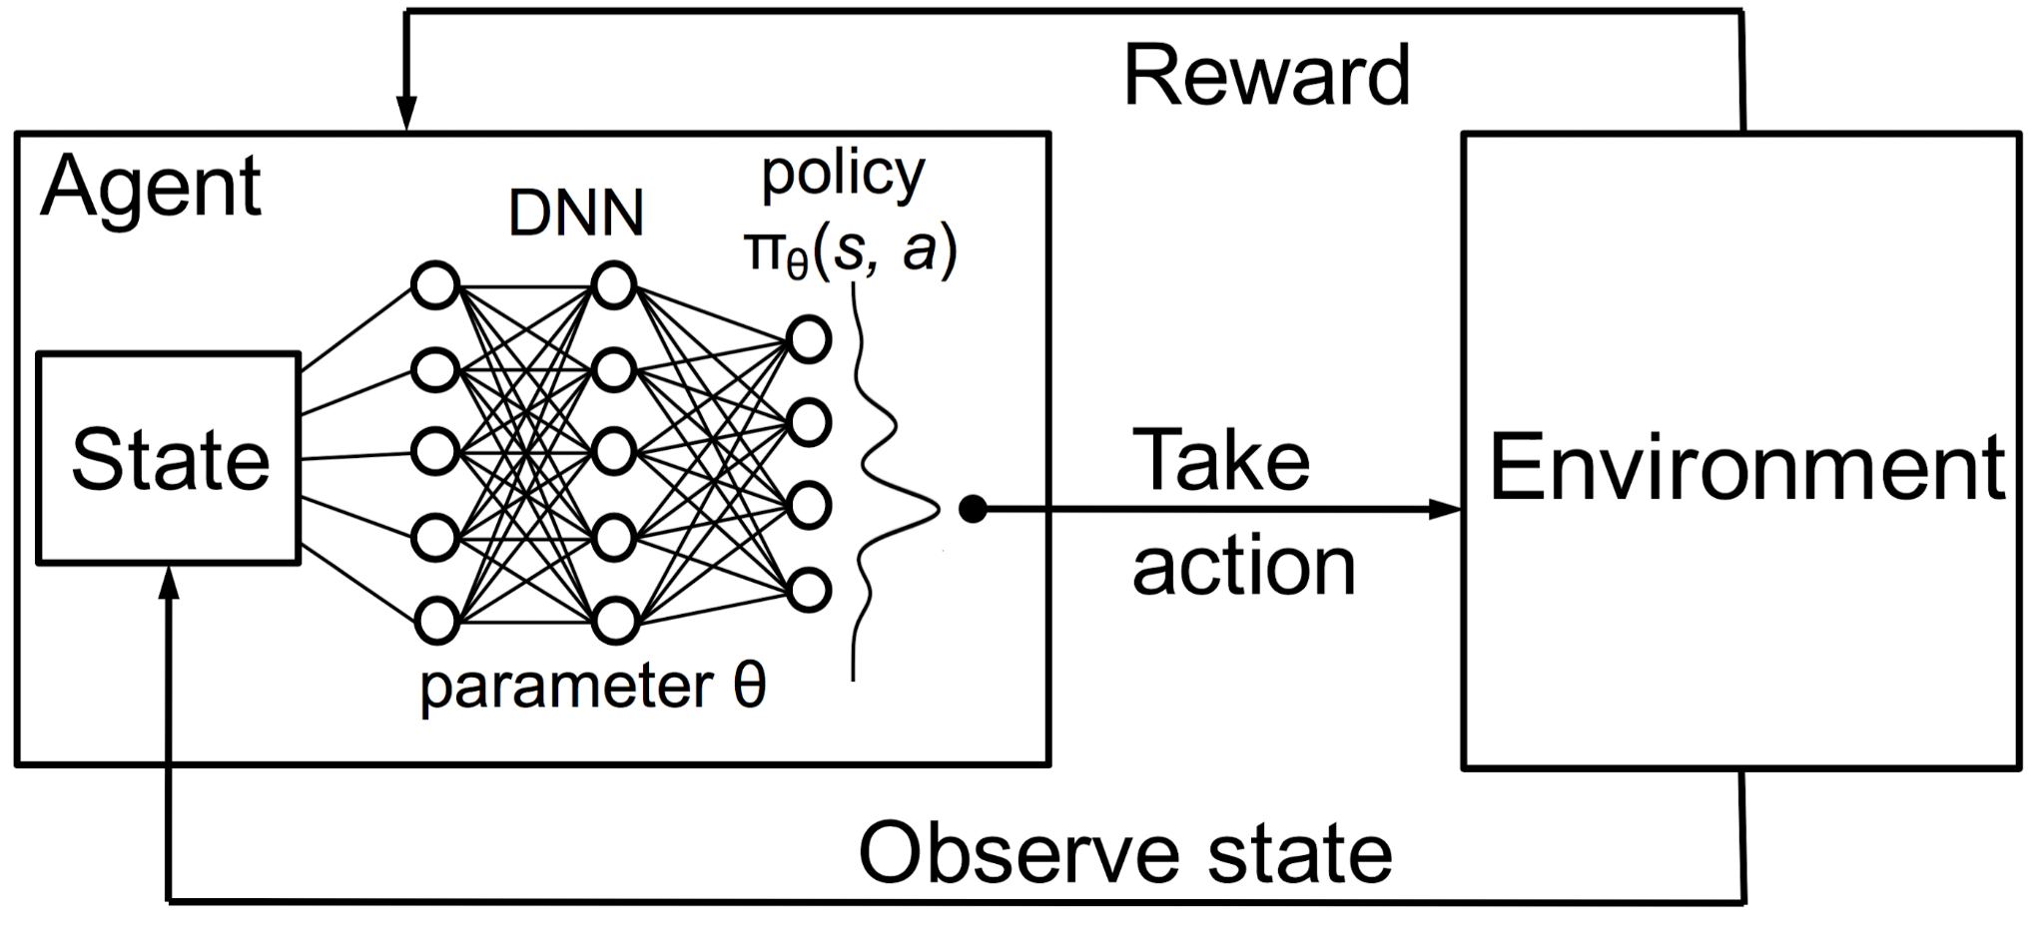
Reinforcement Learning
2
Field of Machine Learning
Agent State, Prediction, Action, Reward
Different algorithms (e.g.: PPO,A2C,DDPG,DQN)
Outperforming professionals (Dota2, Chess)

Slide 6
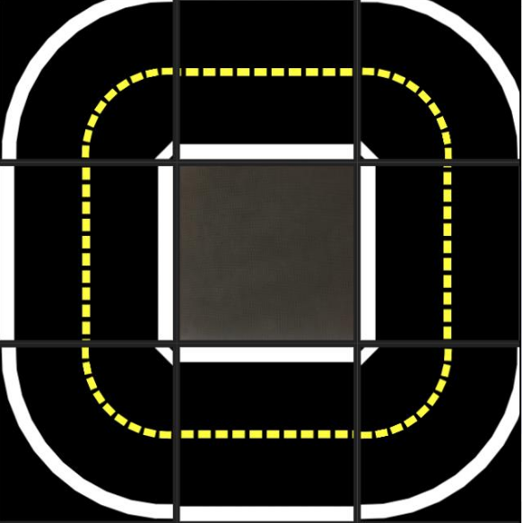
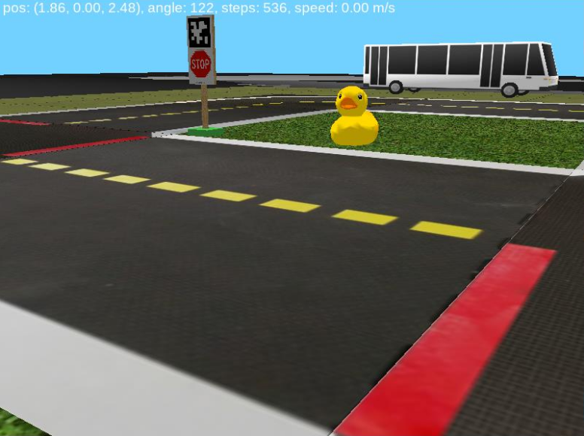
Simulation Environment
3
Structure
OpenAI GYM
Toolkit for RL algorithms
Develop, compare
Open Source interfaces
Duckitown GYM
Python/OpenGL (Pyglet)
Different maps (e.g.:Straight road, small loop, urban environment)
Reward system for TL policies:
Invalid position
Opposing lane
Driving smoothness
Duckietown blocks
Customazible
Road, pedestrian, traffic elements
Multimap

Slide 7
Limitations and Solutions
4
Hardware limitations:
Lack of RAM
Crashes during optimization, lost progress
RL is one of the most computationally expensive ML area
Software limitations:
Huge number of episodes are needed (Huge time consumption)
Solutions:
RAM problem ☞ Garbage collector
Performance, RAM problems ☞ Pruner
Lost progress ☞ Save loop
Handling NaN values ☞ Catch block

Slide 8
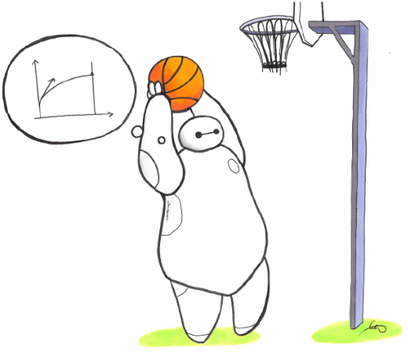



5
Frameworks, Algorithms
Frameworks:
Baseline solution by duckietown,
Tensorforce,
Stable Baselines3
Optimization:
RL Zoo
Optuna
Used hardware:
Provided by Google Collaboratory
Algorithms:
PPO,
A2C,
DDPG

Slide 9
5
PPO
A2C
PPO (Proximal Policy Optimization)
OpenAI
Policy gradient, on-policy
Multi steps of (usually minibatch) SGD to maximize the objective values
A2C (Advantage Actor Critic)
Policy Gradient, on-policy
Learning the value function for one policy while following it
Actor critic

Slide 10
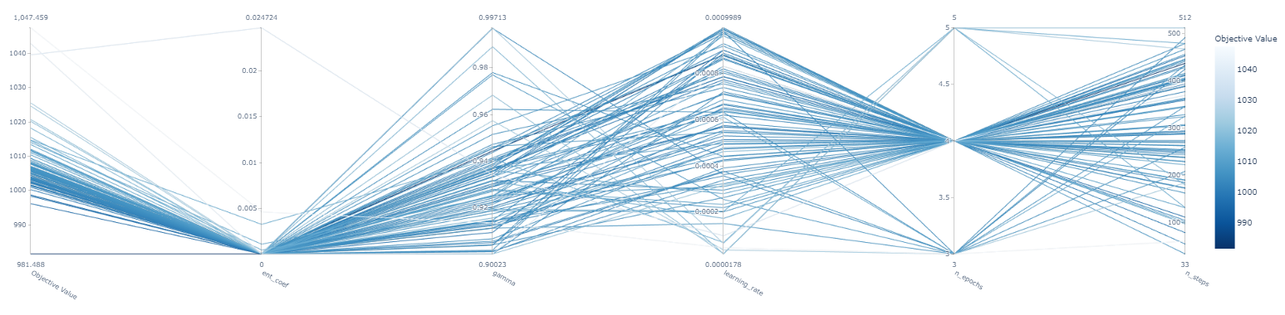

Hyperparameter tuning
6
Parameter whose value controls the learning process
Tree-structured Parzen Estimator
Percentile pruner

Slide 11
Team AICU
December 15, 2020
1
Image preprocessing (Color Segmentation, Normalization for the CNN, Resizing)
What’s Next?
Training on better hardware environment
2
Testing the model in the real DuckieTown on DuckieBot
3

Slide 12
Team AICU
December 15, 2020
Thank you for your Attention!
Keep deep learning!

