Slide 1
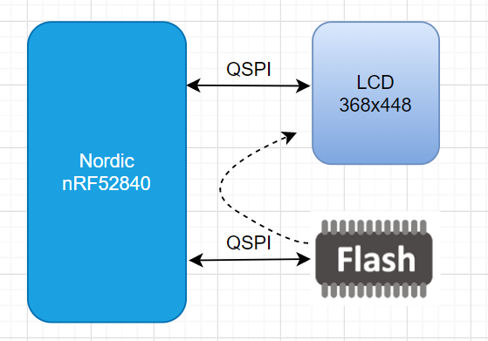
QSPI LCD Display Demo
Key Features
nRF52840 支持32Mhz QSPI，HSPI，64MHz 主频
nRF52840支持内部1MB flash 和 256kB RAM和外部QSPI flash扩展功能
LCD display Demo 的主要特性：
支持最大LCD分辩率是 368x448x16bit, RGB565格式
从nRF52840内部flash读整张图片显示到LCD的总时间是31ms, 即每秒约32帧左右
从QSPI flash 里读整幅图片再切换QSPI引脚显示到LCD上的总时间大约是49ms, 即每秒大约20帧左右
支持Little VGL GUI
Overview
LCD 和 flash 共用QSPI接口，通过分时复用的方式将flash
中UI数据传输到LCD显示出来
LCD和Flash可以共用QSPI Pin，也可以分开映射到两组GPIO上，QSPI引脚需要用高速GPIO口
Target Application
中，高端智能穿戴设备

Slide 2
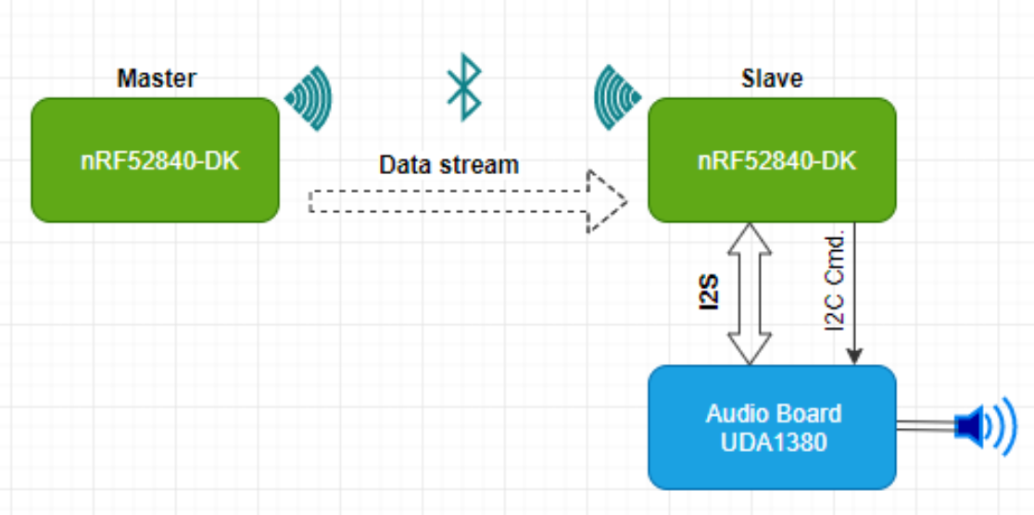
BLE Audio Player Demo
nRF52840 Key Features
• ARM® Cortex®-M4 32-bit processor with FPU, 64 MHz
1 MB flash and 256 kB RAM
Supported BLE5.0 :2 Mbps, 1 Mbps, 500 kbps, and 125 kbps
• IEEE 802.15.4-2006: 250 kbps
• Proprietary 2.4 GHz: 2 Mbps, 1 Mbps
Supported audio peripherals: I2S, PDM
USB 2.0 full speed (12 Mbps) controller
QSPI 32 MHz interface
High-speed 32 MHz SPI
EasyDMA automated data transfer between memory and
peripherals
Overview
This demo mainly realizes audio or voice playback between two nRF52840-DK boards by transferring ADPCM data streams over BLE5.0 protocol..
The audio sampling rate is 16kHz, audio data is 16bit.
Target Application
Voice remote control
Voice recorder

Slide 3
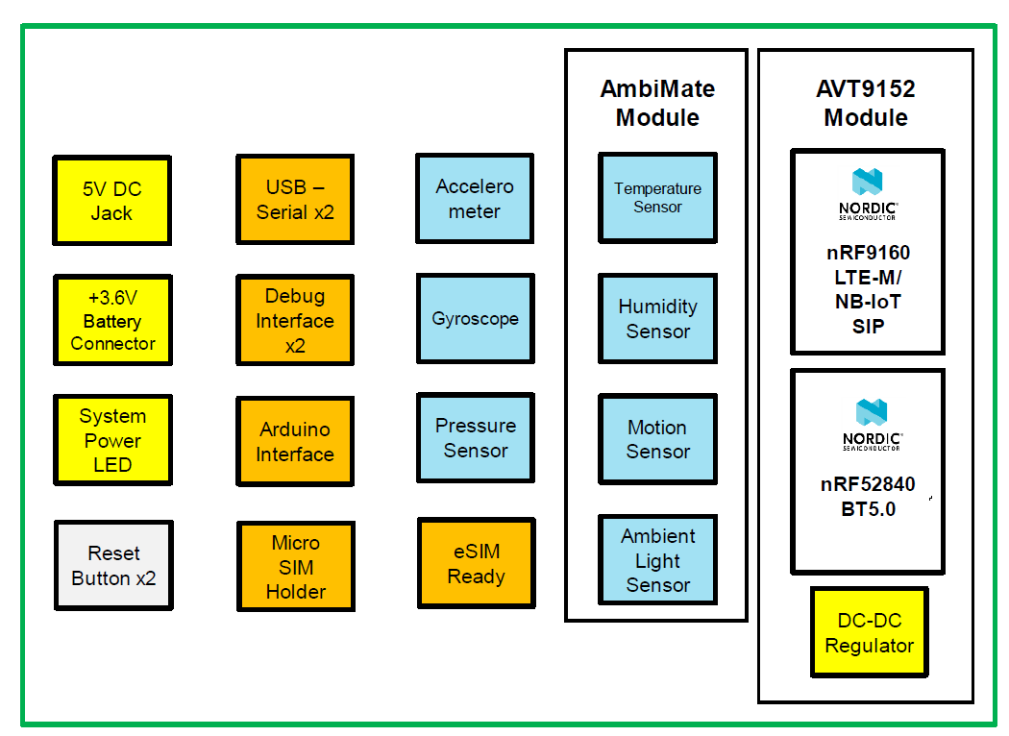
AVT9152 Evaluation Kit
Features
nRF91 with LTE-M/NB-IoT global carrier certification and nRF52 BT5.0
Power save mode, PSM and eDRX
ARM® TrustZone® security isolation
OTA support on both nRF91 and nRF52
Arduino interface for scalability
Onboard sensors - temperature, relative humidity, pressure, accelerometer, gyroscope, ambient light and motion Low power design
eUICC SIM card with free subscription plan for out of box network connection
SDK connecting to free Avnet IoT Connect platform for evaluation
Production ready with FCC, CE, RCM and BQB certified
Target Application
Overview
Tracking device – people, pet, assets
Vending machine
POS terminal
Smart building automation
Medical devices
Beacon based application - contact tracing
AES-CELLIOT-AVT9152KIT is a handy kit that supports both evaluation and development with AVT9152 module. This sensor rich kit comes complete with SDK, eUICC SIM card with free subscription plan and Avnet’s always ready backend IoT Connect cloud platform with dashboard offers unprecedented end-to-end IoT out of box connection experience over LTE-M/NB-IoT network.

