Slide 1

Capstone1 – Java Ledger App
Simple CLI ledger for deposits, payments, and reports

Slide 2

Overview
Command-line ledger to record deposits/payments and view reports
Language: Java (Maven project)
Main class: com.pluralsight.LedgerApp
Persists data in transaction.csv (pipe-delimited)
Menus: Home, Ledger, Reports

Slide 3
Menus
Home: Add Deposit · Make Payment · Ledger · Exit
Ledger: All · Deposits · Payments · Reports · Back
Reports: MTD · Previous Month · YTD · Previous Year · Search by Vendor

Slide 4
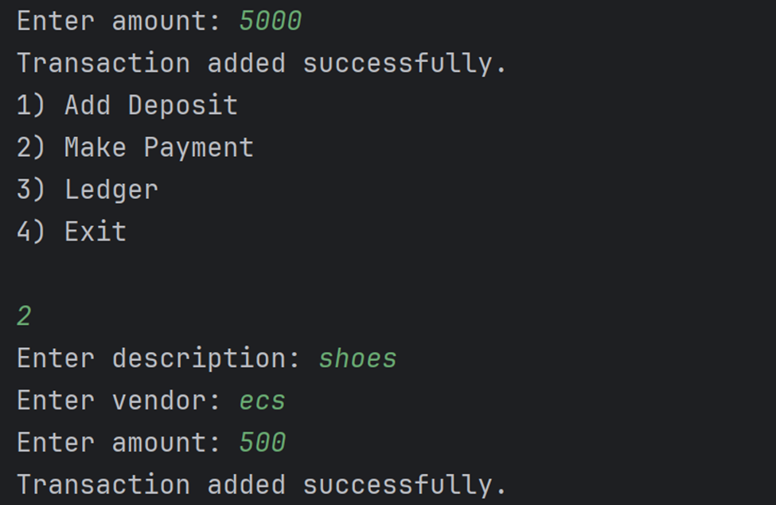
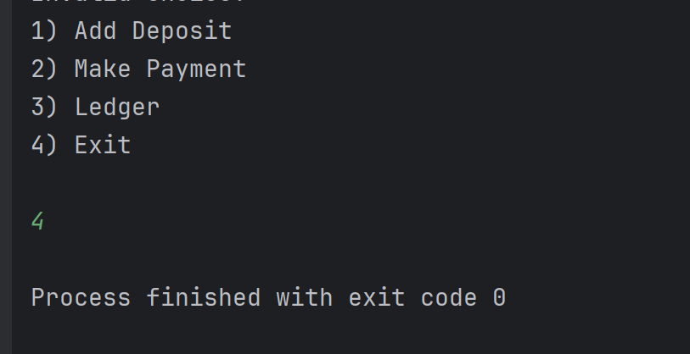
Project Screen Shots

Slide 5
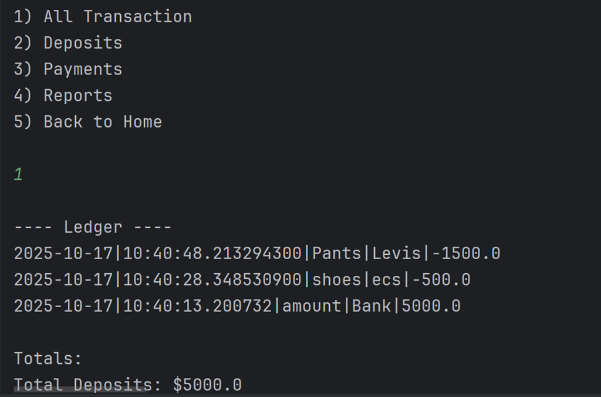
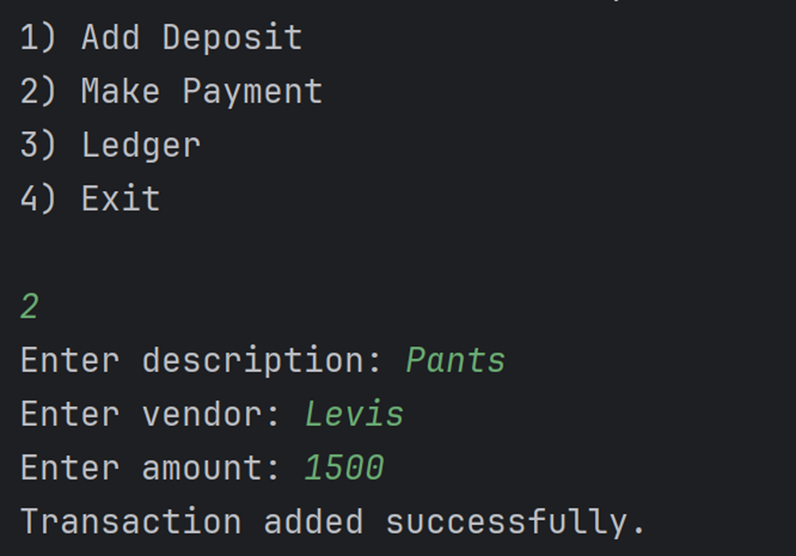

Slide 6
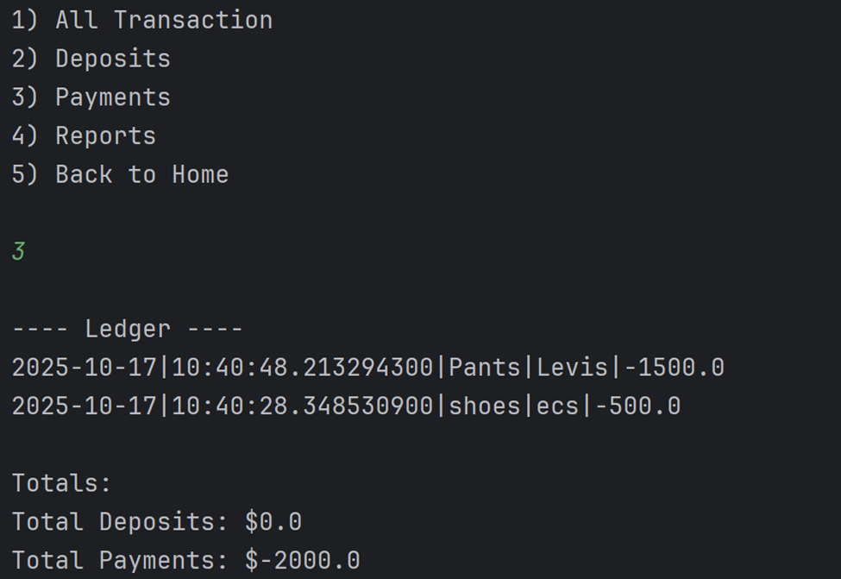
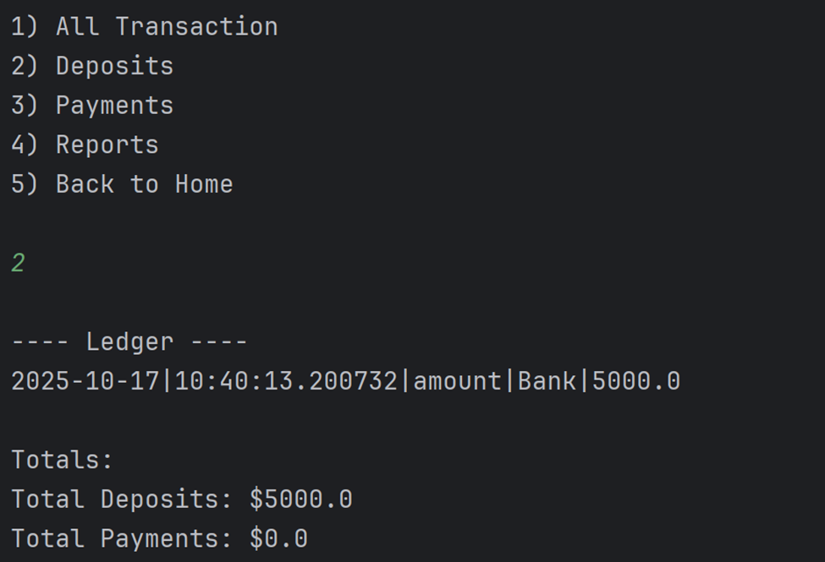

Slide 7
Techniques · Issues · Learnings
Summary
Techniques: Scanner I/O, LocalDate/LocalTime, file append/save, vendor filter
Issues: numeric parsing, file path/writes, menu navigation
Learned: Java file I/O, simple reporting, CLI UX, Git commits

Slide 8

Thank You

