Slide 1
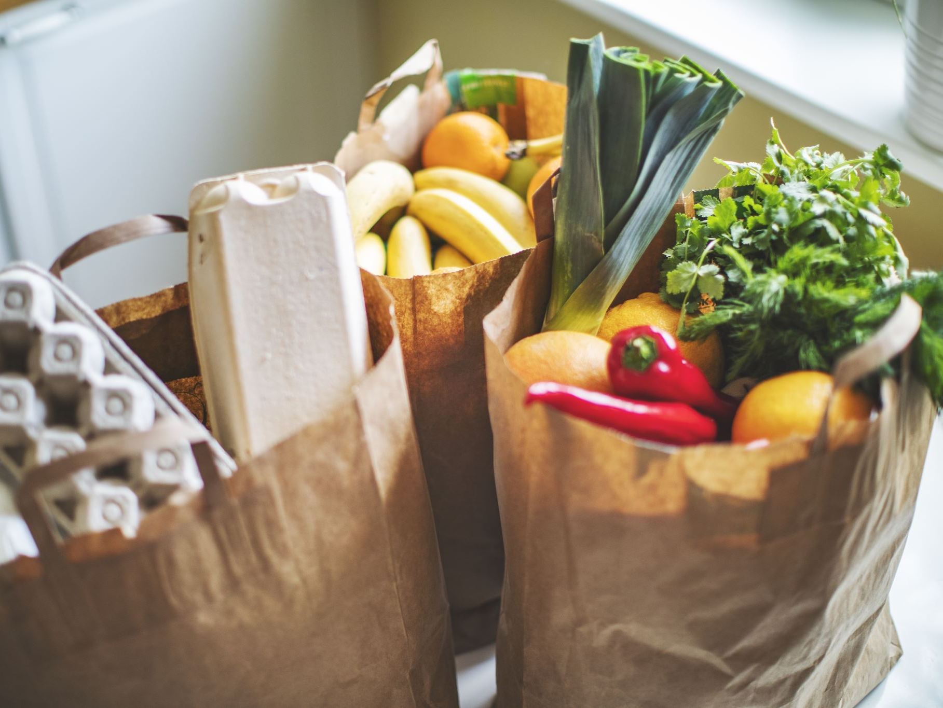
Grocery Store Web Application
Presented By: Najib

Slide 2
Objective
Develop a full-stack e-commerce grocery application.
Implement secure authentication, product browsing, cart management, and checkout.
Validate APIs using Insomnia test collections (Required + Optional).

Slide 3
Why Grocery Store Domain
A grocery store represents a realistic e-commerce use case.
It requires categories, product search/filtering, user accounts, and cart/checkout flows.
It is suitable for demonstrating full-stack and API design skills.

Slide 4
System Architecture
Frontend: HTML/CSS/JavaScript web client
Backend: Spring Boot REST API (Java)
Database: MySQL (groceryapp)
Security: JWT authentication with role-based authorization

Slide 5
Requirements vs Implementation (Summary)
Required:
Category endpoints implemented (CRUD + list products by category)
Product search bug fixes (category, min/max price, subcategory)
Optional Implemented:
- Shopping cart endpoints
- User profile endpoints
- Checkout / order creation endpoint

Slide 6
API Testing (Insomnia)
Imported the provided Insomnia collections.
Executed test suites for required and optional endpoints.
Result: All tests passed successfully (23/23 total across collections).

Slide 7
Key Challenges
JWT authentication and authorization configuration.
Correct HTTP status codes for create/delete endpoints (201/204).
Ensuring consistent test execution order and database state during testing.

Slide 8
Learning Outcomes
REST API design and implementation using Spring Boot.
Secure authentication using JWT.
MySQL database integration and DAO pattern usage.
System validation through automated API tests in Insomnia.

Slide 9
Conclusion
The application meets capstone requirements.
Backend APIs and frontend integration work correctly.
All provided Insomnia tests pass successfully.

Slide 10
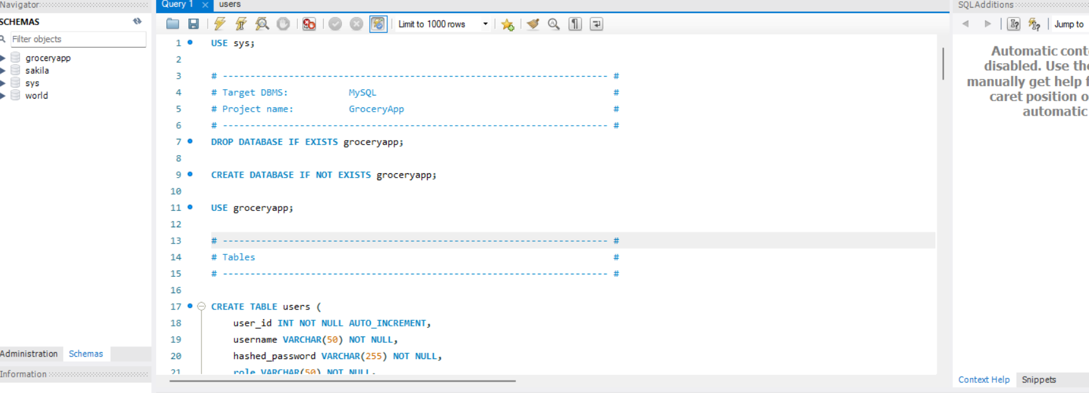
Figure 1: Grocery Database Creation Script (MySQL Workbench)

Slide 11
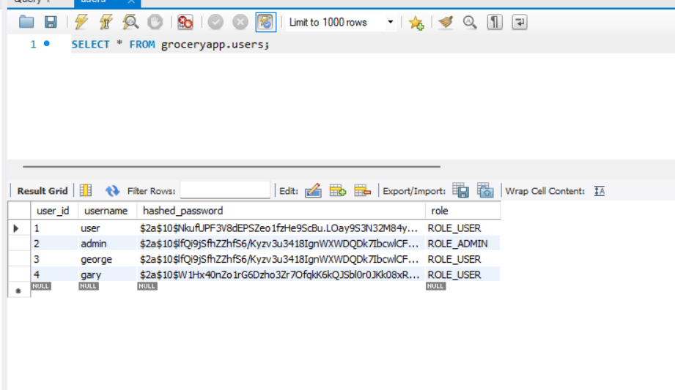
Figure 2: Users Table Showing Registered Users and Roles

Slide 12
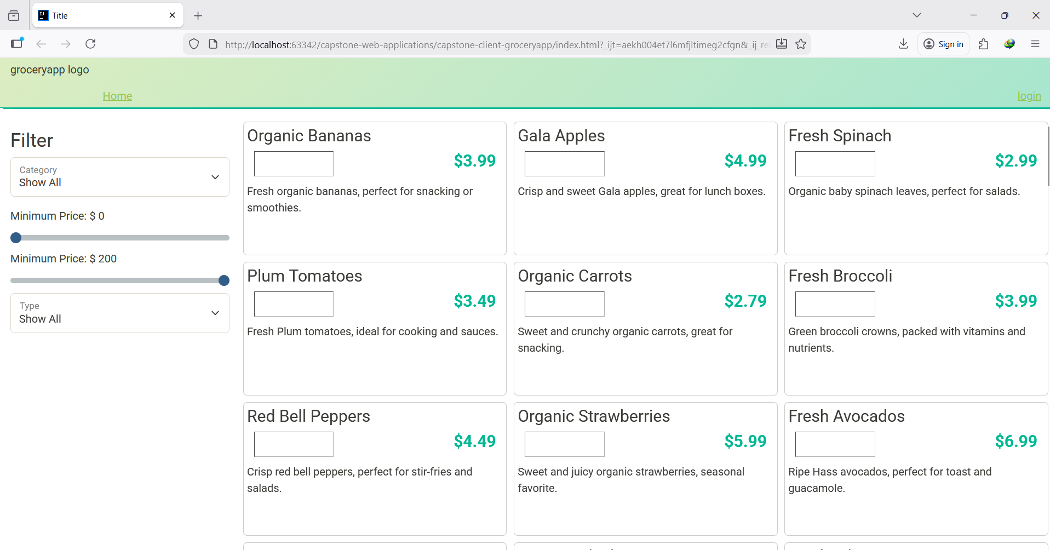
Figure 3: Website Home Page Showing Products Loaded from Backend

Slide 13
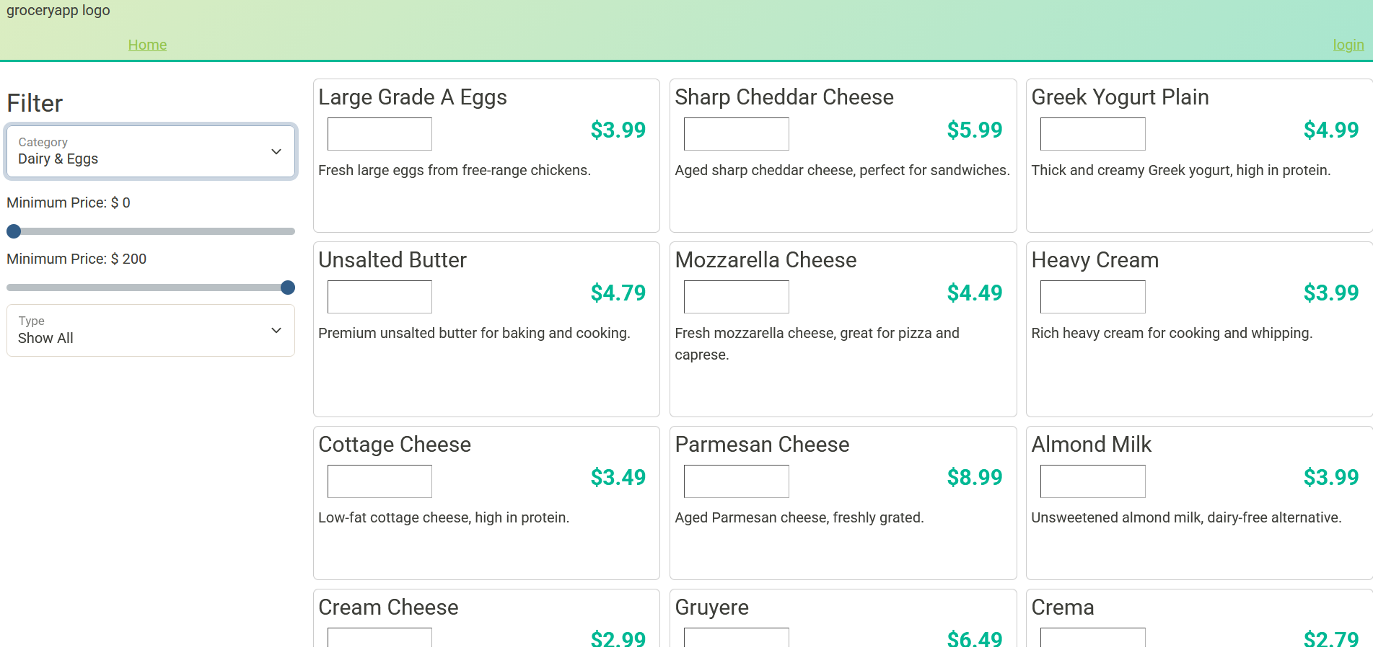
Figure 4: Website Filters Working (Category and Price Filters)

Slide 14
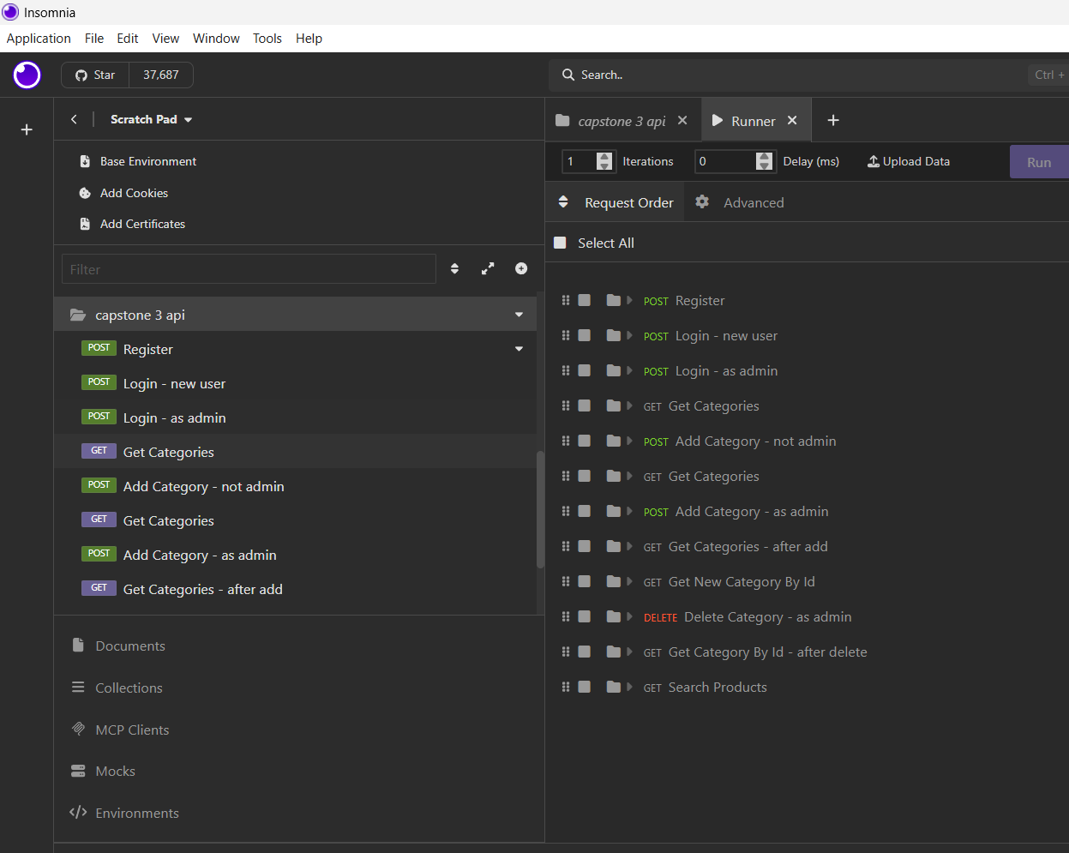
Figure 5: Insomnia Register Request and Response (Example Run)

Slide 15
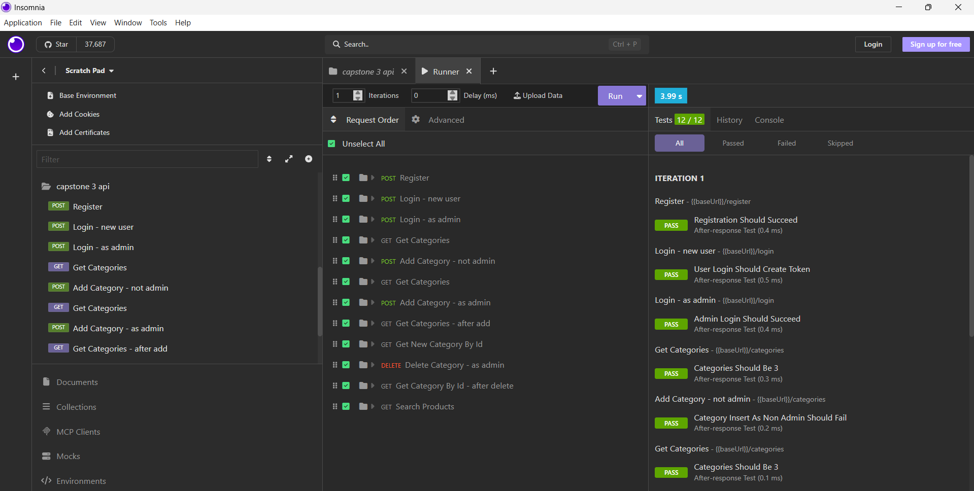
Figure 6: Insomnia Required API Test Suite Results (All Passed)

Slide 16
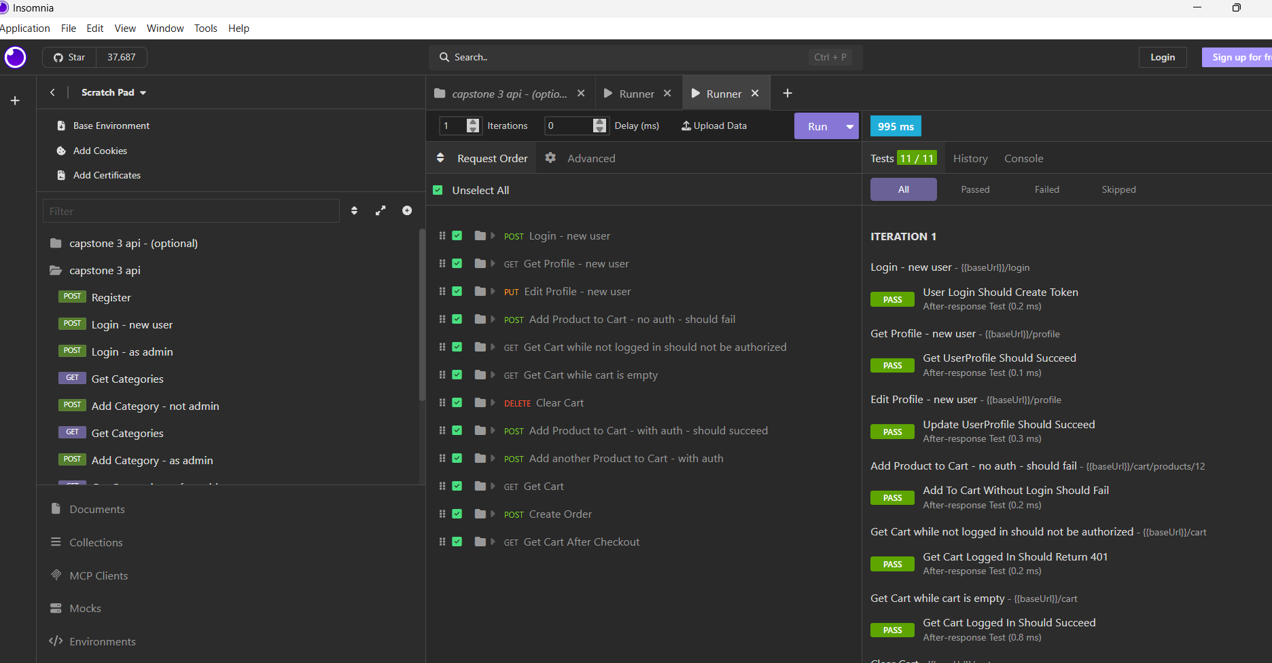
Figure 7: Insomnia Optional API Test Suite Results (All Passed)

Slide 17

Thank you

