Slide 1
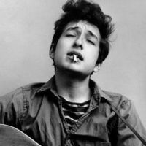
Bob dylan

Slide 2
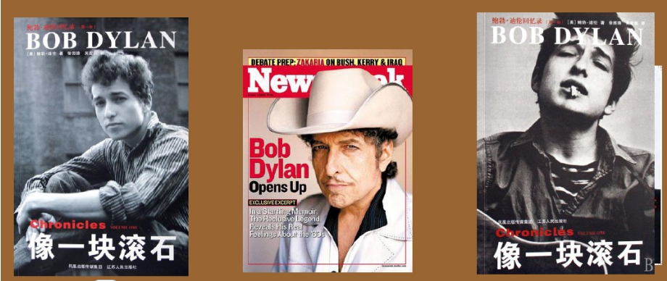

Slide 3
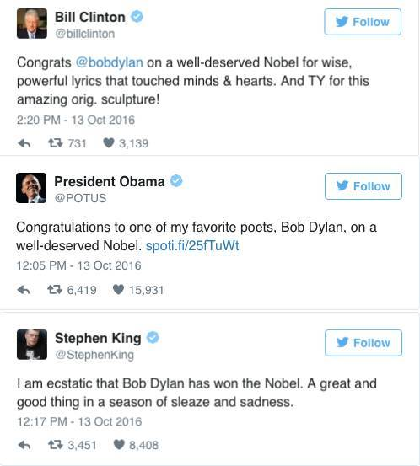

Slide 4
baby boomers

Slide 5
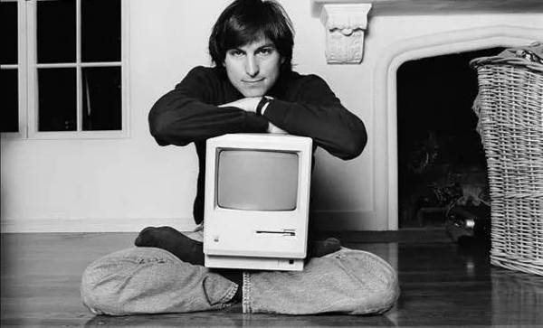

Slide 6
No one is free, even the birds are chained to the sky.
How many times must a man look up Before he can see the sky
I was so much older then，I'm younger than that now.
Some people feel the rain. Others just get wet.
The answer, my friend, is blowin' in the wind.

Slide 7
You lie and deceive
You want me to believe A world war can be won
But I see through your eyes And I see through your brain
Like I see through the water That runs down my drain

Slide 8
Mama take this badge off me I can't use it anymore it's getting dark too dark to see Feels like I'm knockin' on haeven's door knock-knock-knockin' heaven's door Mama put my guns in the ground I can't shoot them anymore That cold balck cloud is comin's down I Feel like I'm knockin' on haeven's door ...
——Bob Dylan 《Knocking on Heaven's Door》

Slide 9
http://wx.paigu.com/a/16690/21514547.html

Slide 10
1.“所有伟大的表演家都拥有一双饱含深意的明眸。就是从那里，我看到了你看不懂的东西。我就想成为这样的演奏者。” -- “All the great performers had something in their eyes. It was that 'I know something that you don't know.' And I wanted to be that kind of performer.” 2.“60年代的故事，就像飞碟登陆一样。每个人都听说过，但很少有人亲眼见过。”--"The 60s was like a UFO landing. A lot of people heard about it, but very few actually saw it." 3.“英雄是懂得责任与自由同在的人。”--"I think of a hero as someone who understands the degree of responsibility that comes with his freedom." 4.“我能做的一切就是做我自己，你管我是谁。”--”All i can do is be myself, whoever that is" 5.“这世间所谓的真相都在累积一个巨大的谎言。”--"All the truth in the world add up to one big lie" 6.“实际上，你要抑制自己的野心，这样你才能成为你应该成为的人。”--“Basically you have to suppress your own ambitions in order to be who you need to be.” 7.“被关注是一个负担。耶稣把自己钉在十字架上是因为他发现自己被关注了，所以我经常失踪。”--“Being noticed can be a burden. Jesus got himself crucified because he got himself noticed. So I disappear a lot.” 8.“大学就像养老院，而且事实上，更多人死在了大学里。”--“Colleges are like old-age homes, except for the fact that more people die in colleges. “ 9.“民主没有统治世界，你最好把它藏在脑袋里。这个世界被暴力主宰，但我觉得你最好别多这个嘴。”--“Democracy don't rule the world, You'd better get that in your head; This world is ruled by violence, But I guess that's better left unsaid." 10.“不管你有多少钱，世上只有两种人：一种是还幸存的，一种是已迷失的。”--“Don't matter how much money you got, there's only two kinds of people: there's saved people and there's lost people. “

Slide 11
11.“他不是在忙着出生，而是在忙着去死。”--"He not busy being born is busy dying." 12.“我接受混沌的世界，但我不晓得它是否接受我。”--"I accept chaos, I'm not sure whether it accepts me." 13.“我觉得自己先是一个诗人，然后才是个音乐家。我活着像个诗人，死后也还是个诗人。”--"I consider myself a poet first and a musician second. I live like a poet and I'll die like a poet." 14.“我不定义任何东西，不管是美，还是爱国。每件事在我眼里该是什么就是什么，没有什么优先规则使之应该成为什么。”--"I define nothing. Not beauty, not patriotism. I take each thing as it is, without prior rules about what it should be." 15.“我不觉得人类的大脑足以理解过去和未来，这二者不过就是幻象而已，驱使你去相信一切有所改变。”--“I don't think the human mind can comprehend the past and the future. They are both just illusions that can manipulate you into thinking theres some kind of change.” 16.“我觉得诗人是不会称自己为诗人的人。”--”I think a poet is anybody who wouldn't call himself a poet. “ 17.“我从不写政治歌曲，歌曲拯救不了世界，我已经看透了一切。”--”I've never written a political song. Songs can't save the world. I've gone through all that.” 18.“如果我不是鲍勃·迪伦，我可能会认为这个名字有许多种答案。”--"If I wasn't Bob Dylan, I'd probably think that Bob Dylan has a lot of answers myself." 19.“就因为你喜欢我的东西，不代表我就欠你什么东西。”--”Just because you like my stuff doesn't mean I owe you anything.” 20.“没有人是自由的，甚至连鸟儿都被天空束缚。”--”No one is free, even the birds are chained to the sky.”

