Slide 1
Hot pot eaten worldwide

Slide 2
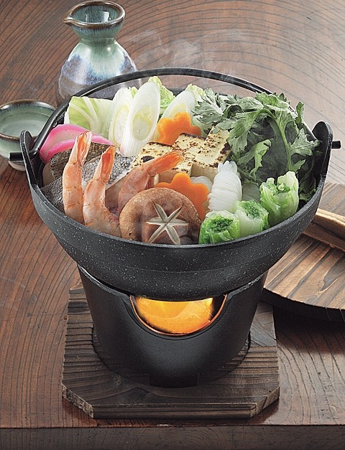
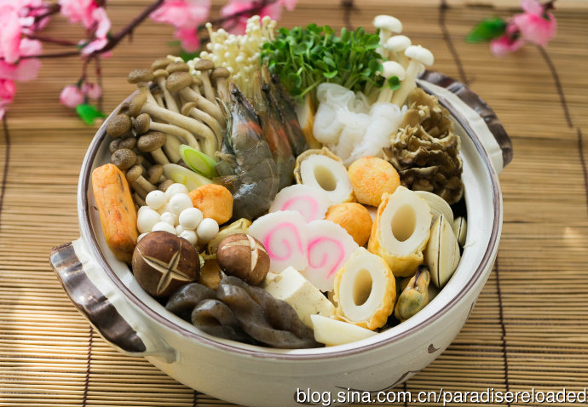
Yosenabe： putting ingredients together in a cooking pot

Slide 3
Ingredients & spices
Miso Porridge
Rice Jellyfish
Eggs Fish ball
Vegetables Prawn
Soy sauce

Slide 4
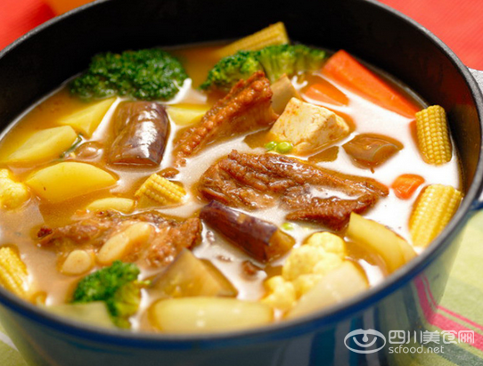
Curry hot pot

Slide 5
Ingredients & spices
Soup Rice noodles
Soup Chicken
Stew Fish head
Curry Coconut cream
Vinegar

Slide 6
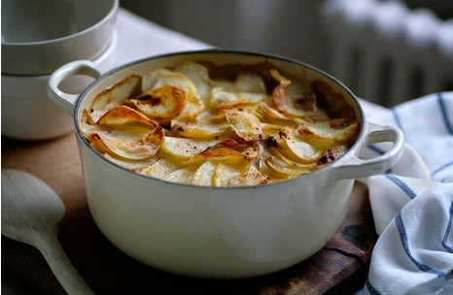
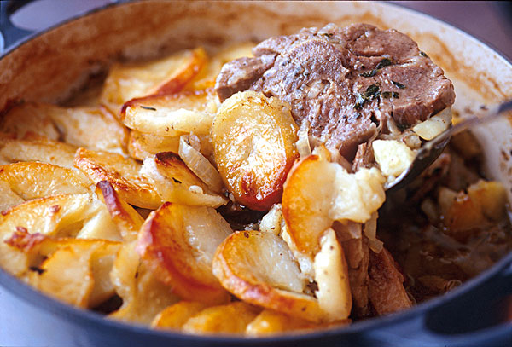
Lancashire hotpot

Slide 7
Ingredients & spices
Slow-cooked stew lamb
Onion salt
Pepper cheese
Sliced potatoes

Slide 8
About cooking
Stir dice
Steam tablespoon
Boil ounce
Fry roast
Rinse grind (ground)
Thaw cornstarch
Shell seasonings

Slide 9
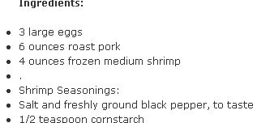
Yangchow Fried Rice

Slide 10
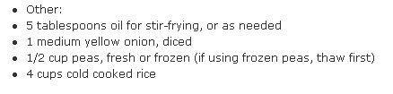
Yangchow Fried Rice

