Slide 1
Legacy that will live on

Slide 2
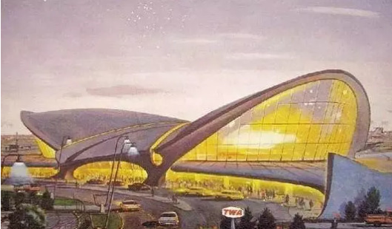
The JFK Presidential Library in Boston, US

Slide 3
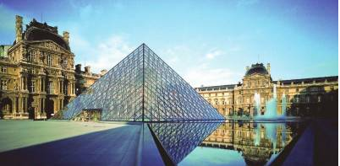
The Louvre Pyramid in Paris

Slide 4
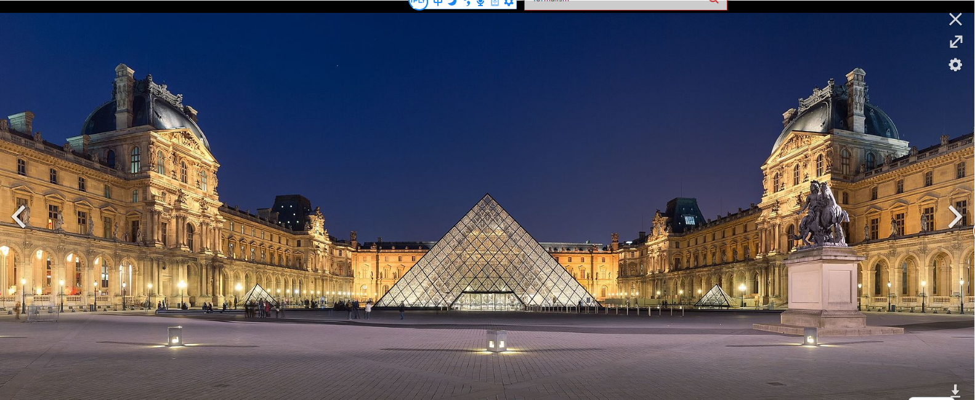

Slide 5
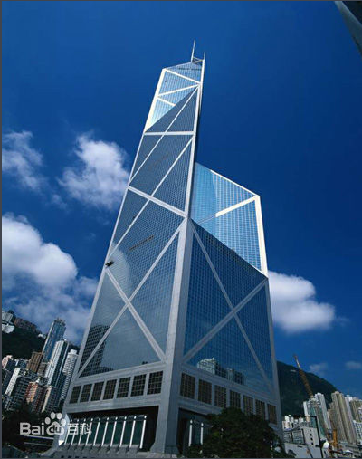
The Bank of China Tower in HK

Slide 6
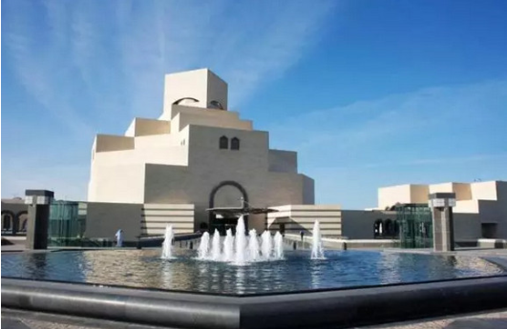
the museum of Islamic Art in Doha, Qatar

Slide 7
I.M. Pei, Architect of Glass Geometries
"I believe that architecture is a pragmatic art. To become art it must be built on a foundation of necessity."
— I.M. Pei, from his acceptance speech for the 1983 Pritzker Architecture Award.

Slide 8
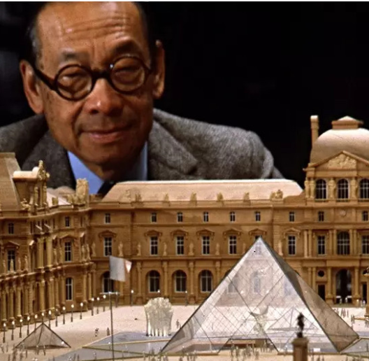
“A living legend ” Ieoh Ming Pei--- The architectural Digest

Slide 9
IMPORTANT BUILDINGS:
1956: Mile High Center, Denver, Colorado
1967: National Center for Atmospheric Research, Boulder, Colorado
1968: Everson Museum of Art, Syracuse, New York
1970: Terminal 6, JFK International Airport, New York City (demolished in 2011)
1973: The Herbert F. Johnson Museum of Art at Cornell University, Ithaca, NY
1976: Oversea-Chinese Banking Corporation Centre, Singapore
1977: Dallas City Hall, Texas
1978: National Gallery of Art, East Building, Washington, DC
1979: John Fitzgerald Kennedy Library, Boston, Massachusetts (extension in 1991)
1981: Museum of Fine Arts, West Wing and Renovation, Boston, Massachusetts
1982: Fragrant Hill Hotel, Beijing, China
1986: Raffles City, Singapore
1989: Bank of China Tower, Hong Kong
1989: Morton H. Meyerson Symphony Center, Dallas, Texas
1989: Phase I Louvre Pyramid (Phase II in 1993)
1993: Four Seasons Hotel, New York City
1995" Rock and Roll Hall of Fame and Museum, Cleveland, Ohio
1997: Miho Museum, in Shiga, Japan
2006: Musée d'Art Moderne, Kirchberg, Luxembourg
2006: Suzhou Museum, Suzhou, China
2008: Museum of Islamic Art, Doha, Qatar

Slide 10
About I.M. Pei’s personal life
Pei's wife of over seventy years, Eileen Loo, predeceased him in June 2014.
They had three sons and a daughter.
T'ing Chung was an urban planner and alumnus of his father's alma mater MIT and Harvard.
Chieng Chung and Li Chung, who are both Harvard Graduate School of Design alumni, founded and run Pei Partnership Architects. Liane is a lawyer. He celebrated his 100th birthday on April 26, 2017.

Slide 11
http://cul.sohu.com/20170426/n490826075.shtml
100 pictures to cover Pei’s life

Slide 12
http://www.en8848.com.cn/tingli/meiwen/mingrenstory/245215.html
Listen to the tape and fill out the blanks

Slide 13
1. Among these largest ________ articles in the world, many originated from the same architect Ieoh Ming Pei.
2. He came to the United States in _____ to study architecture at the Massachusetts Institute of Technology (B. Arch. 1940) and the __________ Graduate School of Design (M. Arch. 1946).
3. During World War II, he served on the National Defense Research Commission at Princeton, and from ___ to ___, taught at Harvard.
4. He is a Fellow of the American Institute of Architects, a member of the Royal Institute of British Architects, and an _____ _____of the American Academy of Arts and Letters

