Slide 1
New kind of advertising

Slide 2



Slide 3
1. Define it--- Influencer marketing
Influencer marketingis a form of marketing in which focus is placed on specific key individuals rather than the target market as a whole.
It identifies the individuals that have influence over potential buyers.

Slide 4


Slide 5
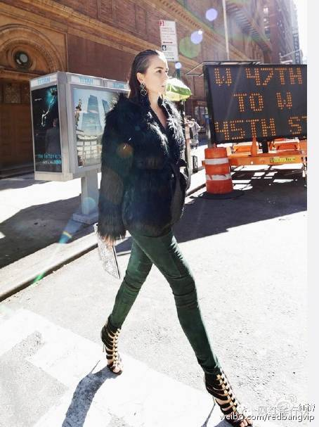


Slide 6
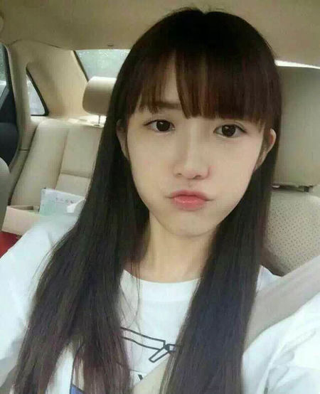
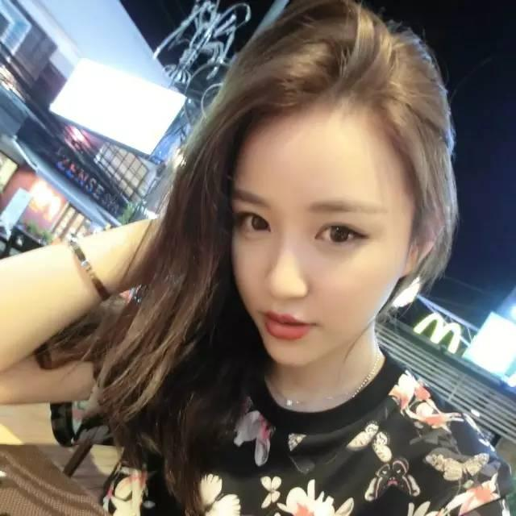


Slide 7

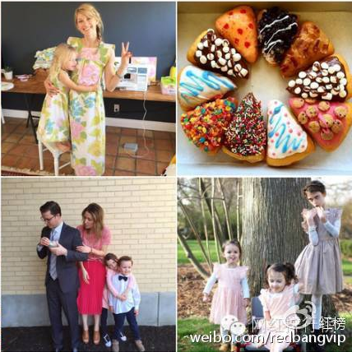

Slide 8
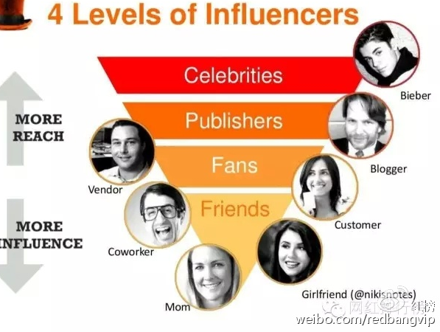

Slide 9

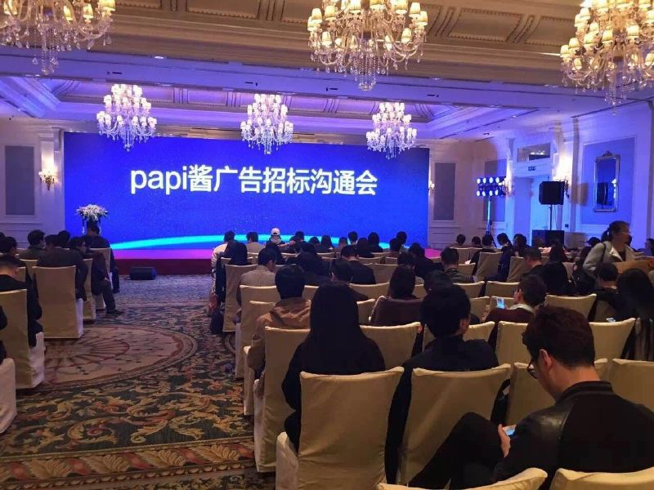

Slide 10
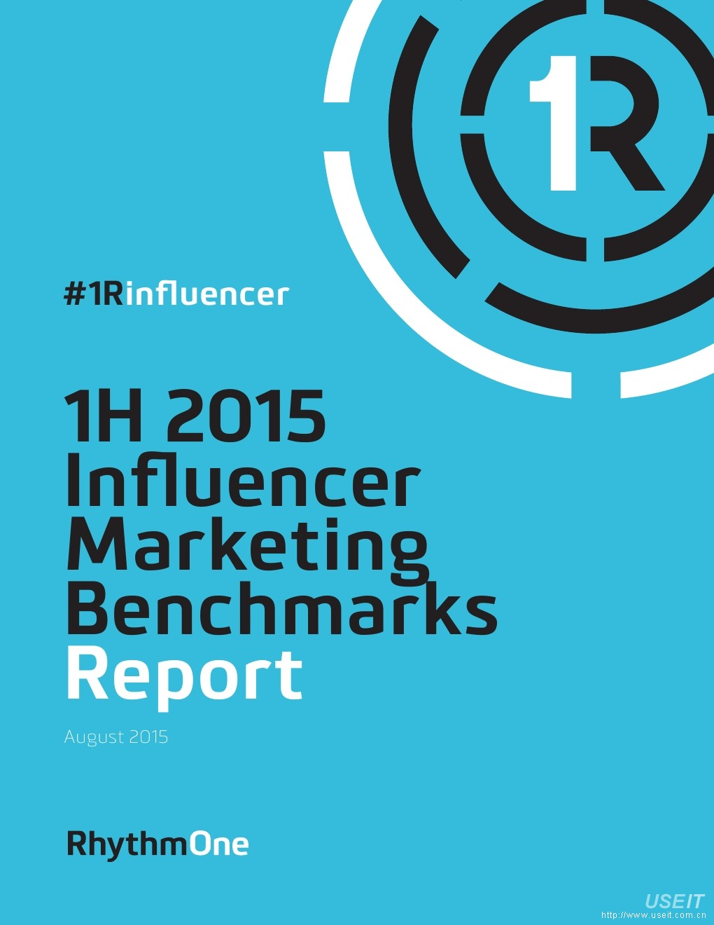


Slide 11
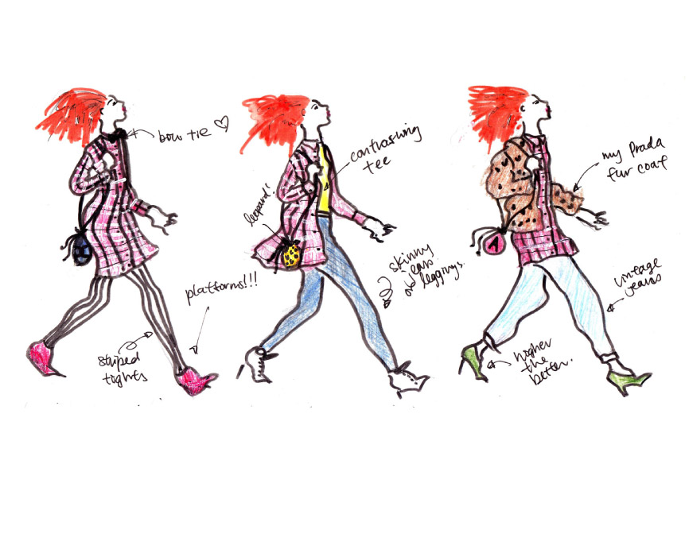

Slide 12
