Slide 1
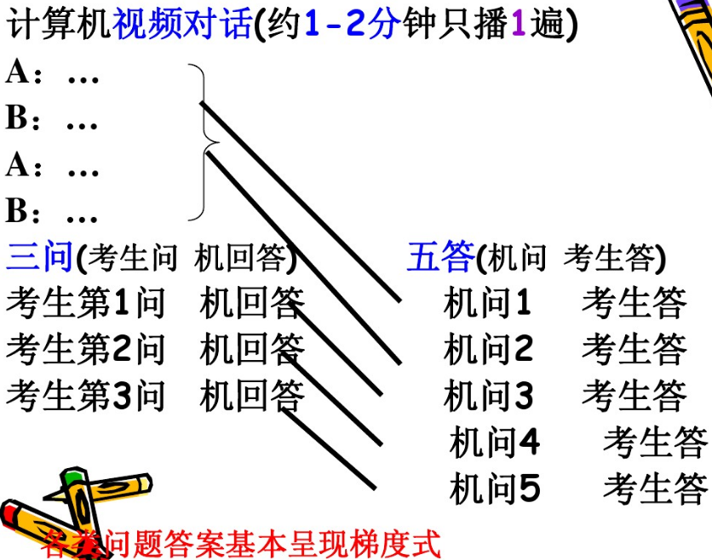

Slide 2
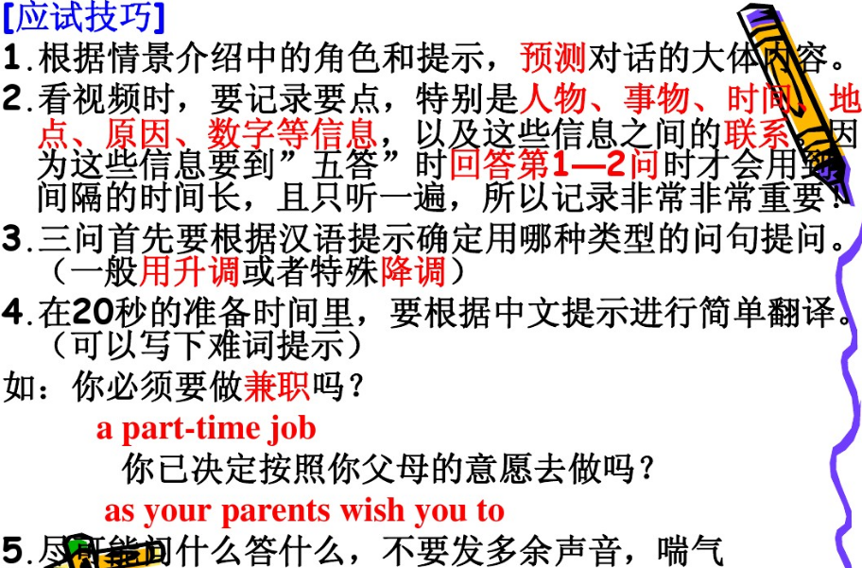

Slide 3
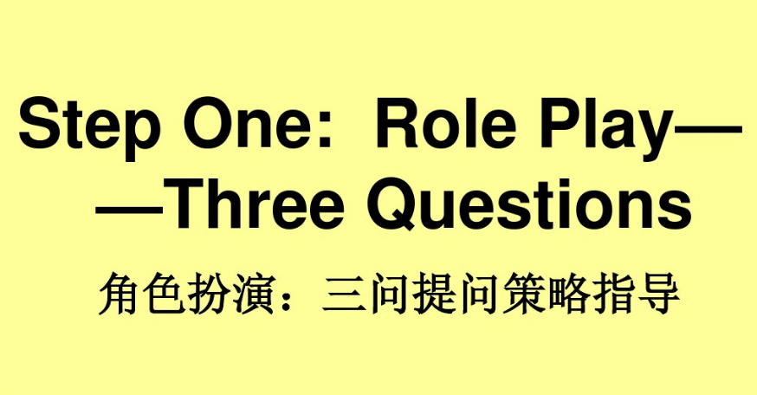

Slide 4
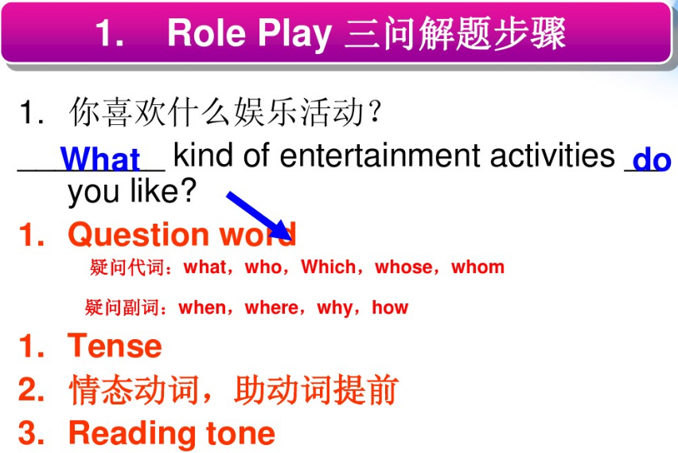

Slide 5
1．有多少人参加了上周日举行的马拉松赛？
How many people took part in/ participated in Marathon(which was)held last Sunday?

Slide 6
你们通常如何处理顾客投诉？
How do you usually deal with the customers' complaints?/
What do you usually do with the customers' complaints?

Slide 7
在市中心租一间公寓要多少钱？
How much does it cost to rent an apartment/a flat in the downtown area?
How much is the rent for an apartment in the downtown area?

Slide 8
你想用哪种方式支付书款，现金还是信用卡？
How would you like to pay for the books, in cash or by credit card?

Slide 9
是什么让你下决心戒烟的？
What has made you determined to give up smoking/quit smoking/stop smoking?/
What is it that has made you determined to...?

Slide 10
我们上个月开始放假的时候是周几？
What day was it when we started the holiday last month?
What day was it when our holiday started last month?

Slide 11
要是明天有暴风雨该怎么办呢？
What if there is a storm tomorrow?
What shall we do if there is a storm tomorrow?

Slide 12
为什么史密斯夫人不能说服她的儿子写数学作业？
Why can't Mrs. Smith persuade her son into doing his math homework?
Why can't Mrs.Smith persuade her son to do his math homework?

Slide 13
为什么最近这么多人感冒？
Why have so many people been getting colds recently?
Why have so many people got colds these days?

Slide 14
他为什么没有参加6月份举行的世界杯？
Why didn't he participate in the World Cup (which was) held in June?

Slide 15
他们决定今年去哪里度假？
Where did they decide (have they decided) to spend their holiday this year?

Slide 16
这位老人想让他的儿子什么时候搬进—个新的公寓？
When does the old man want his son to move into a new apartment?

Slide 17
学生们被要求什么时候付款？
When are students required to pay?

Slide 18
你上次去东京的时候乘坐的是哪一个航班？
Which flight did you take when you went to Tokyo last time? Which flight did you take last time you went to Tokyo?

Slide 19
谁主要为代沟负责任，孩子还是他们的父母？
Who is mostly responsible for the generation gap, the children or their parents?

Slide 20
如果香烟的生产停止了，会影响国家经济吗？
If the production of cigarettes is stopped, will it affect the national economy?

Slide 21
你知道我们什么时候可以从学校图书馆借书吗？
Do you know when we can borrow books from the library in our school?

Slide 22
你尝试过了解绿色食品吗？
Have you ever tried to know more about green food?

Slide 23
费用里面已经包含机票以及就餐，是吗？
The air fare and meals are included in the cost, aren't they?

Slide 24
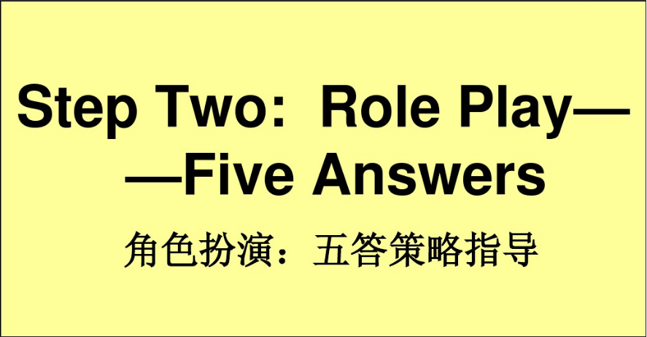

Slide 25
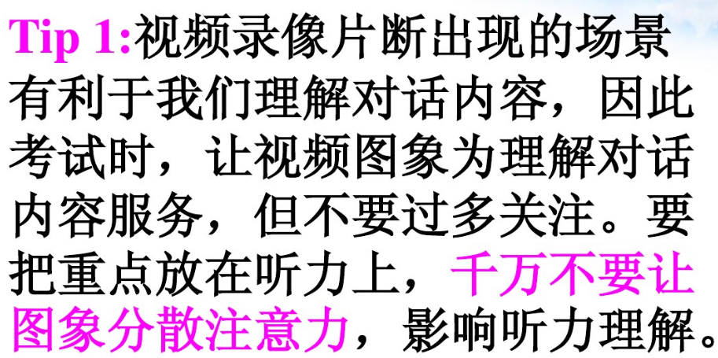

Slide 26
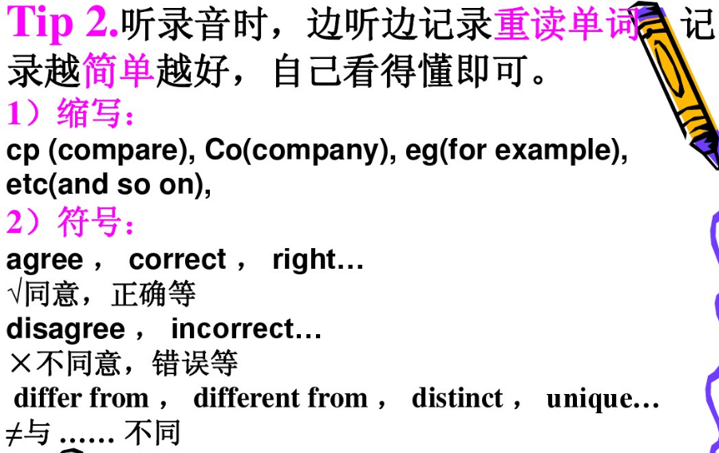

Slide 27
