Slide 1
The show being filmed, expected to hit TV in the fall 2017, will include 14 episodes starring real scientists and professional actors.
Feigley started the program to give teenager filmmakers interested in experiencing the industry a real platform.
Chris Hernandez, 16, shot behind the scenes photos in between takes that will be used as part of a documentary about the teen filmmaking experience.

Slide 2
The occasion never mattered--- weddings, birthdays, anniversaries, Groundhog Day， Arbor Day or no occasion.
Above all, it’s not how fast we live our lives or how much we accomplish that___19___. After all, if life is a race, the winners are not those who run fastest, ___20.___rather those who run well and it takes plenty of slow time to run well.(Page 32 Best English)
A. matters B. challenges C. improves D. decides
A. or B. so C. but D. and

Slide 3
A senior engineer in the automotive engineering department at Tsinghua University expressed doubt about the TEB’s efficiency, saying that such a huge vehicle will need to move slowly in case it needs to use its emergency.
Once she’d take wedding gifts to the gift wrap counter at the department store ,thinking/believing they could do a better job.
Once she sent out a note to family members who had not acknowledged gifts, stating that there were now on her “Decal Roster” and would not be removed until she had received a proper thank you

Slide 4
根据你班最近就科学家是否应该克隆人展开了辩论，用英语写一篇短文，说明这次辩论的情况并表明你的态度。 Sample:
Twenty percent of the students are in favor of cloning human being ,saying that it will be of great benefit to make a breakthrough in this field if scientists clone a human being. In addition, they claim if we clone those intelligent scientists, we will have many more great brains who can probably make outstanding contributions to mankind in the future. However, as many as eighty percent of those argue that it is not moral to clone a human being. In their opinion, a clone, without a father or mother, can not live as normal a life as we do. Personally, I agree with the idea of cloning a human being as long as we make use of it properly for it can save people diagnosed with cancer.

Slide 5
In terms of comparing achievements, sprinting and swimming are about as different as can be. It’s land vs water, endurance and technique vs concentrated speed.
When it comes to Usain Bolt , there may be no greater athletic fame than being world’s fastest human.
In Aug 15’s Olympic final, Bolt started, not slowly but clearly behind American challenger Justin Gatlin. By 60 meters in, the 1.95-meter Bolt was at top speed, and Gatlin may as well have turned to dust.

Slide 6
It can cut down on traffic greatly and therefore reduce the country’s increasingly worrying air pollution.
It is expected to save costs compared with other public transportation like the subway.
A senior engineer in the automotive engineering department at Tsinghua University expressed about the doubt the TEB’s efficiency, saying that such a huge vehicle will need to move slowly in case it needs to use its emergency.

Slide 7
WORD BANK (ISSUE 2)
Over the course of its history, Yellowstone has become one of the most famous nature reserves on
Earth, ________place that generations of travelers have visited.
Places we now explore, like the rainforests of the Amazon that hide cities and farms, were actually homes to civilization for hundreds of years and beat droughts and countless other problems.

Slide 8
Beyond that, Hangzhou has attracted pioneering entreprenurs like Jack Ma of Alibaba.
I would like to take a moment to share my appreciation for our respected English teacher Joanna on behalf of my whole class as Teacher’s Day approaches.
The results of the study suggest that despite having tinny brains, some fish may have a highly developed ability to tell the difference between different people.

Slide 9
Going on a journey with like-minded people had been the top thing on my to-do list for a long time.
Sometimes when we met on campus, he would greet me with a friendly smile.
Why should we give that up for the sake of separatism （独立主义）？

Slide 10
But designing the beak was by no means easy.
During the attack, the top part of his beak was broken off, leaving him unable to feed or defend himself.
Why should we give that up for the sake of separatism （独立主义）？

Slide 11
SENTENCE BANK (ISSUE 2)
Yet never before has the world’s first national park felt as much human love as it has this year.
Good teachers do not just give us comforting words. Teaching technique also counts.

Slide 12
While the rest of the country is moving from two wheels to four, cycling culture is doing well in Hangzhou.
While using emojis(表情符号）in personal emails or text messages is a common practice for many people , using them to communicate at work has long been seen as inappropriate. (Teens Issue

Slide 13
WORD BANK (ISSUE 3)
More importantly, through the eyes of Tom Sawyer, Twain cleverly makes fun of US culture. For instance, Tome hates going to church, and Twain uses Tom to make fun of religion and its old traditions.
Twain wrote in a newspaper article: we do not intend to free, but to subjugate (使屈服） the people of Philippines…We have gone there to conquer.

Slide 14
As a result, students have to not only select courses they are interested in, but also choose ones that are essential to their future studies.
Nevertheless, some students might not be satisfied with their new timetables, and they can discuss with their counselors and try to switch some of them.

Slide 15
Independence is nothing but reflecting seriously on life and struggling to make a success of it.
Mentioned in The Independent newspaper as one of The Best 50 places in Cambridge, Inner space offers a wide range of opportunities to explore spiritual values.

Slide 16
A project conducted by Johann Siau, senior Lecturer at the University of Hertfordshire’s school of Engineering and Technology, has built on the University's InterHome project—aiming to create a home that supervises people living at home who are weak or elderly.
The announcement was made after traffic police in Shanghai started a campaign to get electric scooters off public roads.

Slide 17
Rhyming slang has roots in 19th century east London, and probably started as a way for market stall traders to communicate in secret or as a way for thieves to trade information without giving themselves away---historians are unclear as to where it really came from.

Slide 18
After my brother died, I was in pretty severe grief.
I immersed myself in the world of all things hair.
As I started to cultivate a more loving relationship with my hair, I realized those curly coils (卷发）on my head were teaching me a lot about patience.

Slide 19
SENTENCE BANK (ISSUE 3)
Now I am the captain of my ship; I am the master of my fate. And I would never have known that if it were not for my hair.
The beginning of the 21st century saw revolution in home living with new technology changing the places where we live, from the internet to flat TV screens.

Slide 20
I have a strong enthusiasm for drawing and linguistics, so chances are that I will try to be designer or a liguist in the future.
In recent years the delicious cake has become more popular again, helped in part by the popularity of US television programs such as Sex and City.
The cupcake is a real treat for our taste buds and our eyes.

Slide 21
The _______(surprise) look on her face suggested that she hadn’t known it before.
To tell you the _____(true), I think it ______(embarrass)to speak English before a machine.
It’s ______(true) an honor to take part in the English speaking contest.

Slide 22
V-ing (令人…的）&V-ed （感到…的）
satisfy
excite
confuse
relax
inspire
tire

Slide 23
Remain 的用法
Please remain______(seat) until the plane has come to a complete stop
It remains _________(see)whether you are right.
With many major economic problems____(remain)to be solved, there is no point predicting the growth rate of this year now.
The guests had their meal and left, with nothing ______(remain/leave) on the table.
Nothing ______(remain/leave) after the great fire.

Slide 24
I spend little time practicing English though I am always the first in the ___5___(write) exam.
To my delight, when ___8__(give) the test paper today, I found the questions not so difficult as ____9____(expect)

Slide 25
高考实战
(2010四川) A great number of students ___________ said they were forced to practise the piano.
A. to question B. to be questioned
C. questioned D. questioning

Slide 26
(2009·全国Ⅰ)
Now that we’ve discussed our problem, are people happy with the decisions ______？
A. taking B. take
C. taken D. being taken

Slide 27
(2009·重庆)
Michael’s new house is like a huge palace, ______ with his old one.
A. comparing B. compares
C. to compare D. compared

Slide 28
高考实战
(2011·江苏) Recently a survey ________ prices of the same goods in two different supermarkets has caused heated debate among citizens.
A．compared B．comparing
C．compares D．being compared

Slide 29
(2009·福建)
______ not to miss the flight at 15：20, the manager set out for the airport in a hurry.
A. Reminding B. Reminded
C. To remind D. Having reminded

Slide 30
(2009·北京)
______ twice, the postman refused to deliver our letters unless we chained our dog.
A. Being bitten B. Bitten
C. Having bitten D. To be bitten

Slide 31
(2009·福建)
In April, 2009, President Hu inspected the warships in Qingdao, ______ the 60th anniversary of the founding of the PLA Navy.
A. marking B. marked
C. having marked D. being marked

Slide 32

（10天津12）
It rained heavily in the south，______ serious flooding in several provinces.
A. caused B. having caused
C. causing D. to cause

Slide 33
(2009·龙岩毕业班质检)
Realizing I would be late, I quickly dressed my son and, ______ my bag, went to work.
A. carried B. having carried
C. to carry D. carrying

Slide 34
The flowers _______ sweet in the botanic garden attract the visitors to the beauty of nature.
A. to smell B. smelling
C. smelt D. to be smelt

Slide 35
(2009·金丽衢十二校联考)
______ by his grandparents in the countryside, he isn’t accustomed to ______ in the city.
A. Having brought up; live
B. Grown up; living
C. Growing up; live
D. Brought up; living

Slide 36
［2011·江西卷］
On receiving a phone call from his wife ________ she had a fall, Mr. Gordon immediately rushed home from office.
A．says B．said
C．saying D．to say

Slide 37
(2011·天津)
________into English, the sentence was found to have an entirely different word order.
A. Translating B. Translated
C. To translate D. Having translated

Slide 38
(2009·天津)
______ by the advances in technology, many farmers have set up wind farms on their land.
A. Being encouraged B. Encouraging
C. Encouraged D.Having encouraged

Slide 39
高考中分词的考查点
doing
done
done
being done
to be done
doing
having done

Slide 40
分词考点的两个误区
being done
done
done
having done

Slide 41
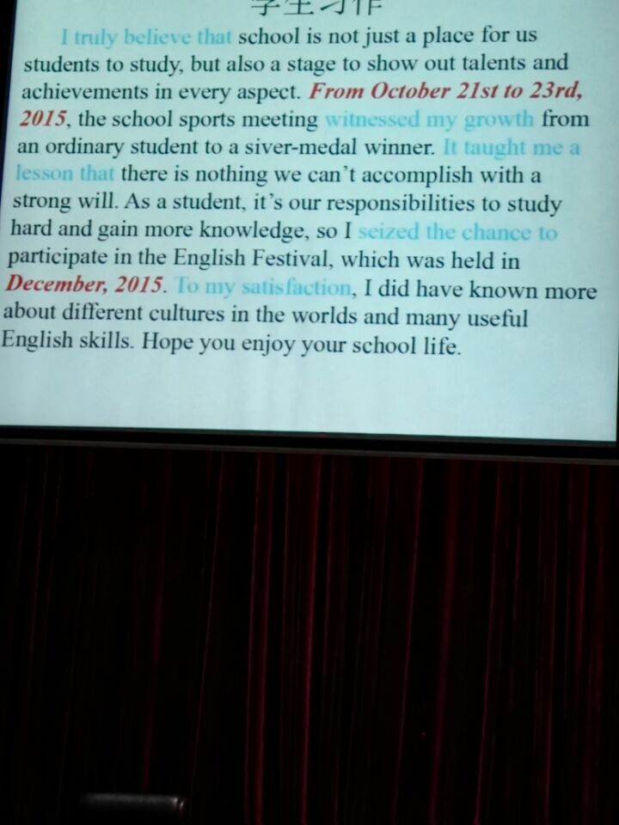

Slide 42
Unless you’re from England, you may be wondering what on earth all this means.

Slide 43
Keys to the Mini Test
1-10 CBDCC DDCAD
11-25 CDA BDBC BADA DACB
26-30 DCGAF
31-50 ADBCD ABCDA BACDB CDABC

Slide 44
Blame 的用法
He was so careless that he was ________(blame) for the accident.
________(blame) for making mistakes in speaking English, he looked very upset.
Air pollution will be partly ______(blame) for such a temperature rise.

Slide 45
Delighted as I was by the tomatoes in sight, my happiness deepened when I learned that Brown’s Grove Farm is one of the suppliers for Jack Dusty, a newly opened restaurant as the Sarasota Ritz, where I was planning to have dinner that very night.

Slide 46

Inversion
n./adj /adv + as\though+主语+其他
Although I am ugly, I am gentle.
Ugly as I am, I am gentle.
Though he is a child, he has to make a living.
Child as he is, he has to make a living.
注意：从句的表语是名词，其名词前不加任何冠词

Slide 47
Though I like you much, I will never marry you .
Much as I like you , I will never marry you .
Although she might try, she could not pass the exam.
Try though she might , she could not pass the exam.

Slide 48
_______, his idea was accepted by all the people at the meeting. [2007 重庆]
A. Strange as might it sound
B. As it might sound strange
C. As strange it might sound
D. Strange as it might sound

Slide 49
21-25 CBABC 26-30 DDBCA 31-35 DBCAA
CGFAE DBCAD BCADB ADCAB DCABC
61. that/which 62. strength(s) 63. yourself
64.Various 65. to 66. to see 67.makes
68. a 69.least 70. mentioned
第一句：去掉was
第二句： think---thought weigh---weight
第三句： the ---a
第四句： searching 后加for ; cross—across
第五句：as---if ; vegetable---vegetables
第七句： both---all 第八句： benefit---benefits

Slide 50
2015年（全国卷I）
When I was a child, I hoped to live in the city. I think I would be happy there. Now I am living in a city, but I miss my home in countryside. There the air is clean or the mountains are green. Unfortunately, on the development of industrialization, the environment has been polluted. Lots of studies have been shown that global warming has already become a very seriously problem. The airs we breathe in is getting dirtier and dirtier. Much rare animals are dying out. We must found ways to protect your environment. If we fail to do so, we’ll live to regret it.

Slide 51
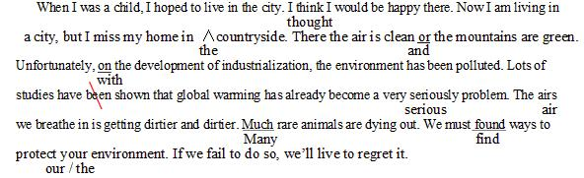

Slide 52
Upon the arrival of spring, beautiful birds would sing happily.
I feel puzzled as to why people do not clean up before they leave the park.

Slide 53
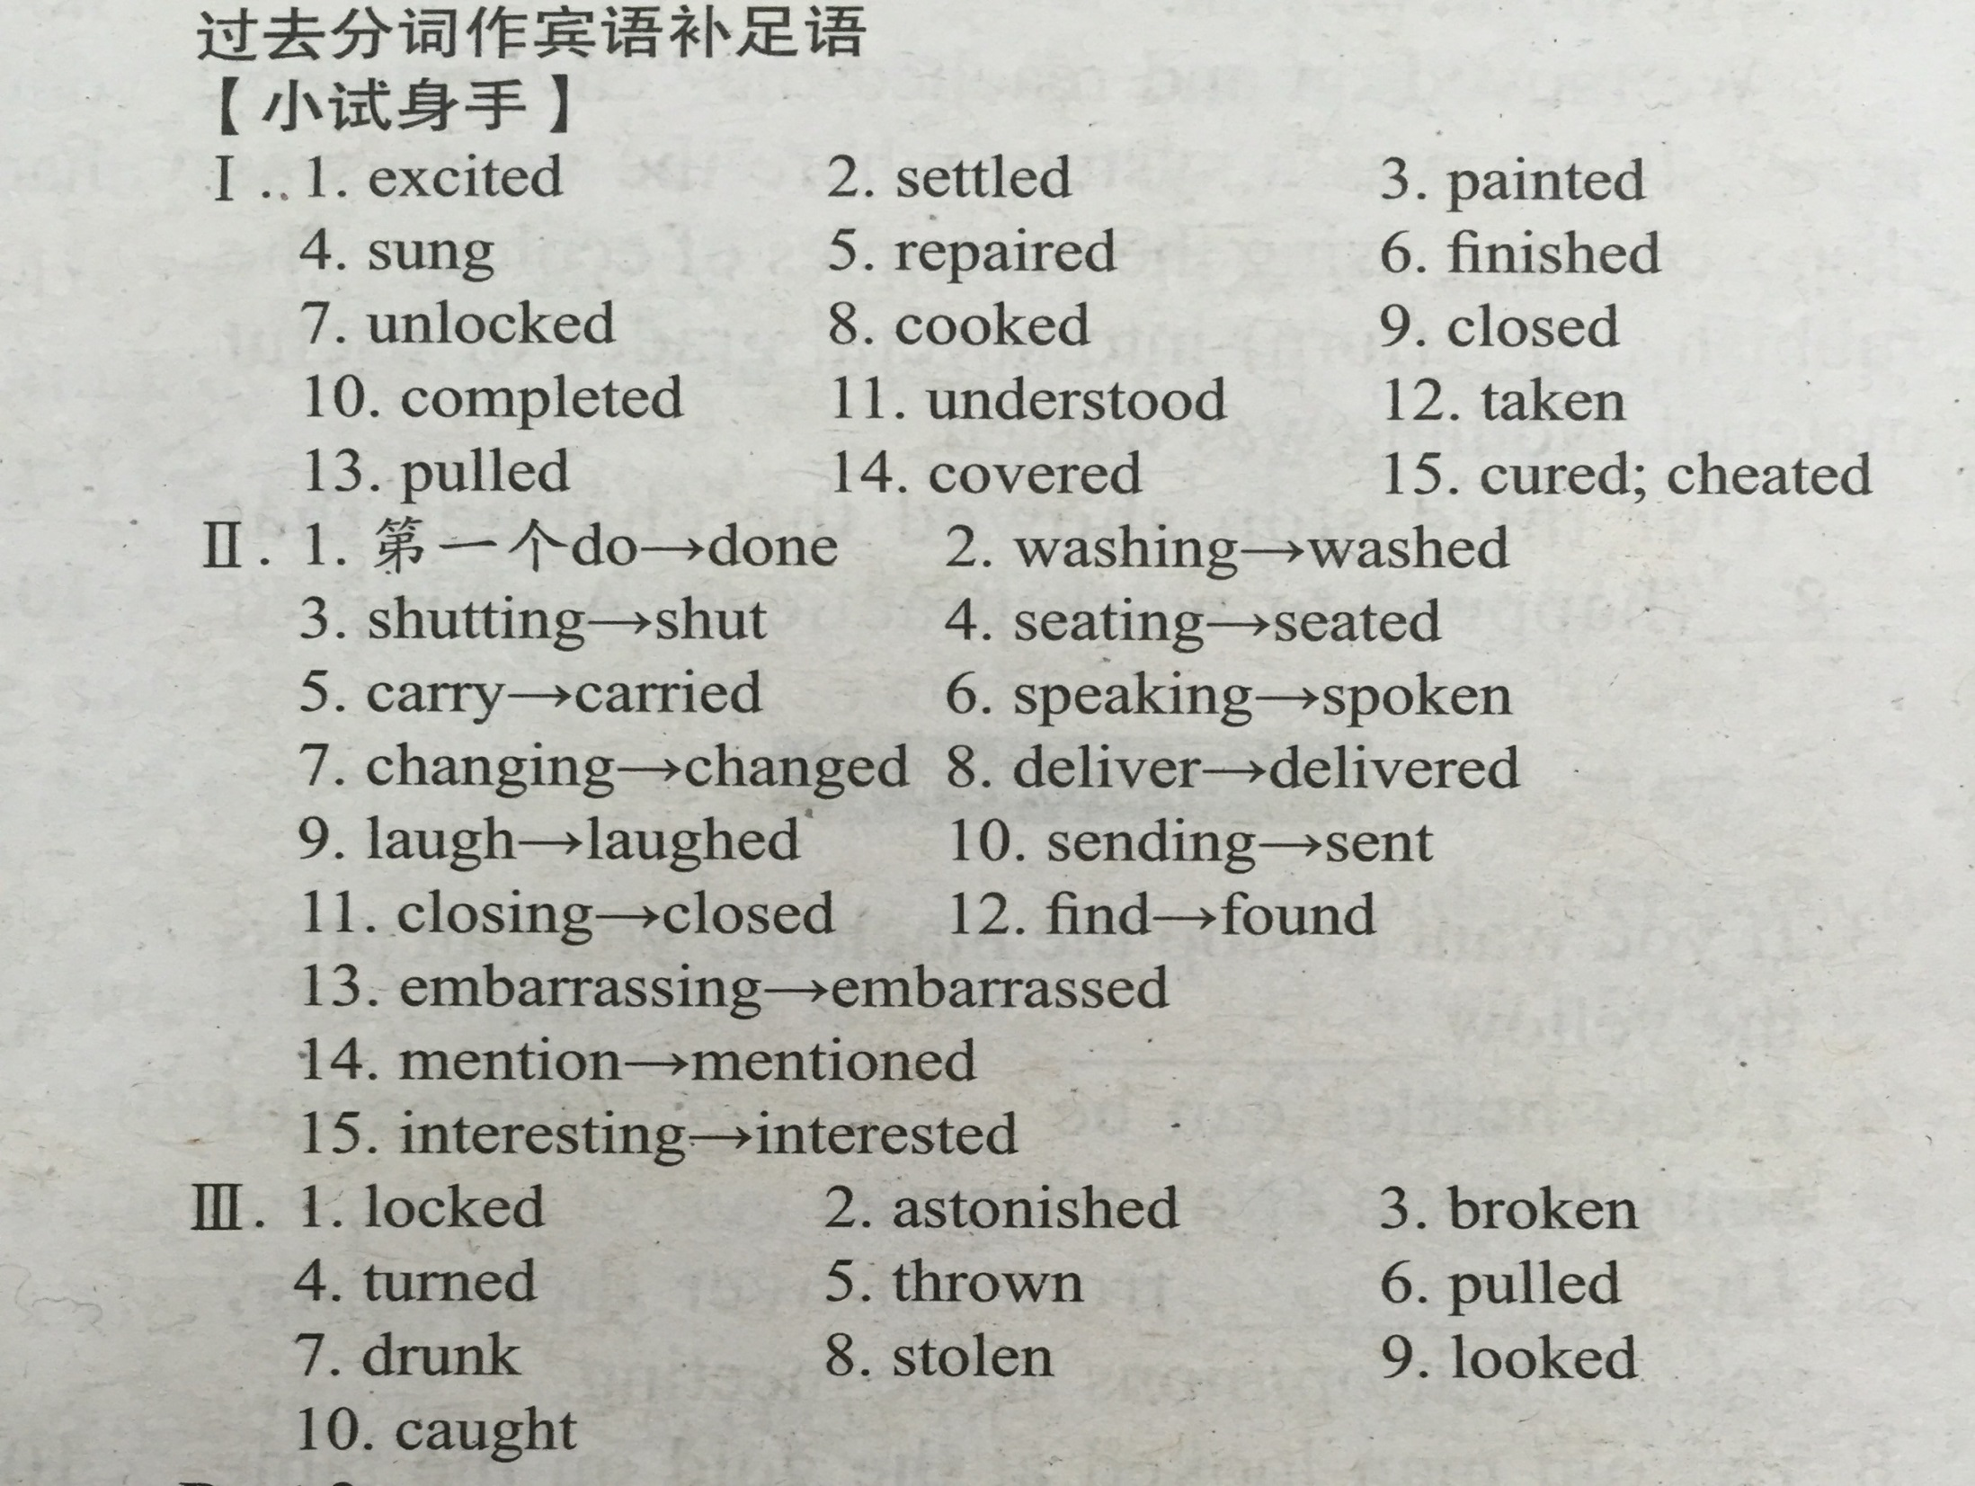

Slide 54
WORD BANK (learning English )
He liked laughing at others, only to find himself laughed at.
Worse still, she found her jewellery stolen.

Slide 55
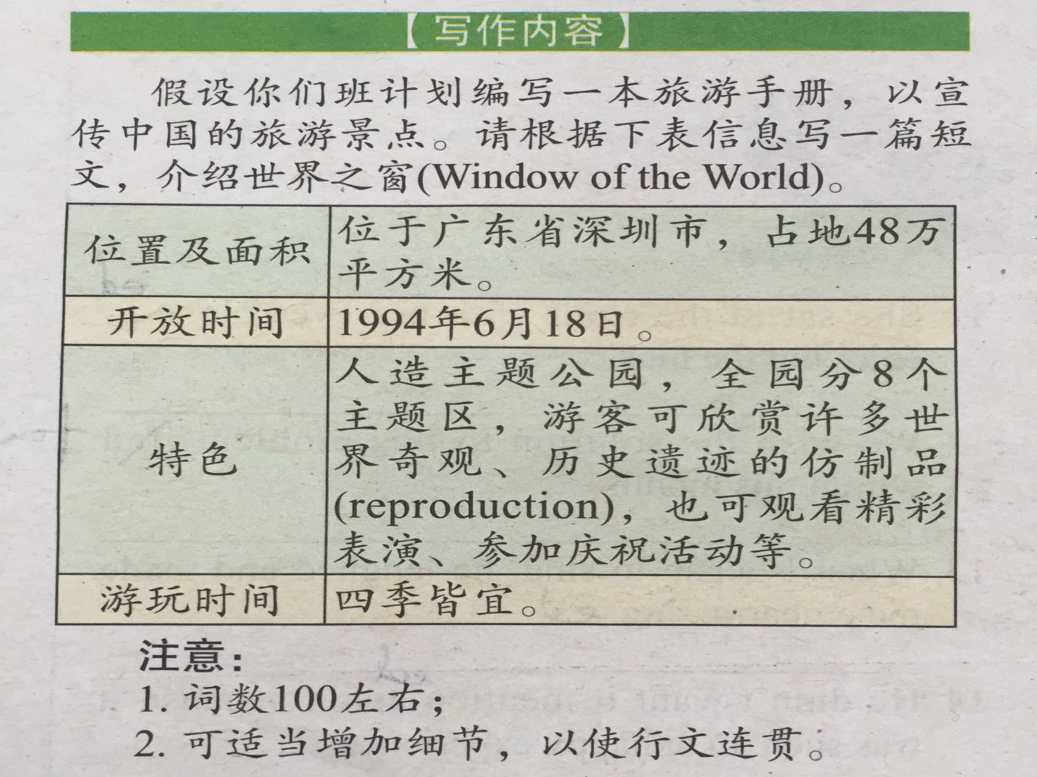

Slide 56
21-25 CBABC 26-30 DDBCA 31-35 DBCAA
CGFAE DBCAD BCADB ADCAB DCABC
61. that/which 62. strength(s) 63. yourself
64.Various 65. to 66. to see 67.makes
68. a 69.least 70. mentioned
第一句：去掉was
第二句： think---thought weigh---weight
第三句： the ---a
第四句： searching 后加for ; cross—across
第五句：as---if ; vegetable---vegetables
第七句： both---all 第八句： benefit---benefits

Slide 57
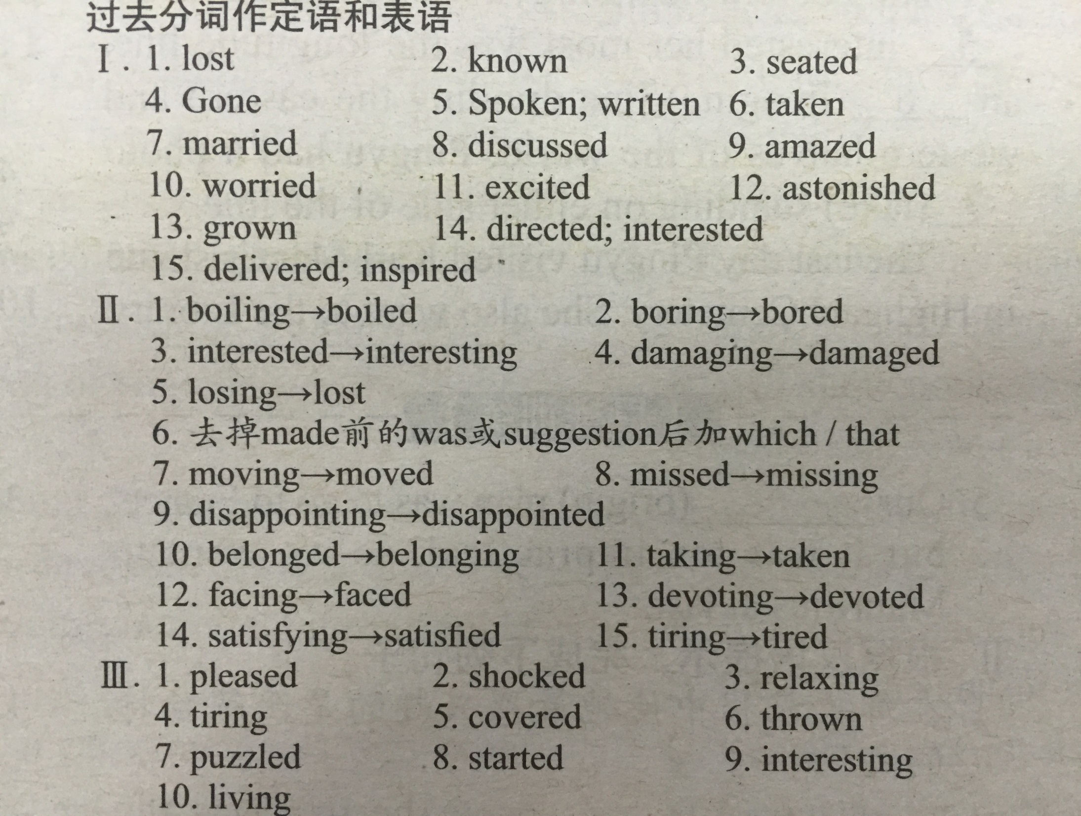

Slide 58
WORD & Sentence BANK (learning English )
Gone are the days when farmers lived in poor conditions.
When you are faced with difficulties, your confidence makes a difference.
The research to which she’d been devoted turned out to be a great success.

Slide 59
1.children改成child 2. late改成later 3. at后面加the 4.her改成him 5.was改成were 6.knowing改成know 7.去掉had 8. chat改成chatted 9. in改成on 10.excited改成exciting

Slide 60
WORD BANK (Teens Issue 4)
One British teenager is a baby namer who is laughing all the way to the bank.
I have a target to reach that will allow me to pay for my university fees.
The practice of the Chinese choosing western names for themselves and their kids has been going on for decades.
It is a common practice that… （惯常做法…）

Slide 61
WORD BANK (Teens Issue 4)
When it comes to cuteness, few animals can compete with the giant panda. There is good news for the lovable creature: it has just been brought back from the brink of extinction.
This is the main problem that species are facing all over the world with regard to(关于） climate change.

Slide 62
WORD BANK (Teens Issue 4)
Improv was very different from what I imagined it would be when I signed up for the class.
Random and unplanned as it may seem , there are gold rules in the art of improv.
Once, in the story telling part, nobody seemed willing to take the lead.

Slide 63
WORD BANK (Teens Issue 4)
I have lost count of the numbers of emails I have ignored. I have spent hours at meeting listening as hard as I could for story, only to go home empty-handed.
While it’s easy to hit “cancel” and go back to what you’re doing, the few minutes it takes to down load and install software updates could save you a huge amount of time and trouble in the long run. But it turns out , many people tend to put it off.

Slide 64
WORD BANK (Teens Issue 4)
Over the years, the party has grown into its modern day form.
To motivate the people who took part to reach the goal, researchers divided them into three groups.
Our brains tend to avoid wanting to lose things
More than they try to get the benefits from gaining them.
Many participants will drop out quickly and only the motivated will stay involved.

Slide 65
WORD BANK (Teens Issue 4)
I’m carrying a 13 kg pack, most of the weight taken up by climbing gear for the canyon, food and four liters of water.
The extreme pain throws me into a panic.

Slide 66
WORD BANK (Teens Issue 4)
He looks righteous and innocent, seemingly having no knowledge of the darkness in the world.
Life is not always plain sailing . He has suffered many ups and downs as well.

