Slide 1
Dear_____________,
Thank you very much for _____________. To be honest,__________.However, the current situation does not allow me to do this.
This has been a difficult decision for me, but I have to do this. On the one hand, ____________. On the other hand, __________. In view of these, I regret that_____________. I hope this does not bring you much inconvenience.
I feel very sorry to disappoint you. If___________, I will __________. I do appreciate your ________. Meanwhile, I wish___________.

Slide 2
We are terribly sorry that …
I am extremely sorry that …
Congratulations --- regret --- reasons --- pity --- make-up--- wish --- thanks

Slide 3
Unit 1 A Land of Diversity

Slide 4
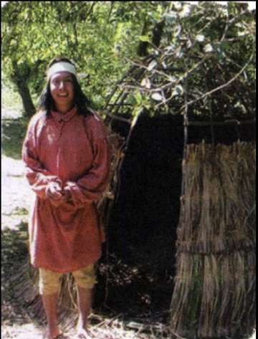
Pre-reading
Native American Indian - one of the first people to live in California

Slide 5
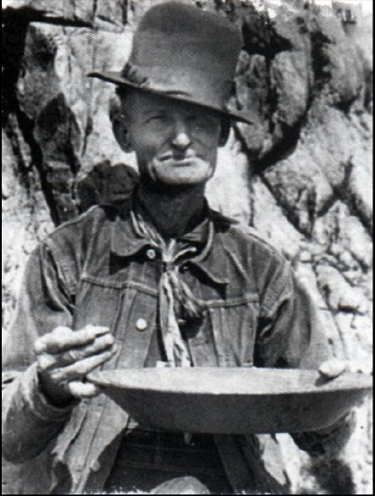
Pre-reading
A gold miner – the discovery of gold in California created a gold rush which brought people from all over the world to California.

Slide 6
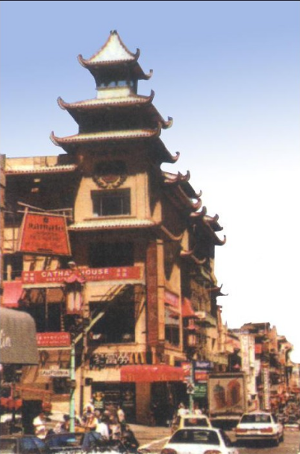
Pre-reading
A building in Chinatown,
San Francisco – many Chinese have settled in California and many of them lived in Chinatown in San Francisco

