Slide 1
A Short history of western painting

Slide 2
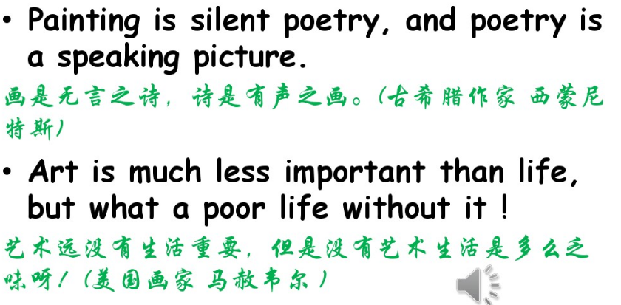

Slide 3
Word List

Slide 4
Realistic
Abstract
Religion
Religious themes
Art gallery
Faith
Consequently
Conventional
Renaissance
Gradually
Replace
Concentrate less on
Humanistic
Possess
Decorate
Superb
Possession
Perspective
By coincidence
Masterpiece
Ridiculous
Controversial
Scores of
Attempt
On the one hand,
On the other hand
Predict

Slide 5
1. Why did the author provide a short history of western painting instead of a longer one?
2. What important western art styles have been mentioned in the text?
3. what’s the main aim of painters in the Middle Ages?
4. why did they draw religious symbols?
5. name one famous artist during the Middle Ages
6. what did the painters during the Renaissance focus more on?
7. what is the most important discovery during the Renaissance?
8. what is the new technique during the Renaissance?
9. what happened to the painting styles during the impressionism?
10. Modern art are divided into two parts, what are they?

Slide 6
Timeline
History Period & Painting Themes

Slide 7
