Slide 2
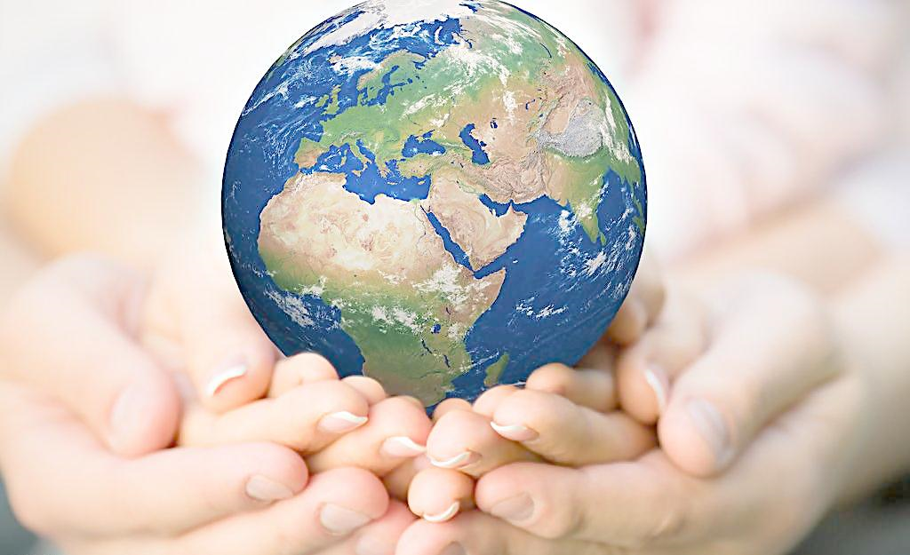
请根据所给图片和文字提示用英语写一张海报
列举目前地球所面临的严重问题 （disasters, extreme weather, pollution …）
呼吁全社会关注环境
提出建议
要求：语言连贯，词数100左右

Slide 3
Outline
The earth is faced with a lot of problems… because of…
disasters like floods, droughts, haze as well as extreme weather and pollution
As a result, if we ignored the serious situation, possibly… (可使用虚拟语气)
pay no attention to, think little of, be unaware of
We’d better…
a. realize the seriousness of the situation
b. work out a solution
c. take measures (regulations, laws…)
It’s high time…
There is much point in …
It is necessary for people to …

Slide 4
Over recent years, the earth, the only habitat for us, is struck frequently by disasters like flood droughts and landslides as well as extreme weather and pollution due to the damage done by human activities, which rings an alarm to us. As a consequence, if we didn’t pay much attention to the destruction, our planet would become a ruined globe rather than a comfortable home, where people would suffer a lot.
Therefore, it is high time we spared no efforts to raise people’s awareness of environmental protection. In addition to appealing to people to consume as less energy as possible and recycle materials to avoid the waste of natural resources, it will be necessary to punish those who are involved in destructive conducts with strict laws. (126)

