Slide 1
2017广州深圳二模

Slide 2
In the West we are familiar with ballets like Swan Lake. But there’s another classical dance form with a long history 61 has only recently burst onto the world scene. It is called classical Chinese dance.
Classical Chinese dance is 62 incredibly demanding, refined, and expressive dance form. Alongside ballet, it is also one of the most comprehensive dance systems 63 (know) to humankind.
64 recently, few people outside China had ever heard of classical Chinese dance. One major reason was that when Chinese companies performed abroad, they often mixed Chinese dance with western dance style. And so the audience left the theater not sure exactly 65 they had just seen.

Slide 3
In 2006, however, the Shen Yun Performing Arts Company 66 (establish) in New York. Its mission was to promote 67 (tradition) culture, and this included 68 (present) classical Chinese dance in its pure form. Not quite a decade later, classical Chinese dance has become much 69 (well) recognized and is starting to influence western ballet.
Although they have significant differences, both ballet and classical Chinese dance have the ability to vividly tell 70 (story) and move us through beautiful art.

Slide 4
Getting around the city when you are six months pregnant and have a two-year-old girl can be really challenging. One spring afternoon, we went to one of the grocer 61. (store) nearby to buy some food for dinner. There was no sign of rain, and the store was just around the corner, 62. we went there without an umbrella. However, we were about 63. (leave) the store when the rain came in full force. It seemed that the streets would be flooded 64. water within minutes.
I noticed a young Chinese couple staring at 65. (we) when we came to a crossroads and were waiting for the light to change.

Slide 5
I figured they were 66. ________(probable) wondering why a pregnant foreigner was dragging her little kid out through the rain. But as we crossed the street. 67. woman offered me her umbrella. I told her I couldn’t take it when it was clearly starting to storm. She insisted and handed it to me as she 68. (hurry) off with her husband.
Though 69. (catch) in the ruin unexpectedly, we still treasured the memory and will always recall the 70. (warm) and kindness of the Chinese couple.

Slide 6
It has been several week since I came to my new school. It was a clean, beautiful and modern one, with a large playground and an amazed digital reading-room. All the teachers are friendly and kindly. Among them, I like my English teacher best, who is enthusiastic but popular with us. He is also strict to us. He teaches us in an unusual way. Besides, he always avoids making us to feel embarrassed in class. All my classmates works hard. We're enjoying such new life and trying to develop us for the future.

Slide 7
Dear Chris,
Are you interested in coming with me to see a famous opera? It will performed at the Guangzhou Opera House at 2 pm in May Day. I know you took great interest in Chinese culture, especially local opera. I think the perform will not only leave you with an unforgettably impression, but satisfy your interest in Chinese opera as well. If you can come, I suggest us should visit the Guangzhou Museum near the Opera House before and after the opera. You decide. The museum is hosting a exhibition on Cantonese opera. If we go, I believe you can learn many about Chinese opera in there.
Yours, Li Hua

Slide 8
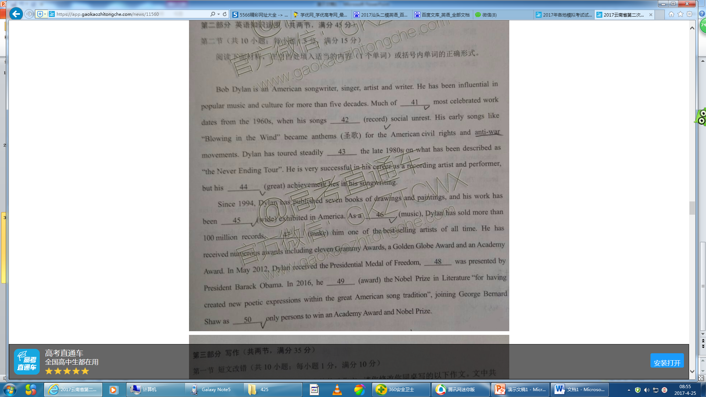

Slide 9
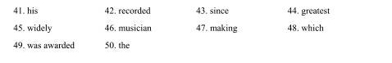

Slide 10
