Slide 1
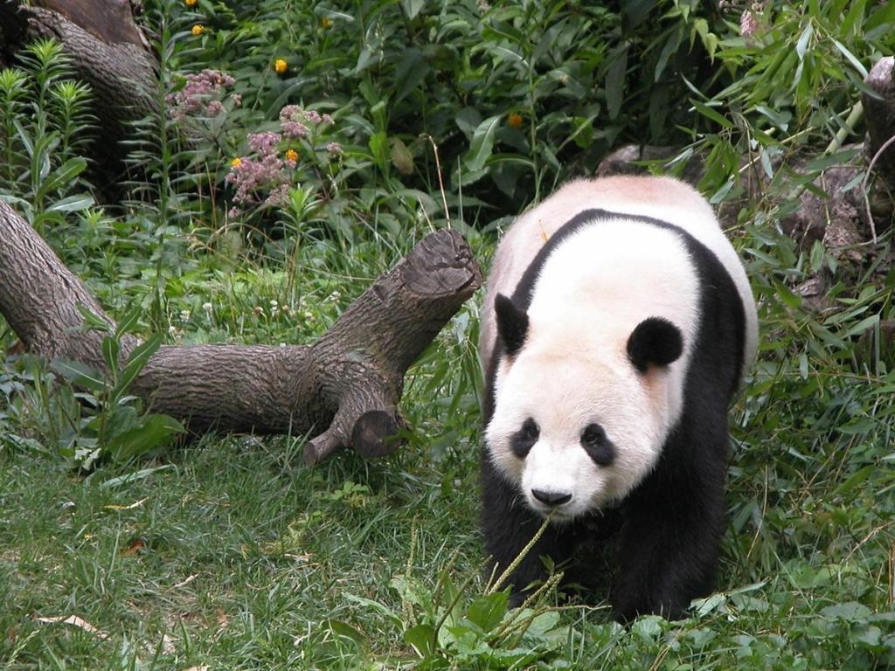
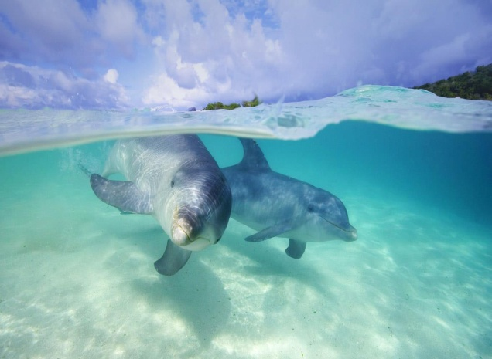
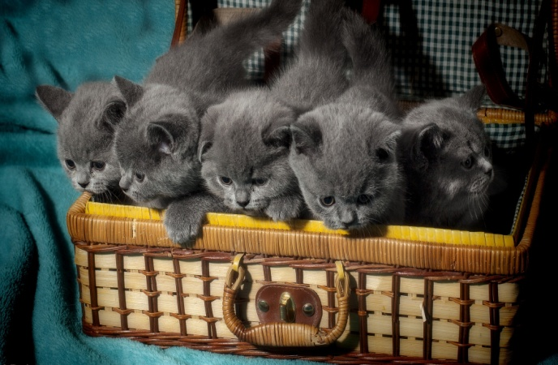
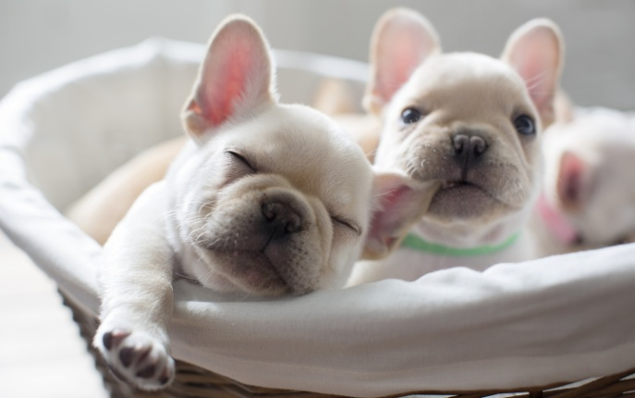
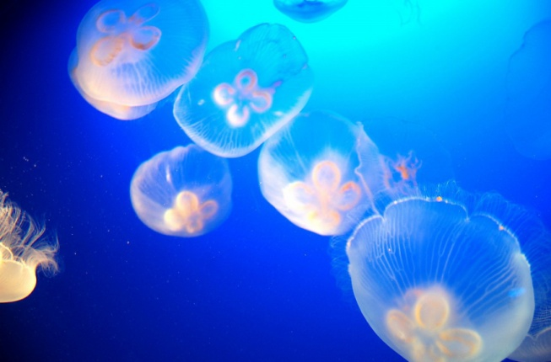
Animals

Slide 2
Endangered animals?

Slide 3
白眉长臂猿Bridled gibbon
墨西哥草原松鼠Mexico grassland squirrels
白鱀豚Lipotes vexillifer
蓝鲸Balaenoptera musculus
亚洲象Elephas maximus
藏羚羊Pantholops hodgsonii
扬子鳄Alligator sinensis
红带箭毒蛙Dendrobates lehmanni
大鲵Andrias davidianus
中华鲟Acipenser sinensis
大熊猫Giant panda
苏门答腊虎Panthera tigris ssp. Sumatrae
……
……
……

Slide 4
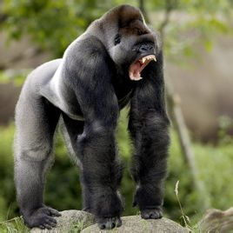
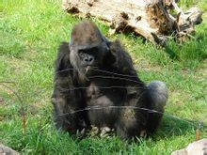
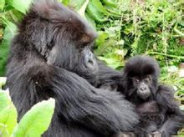
Gorilla(大猩猩)
刚果（Republic of the Congo）
喀麦隆政府（Cameroon government ）

Slide 5
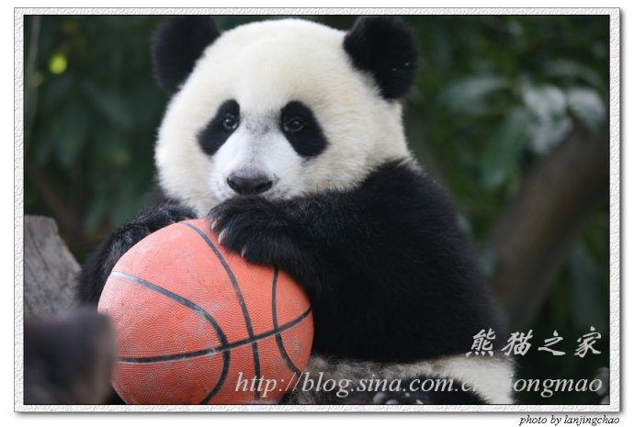
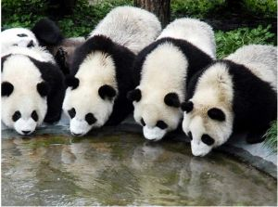

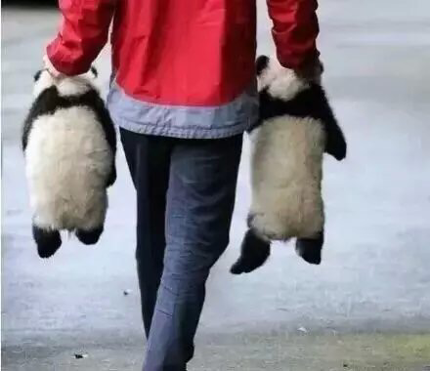
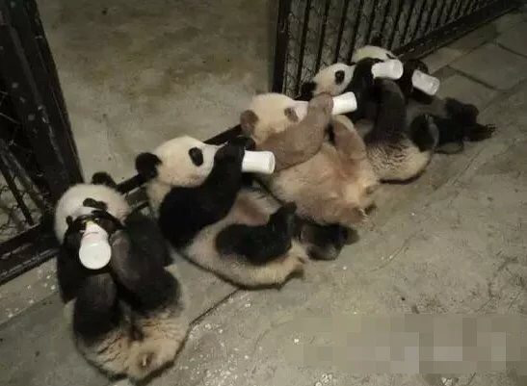
Giant panda

Slide 6
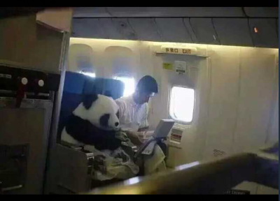
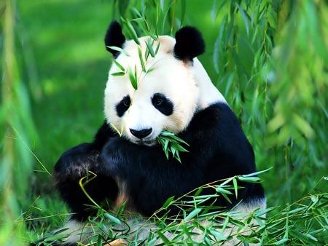
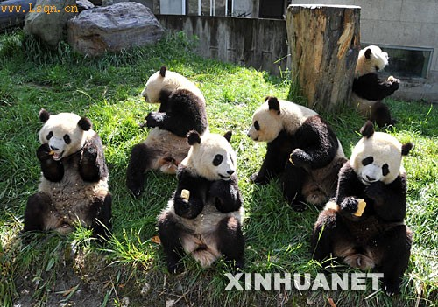
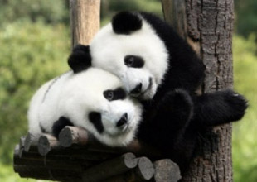
bamboo

Slide 7


Slide 8
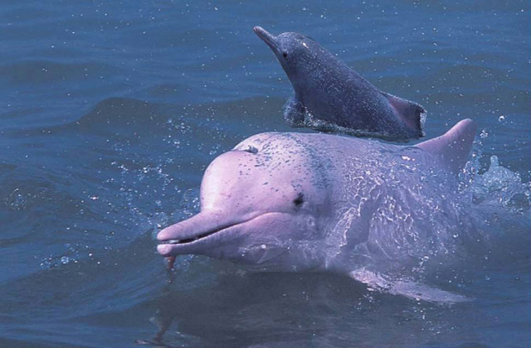
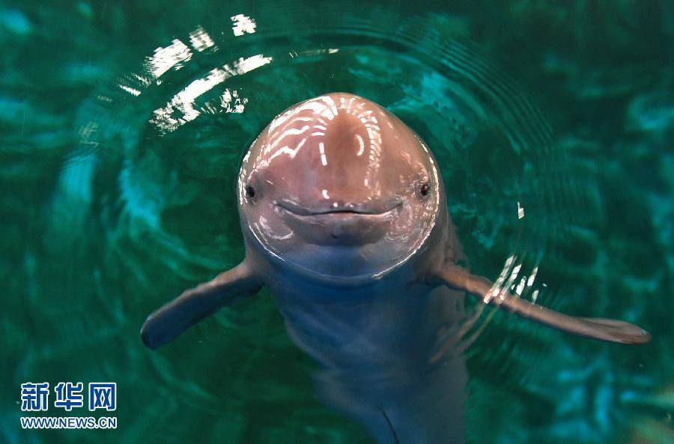
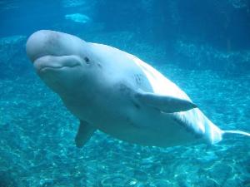
Lipotes vexillifer（白鳍豚）
“The water of the giant panda”

Slide 9
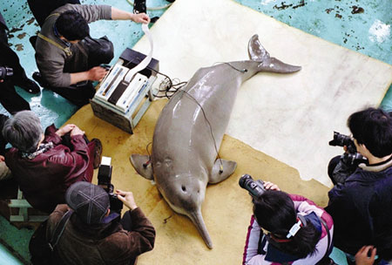
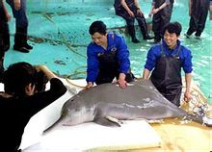
To protect them
Many people was paying attention to them.
His name is qiqi.
1980,he was sent to Wuhan.
He has lived there for 22 years.
Sadly,he was dead in 2002.

Slide 10
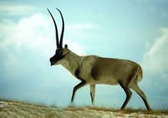
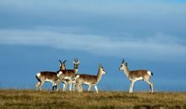
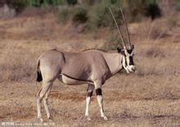
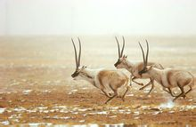
Tibetan Antelope(藏羚)

Slide 11
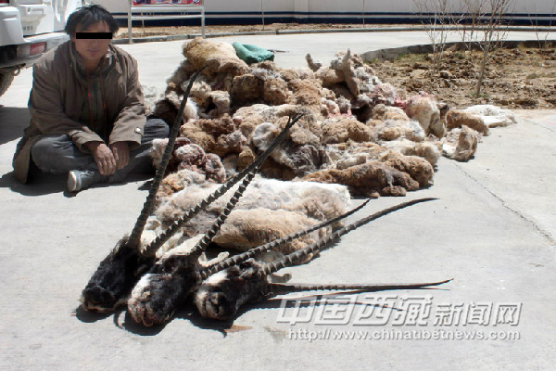
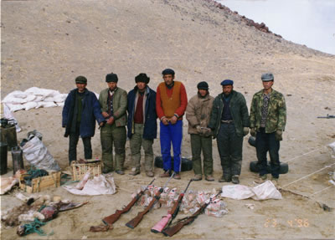
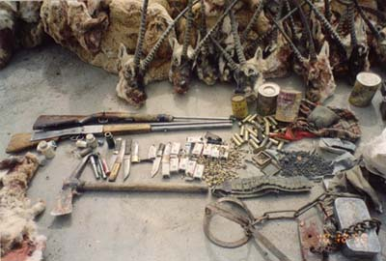
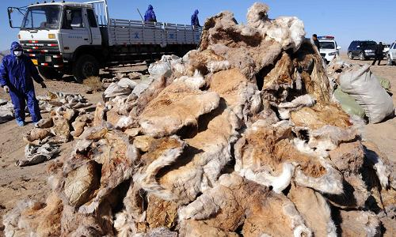
Get their beautiful fur=makes them die

