Slide 1
A r t
Richard
Shenzhen Experimental School

Slide 2
A Short History of Western Painting
The most important Styles of Western Art
The Middle Ages
Impressionism
Modern Art
The Renaissance

Slide 3
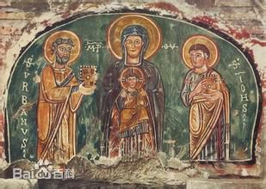
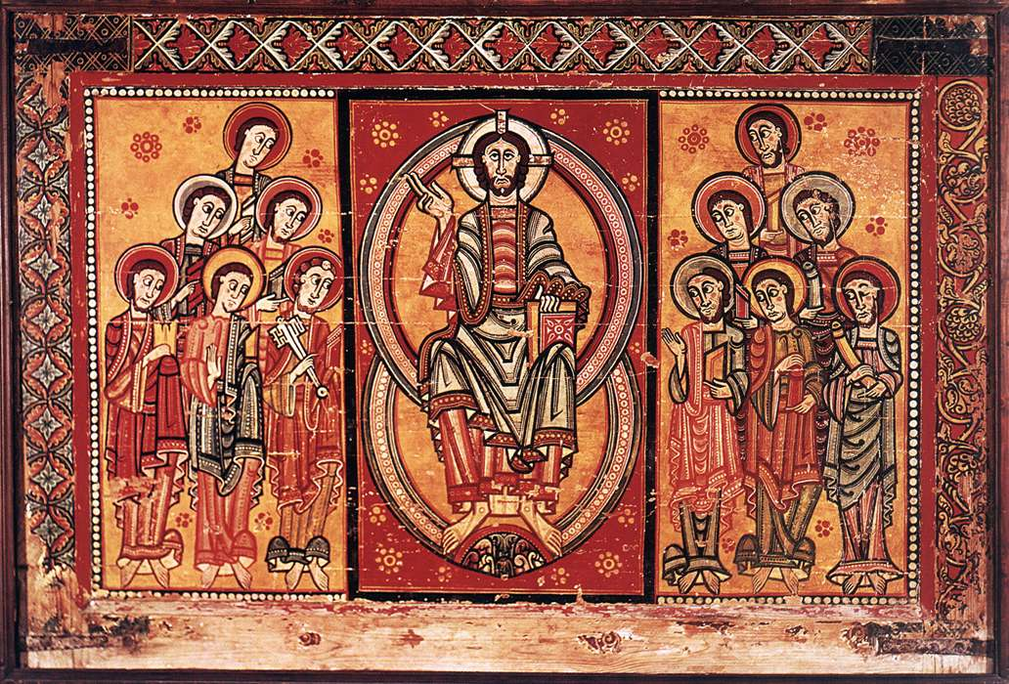
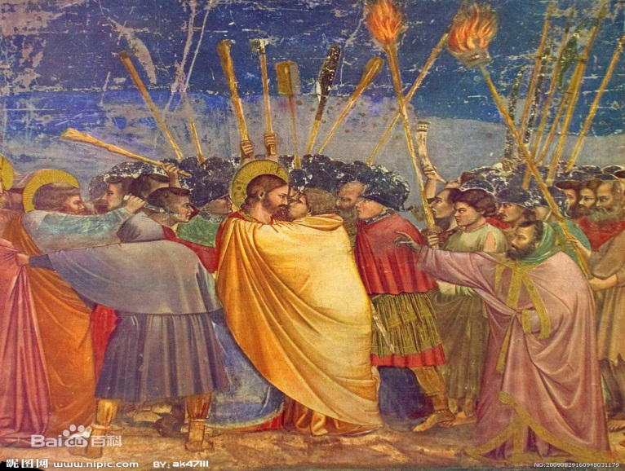
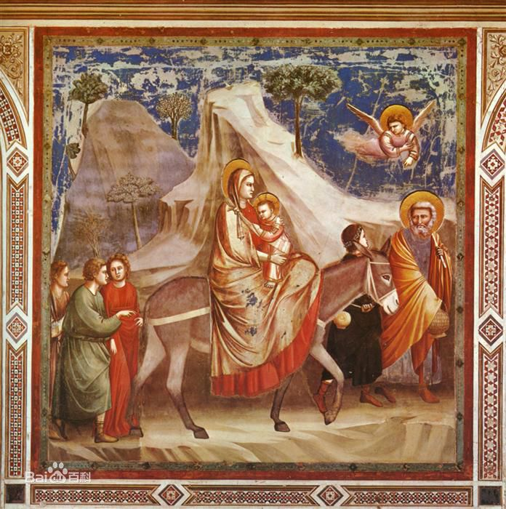
The Middle Age ( 5th to 15th century AD)
Can you see the
similarity and
the difference
between the
two paintings
above and
the two below?

Slide 4
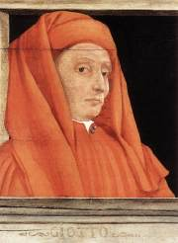
A great name to remember
Giotto di Bondone
(1266－1337)
Florence, Italy
architect/ painter/ sculptor
“opener of the Renaissance”
“ father of European painting”
painted religious scenes in a
more realistic way

Slide 5
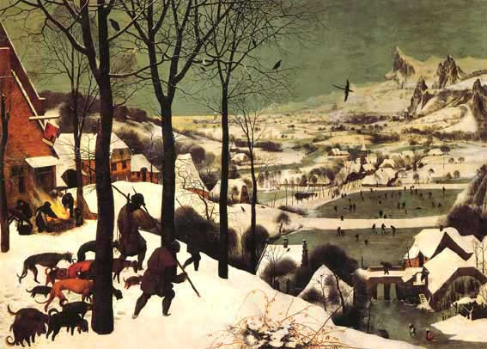
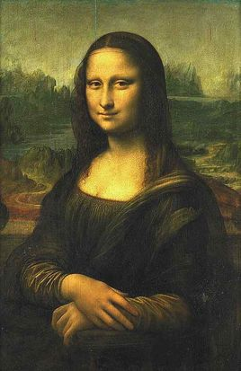
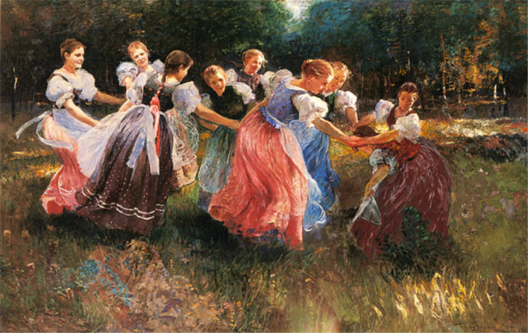
The Renaissance
(15th to 16 century)

Slide 6
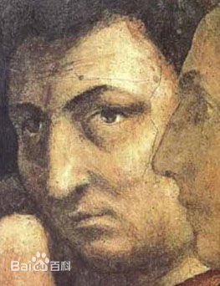
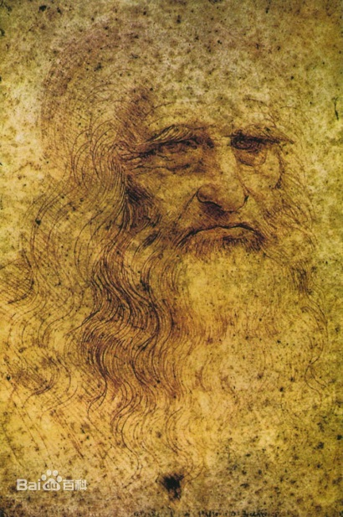
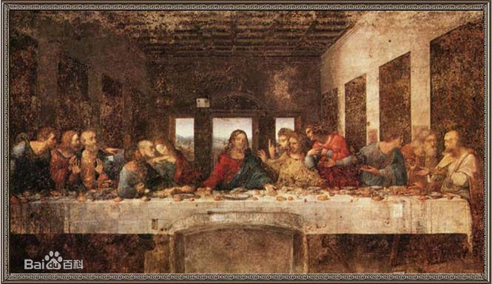
great names to remember
Masaccio (1401—1428)
Italy
painter
the first to use perspective
“pioneer of the Renaissance”
a revolutionary in art history

Slide 7
Leonardo da Vinci (15. April 1452 – 2. May 1519) was an Italian man who lived in the time of the Renaissance. He is famous for his paintings, but he was also a scientist, mathematician, engineer, inventor, anatomist, sculptor, architect, botanist, musician, and a writer. Leonardo wanted to know about everything in nature. He wanted to know how everything worked. He was very good at studying, designing and making all sorts of interesting things.
Many people think that Leonardo was one of the greatest painters of all time. Other people think that he was the most talented person ever to have lived. The art historian Helen Gardner said that no-one has ever been quite like him because he was interested in so many things that he seems to have had the mind of a giant, and yet what he was like as a person is still a mystery.

Slide 8
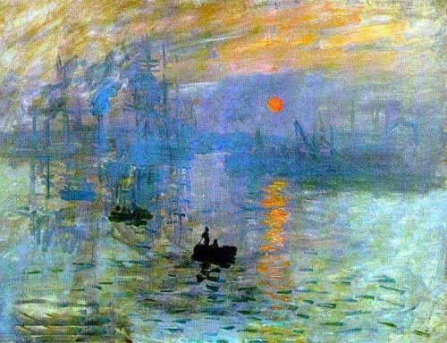
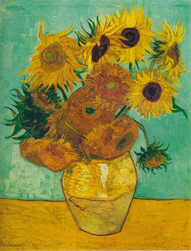
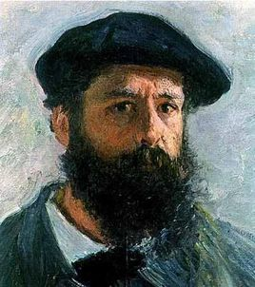
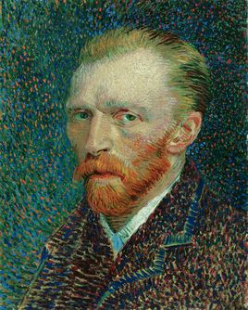
Impressionism
(late 19th to early20th century)
Claude Monet ( 1840-1926)
Vincent van Gogh (1853-1890)

Slide 9
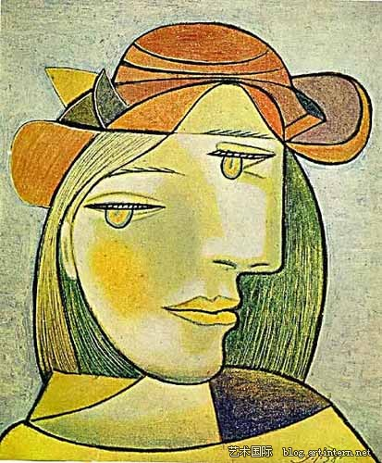
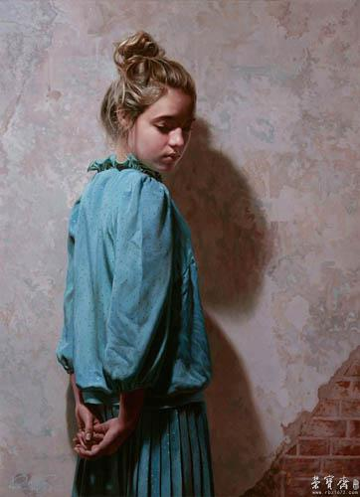
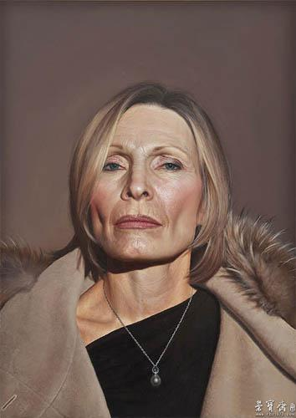
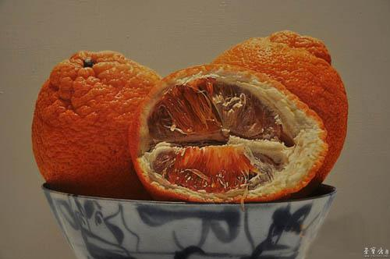
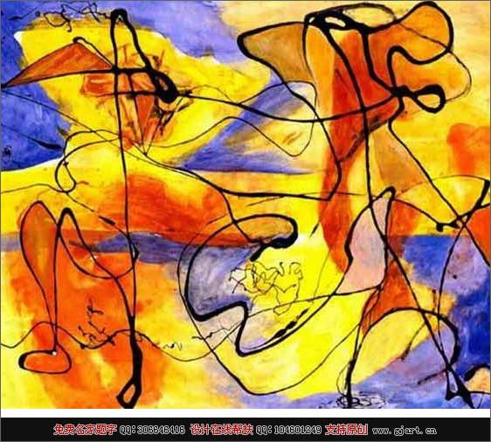
Can you tell
the difference
between the
two paintings
on the left and
the three on the
right?
abstract painting
hyperrealism

Slide 10
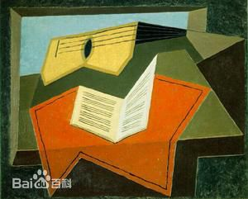
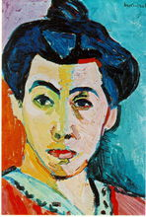
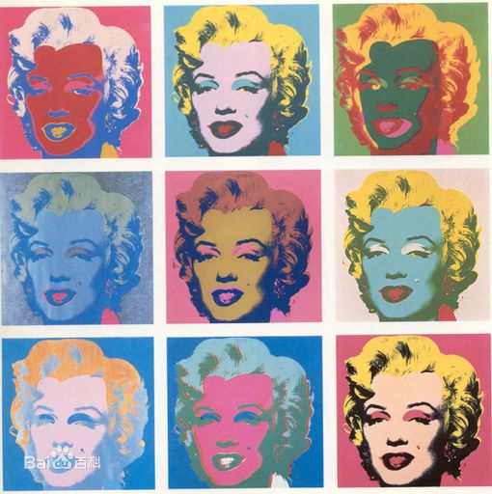
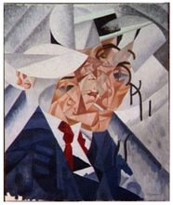
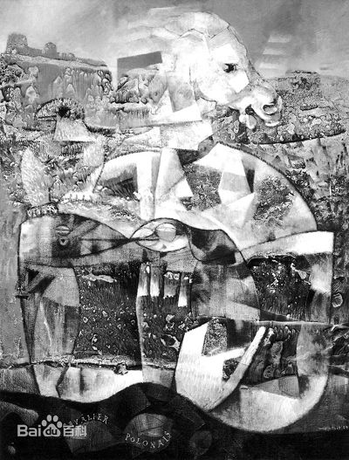
cubism （立体画派）
fauvism (野兽派)
pop art (波普艺术)
futurism (未来主义)
dada (达达主义)

Slide 11
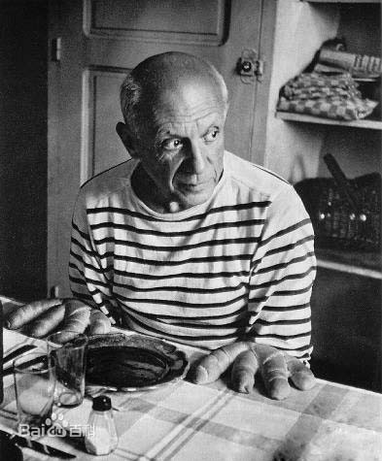
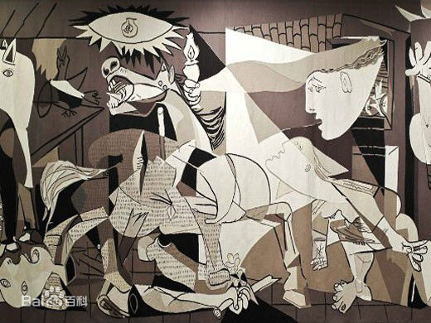
Do you know this person and the picture?

Slide 12
Questions:
What influences an art school（流派）？
Why does the late Middle Age deserve special mentioning?
What contributions did rich people make to the development
of art during the Renaissance?
4. What are the two things that have brought along many
masterpieces, making the Renaissance art noticeable?
And how did they make it?
Who do you think could have thought impressionist paintings
were of little value?
6. Throughout the art history, modern art is the broadest art category.
Do you agree or disagree? Why or why not?

