Slide 1
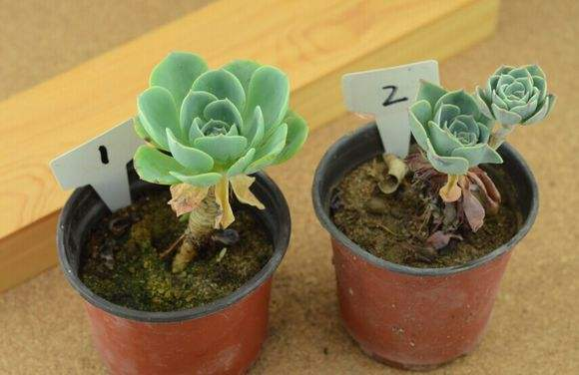
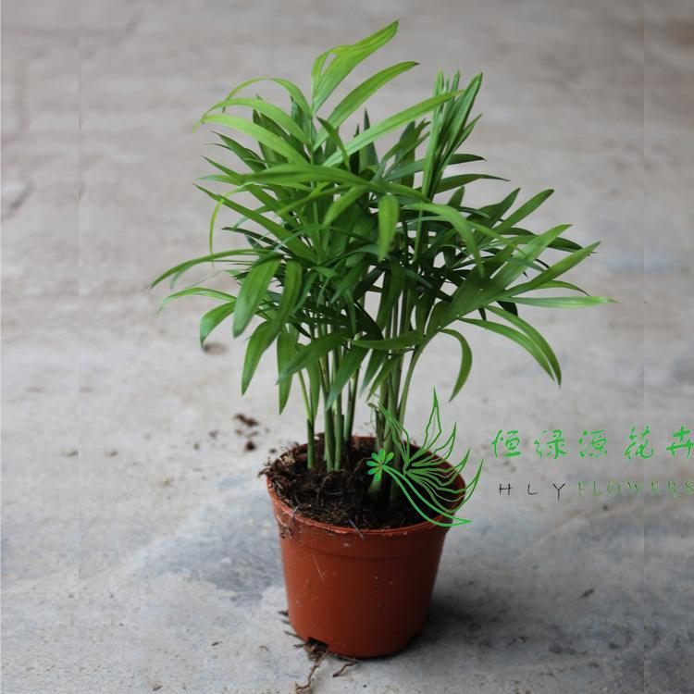
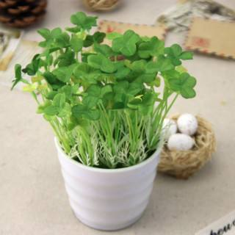
Pictures to help understanding
potting

Slide 2
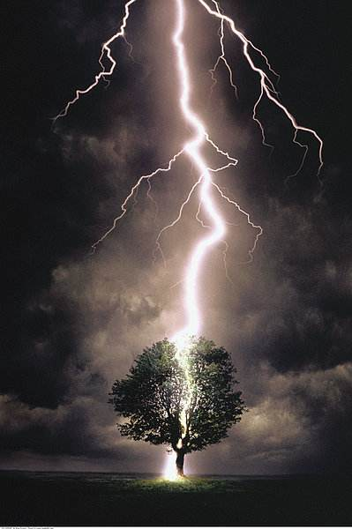
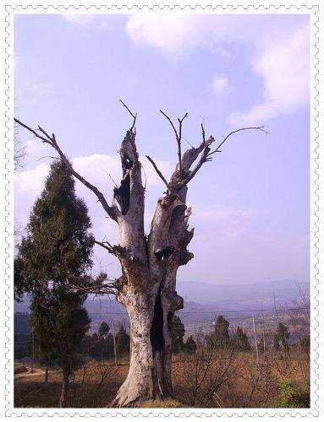
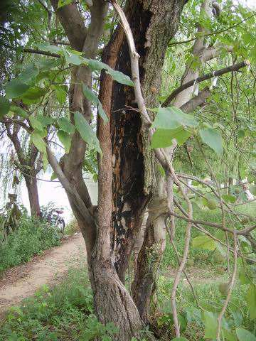
Pictures to help understanding
lightning strikes in tree trunks

Slide 3
What is sustainability?
In ecology, sustainability (from sustain and ability) is the property of biological systems to remain diverse and productive. Long-lived and healthy wetlands and forests are examples of sustainable biological systems. In more general terms, sustainability is the endurance of systems and processes. The organizing principle for sustainability is sustainable development, which includes the four interconnected domains: ecology, economics, politics and culture. Sustainability science is the study of sustainable development and environmental science.
Sustainability can also be defined as a socio-ecological process characterized by the pursuit of a common ideal. An ideal is by definition unattainable in a given time and space. However, by persistently and dynamically approaching it, the process results in a sustainable system

Slide 4
Analyze these sentences:
Because that’s where as a child, I explored lightning strikes in
tree trunks, dug in the ground for hidden springs, or searched
for wild fruit. (summarize the underlined expressions in your
own words)
I wonder if the hours of free play she has had in the same fields,
woods, and streams that remind me of my childhood are her
ball and chain.

Slide 5
Develop your thinking:
Question 1: What are the benefits of pushing your boundaries?
And how?
Question 2: Why do you think Sampson suggests “sit-spot”
should be close to the home

