Slide 1
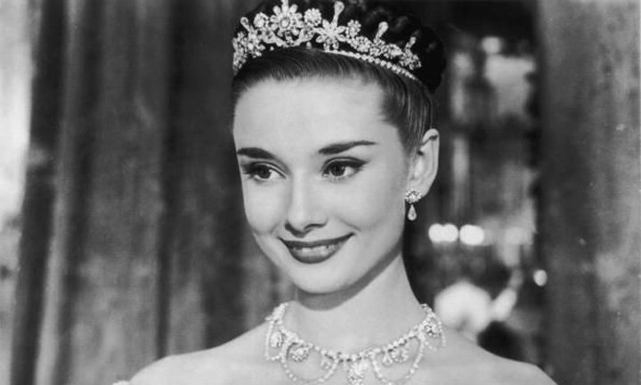
Audrey Hepburn

Slide 2
Life Experience
4th,May,1929, was born in a noble family in Belgium Brussel
During 1935 to 1938,studied at a boarding school in UK
From 1939 on, was admitted to a conservatory to study ballet in Holland
Because she was so tall that she was told that she cannot be a professional ballet player. She started to be an actress.
Died of cancer on 20th,Jan.,1993

Slide 3
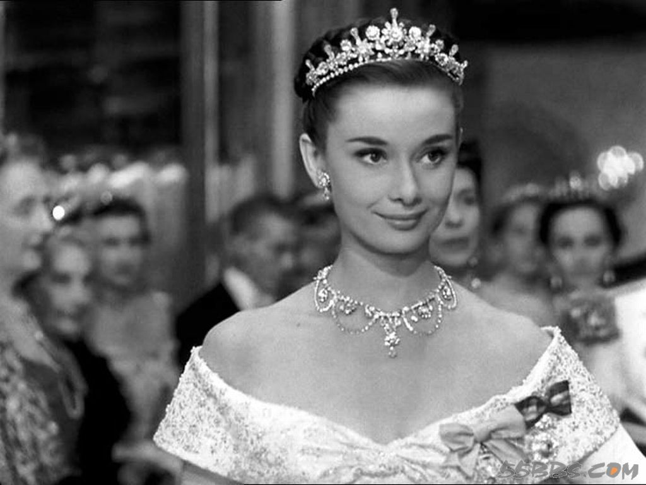
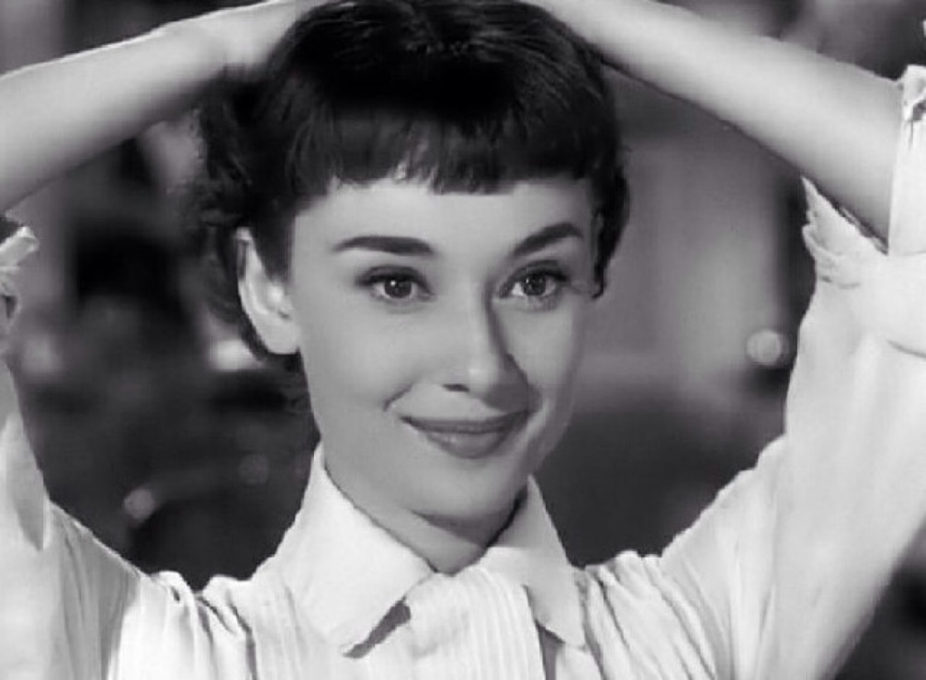
Roman Holiday
A princess called Ann had met an American journalist and they had experienced some romantic things just in one day. But they had to separate because the giant class difference.

Slide 4
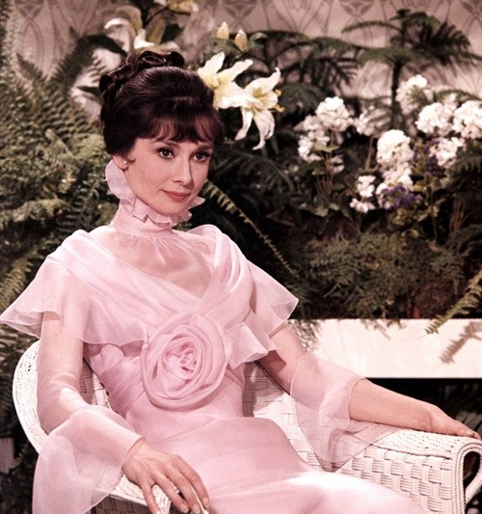
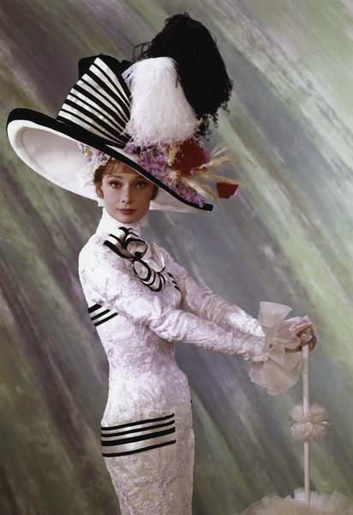
My Fair Lady
This movie tells about a maid who made a living by selling flowers was changed to be an elegant lady by a professor called Higgins.

Slide 5
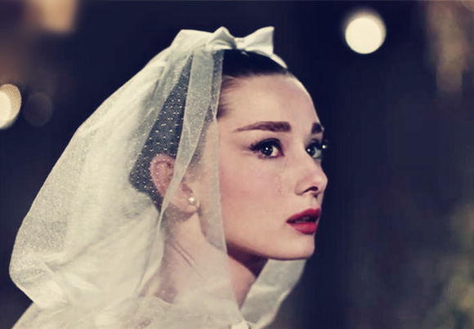
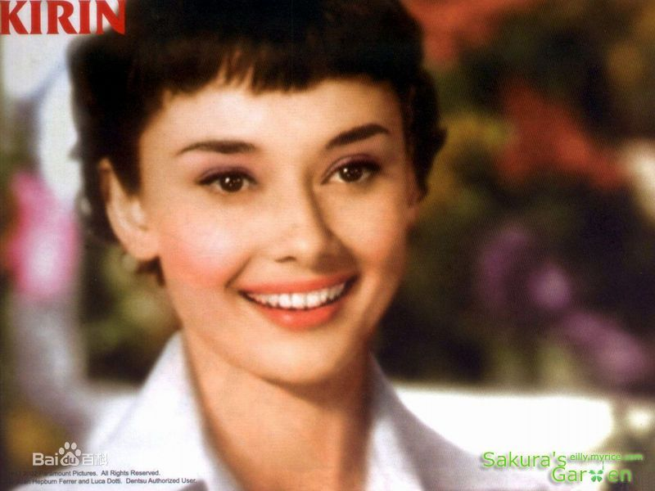

Slide 6
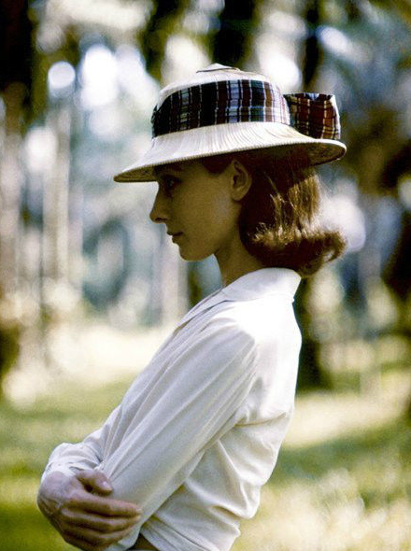
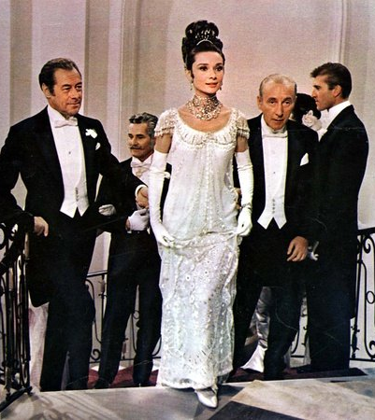

Slide 7
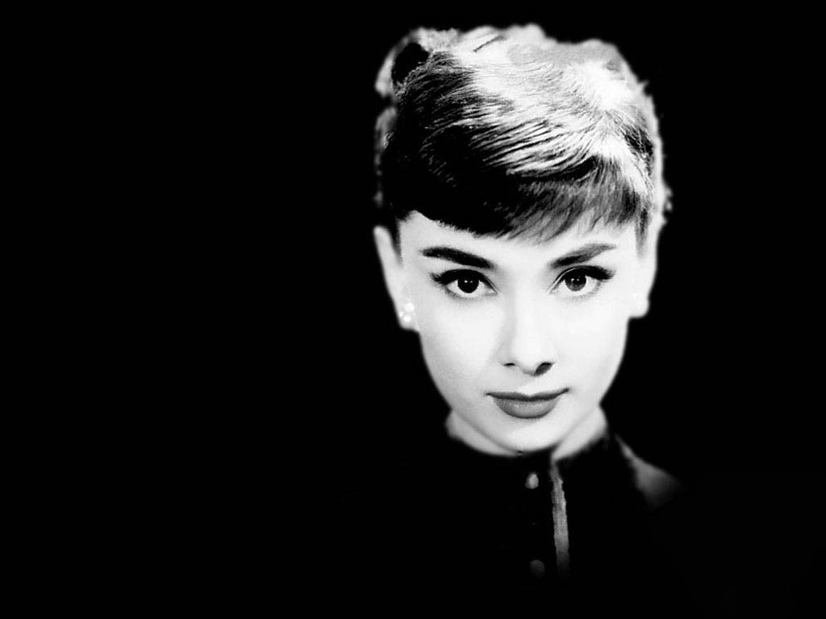
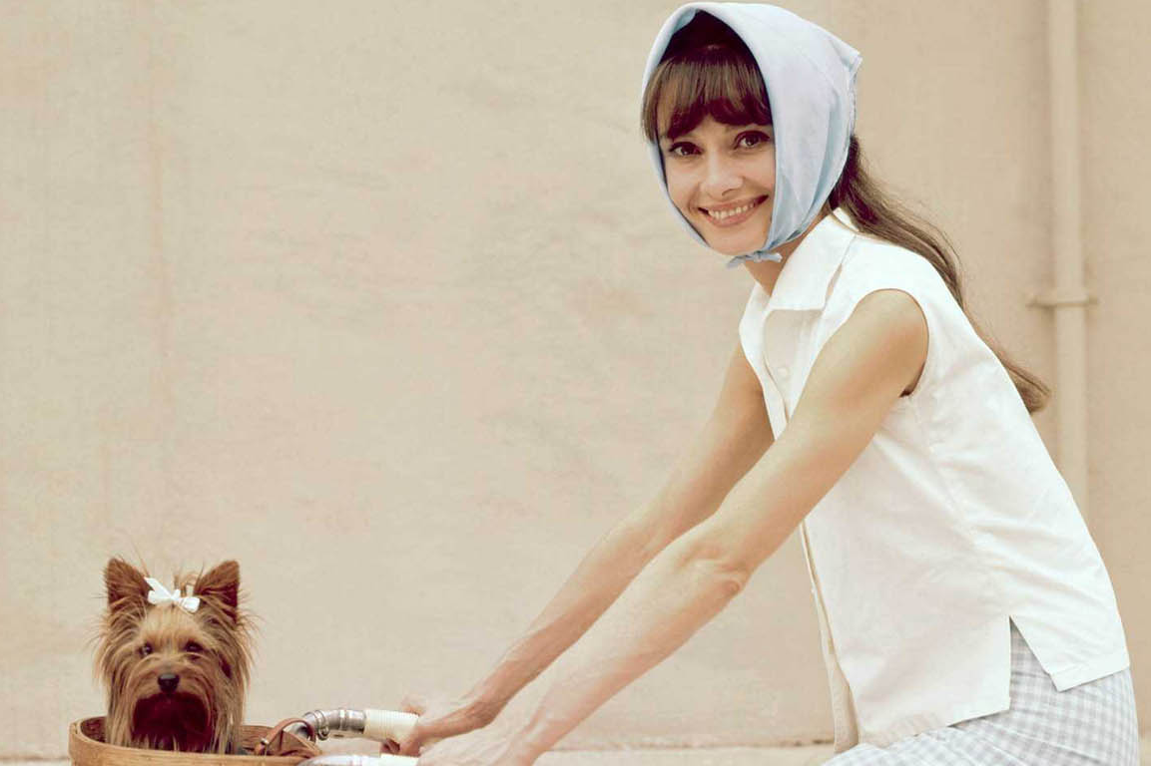

Slide 8
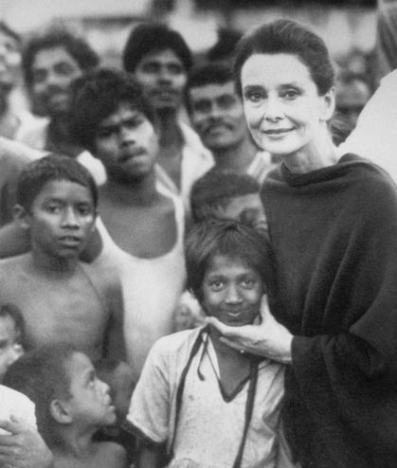
Conclusion
Embodiment 体现
Charm 魅力
Diligent dedication 努力奉献
Classical qualities 古典的品质
Etiquette 礼仪

Slide 9
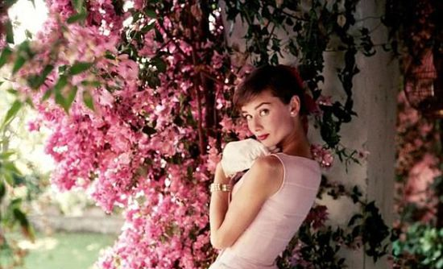
Thanks for watching.

