Slide 1
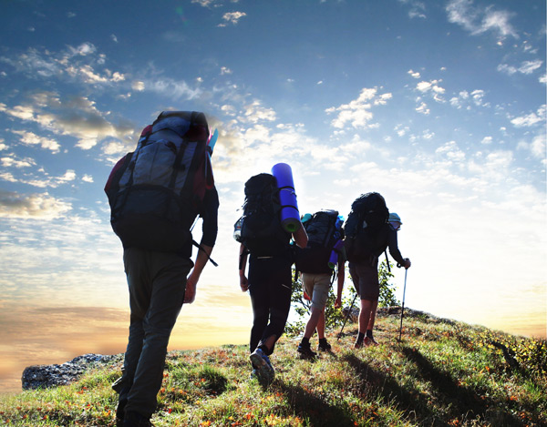

World Walking Day
Believe in yourself is
Nov.20.2015 Caocao Zhang

Slide 2
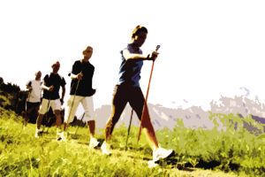
Its origin
"World Walking Day" by the international public fitness sports association (TAFISA) initiative launched in 1992, TAFISA on June 7, 1992, the global summit in Rio DE janeiro, launched the World Walking Day for the first time, after that, this activity is quickly spread. Walk in the world of October 2, 2005 day, already has more than 72 countries are members, World Walking Day also has strong support from the World Health Organization (WHO), and with who conducted every year for health and sports programs, the combination of each year, millions of participants, has become one of the world's most influential sports.
by Mother Du
↑DON’T CARE THESE WORDS.
THEY ARE JUST TELLING
US THAT THIS ACTIVITY IS GOOD.
HOWEVER,THIS ACTIVITY IS A GREAT HIT IN THE WORLD.

Slide 3



The 2015 World Walking Day
In this year,the WWD will be held in Qingdao、Guangzhou and so on.
←I can’t translate the words in this picture……

Slide 4

A specific setting activity area, as a partner to keep hydrated.

Slide 5
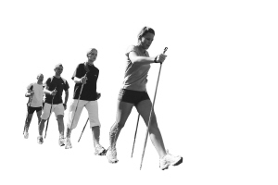
WALK WALK WALK! The important word should be said for three times.
Walking is really healthy,.In addition, it’s also very friendly to the environment.

Slide 6
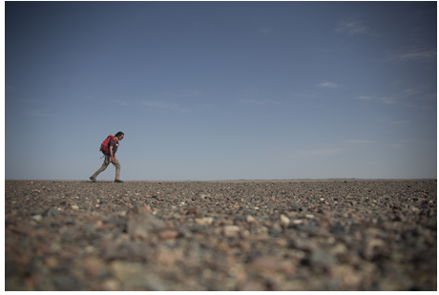
END
Background Music:
相信自己无限极 陈奕迅

