Slide 1

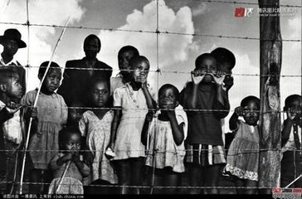
Unit 5 Reading
ELIAS’ STORY

Slide 2

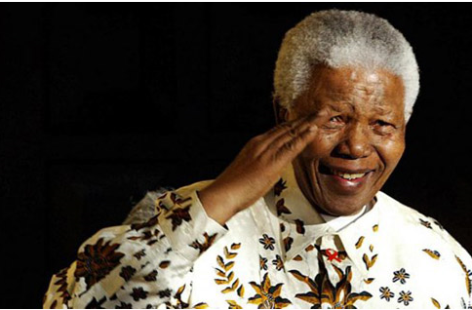

Slide 3
Skim Para.1 and fill in the blanks.
Elias:
black worker
a poor _____ ______ in South Africa
Nelson Mandela:
a _____ _______ who offered guidance to poor black people in South Africa
black lawyer

Slide 4
Skim Para.2 and answer the question.
Why did Elias visit Nelson Mandela? (Para.2)
Elias visited Nelson Mandela because he needed legal help. He was not legally allowed to work without a passbook.

Slide 5
Skim Para.3 and answer the question.
2. Why did Elias say it is the happiest day of his life? (Para. 3)
Because with Mandela’s help, Elias could stay in Johannesburg. He became more hopeful about his future.

Slide 6
Skim Para.5 and answer the question.
3. What was the unfair situation black people faced？(Para.5)
They could not vote or choose their leader.
They could not choose where to live, their jobs or their homeland outside the city.

Slide 7
Use adj.(s) to describe the changes of
Elias’ life Elias’ feelings
Para.2
sad, hopeless, worried
difficult, worrying, poor
Before E met M
Para.3
happiest
M helped E
hopeful
Para.7
dangerous, meaningful
E joined ANC
proud

Slide 8

Find out the great qualities of Mandela according to the passage.

Slide 9
Examples
He offered guidance to poor black people on their legal problems.
Helpful

Slide 10
Read Para.6 and find out the qualities of Mandela
We were put into a position in which we had either to accept we were less important, or fight the government. We chose to attack the laws. We first broke the law in a way which was peaceful; when this was not allowed … only then did we decide to answer violence with violence.
Brave, Determined & Unselfish

Slide 11
Homework: （Textbook）
Read the passage on P38
Exercise on P70 T1.2

