Slide 1
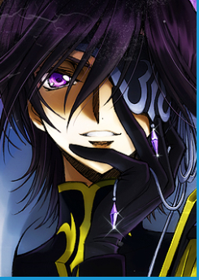
Code Geass 反叛的鲁鲁修

Slide 2
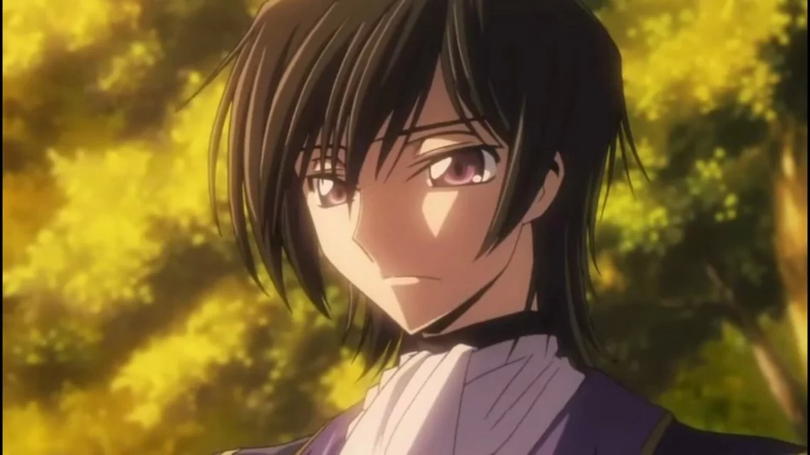
11th son his dad expelled him
He was allocated to the 11th colony of British——Janpan

Slide 3
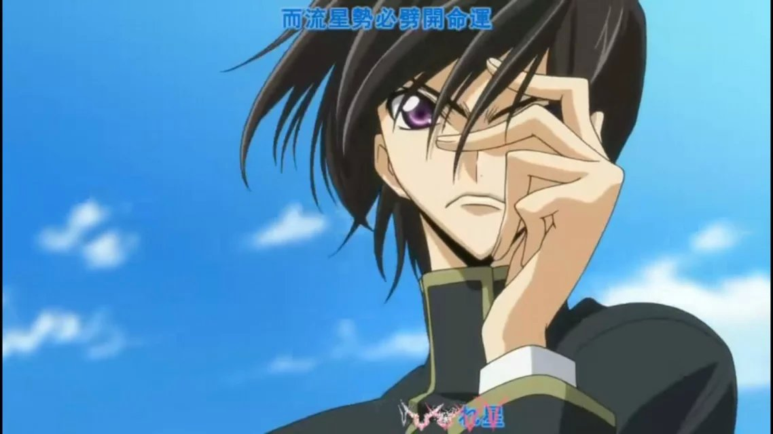
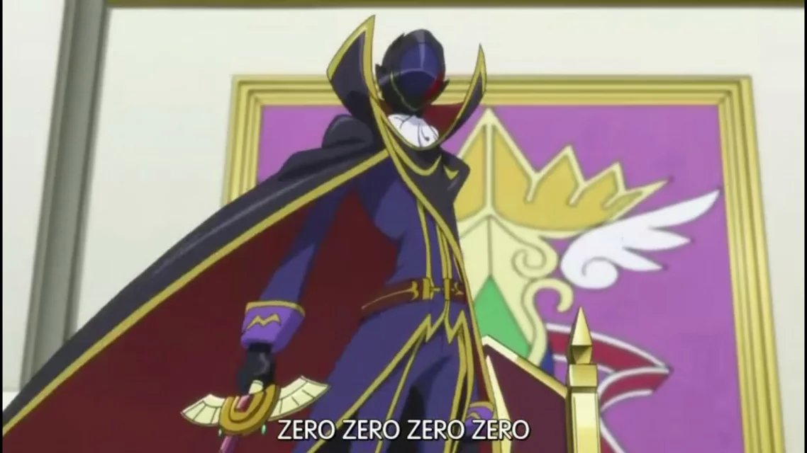
Student
Brilliant
handsome
Zero
Leader of
black
knights

Slide 4
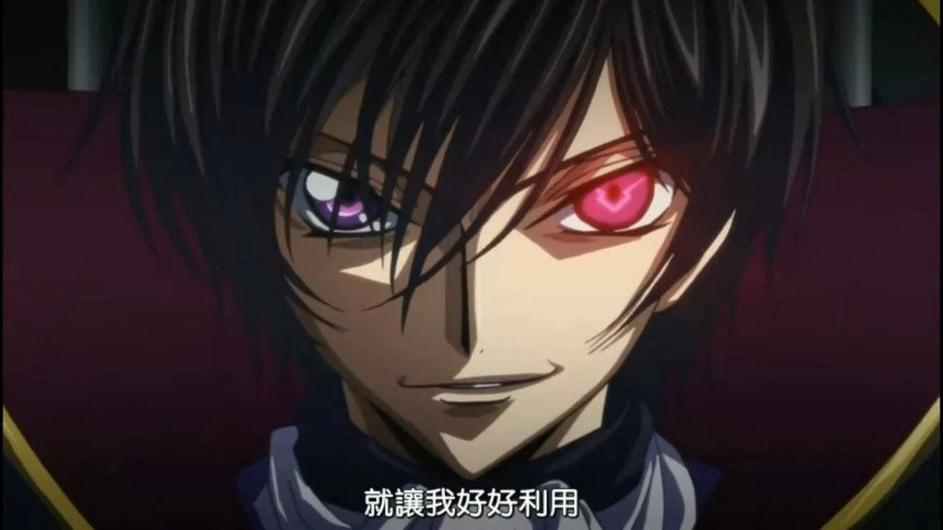
Geass—he can order anyone to do anything once including himself

Slide 5
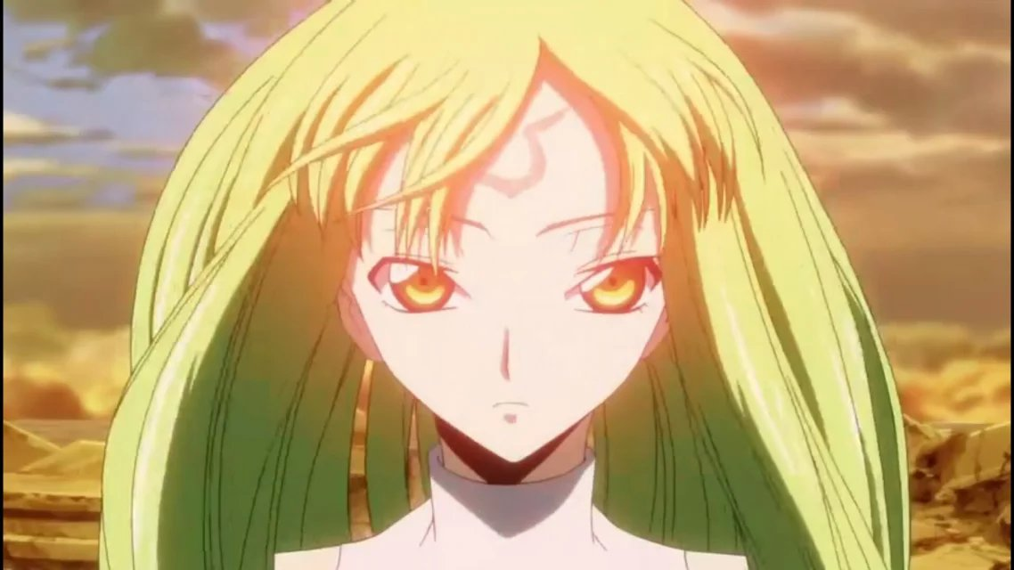
Code lovely and endless C.C

Slide 6
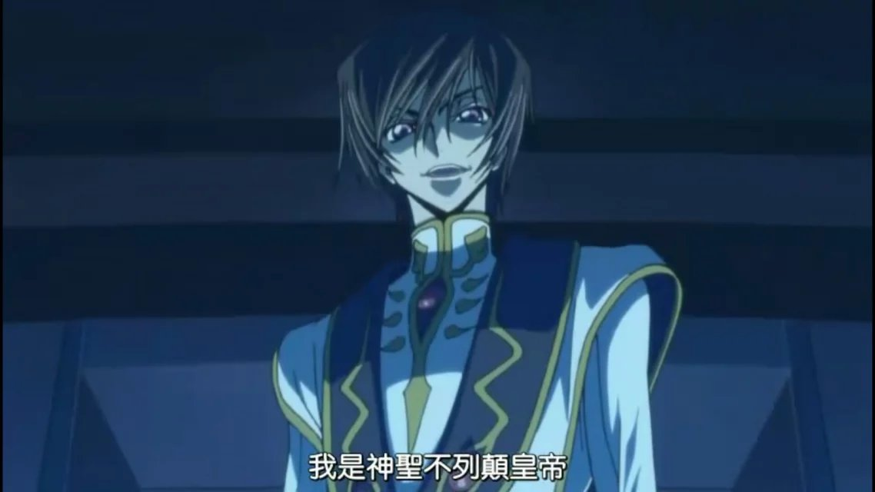
With the help of CC
King

Slide 7
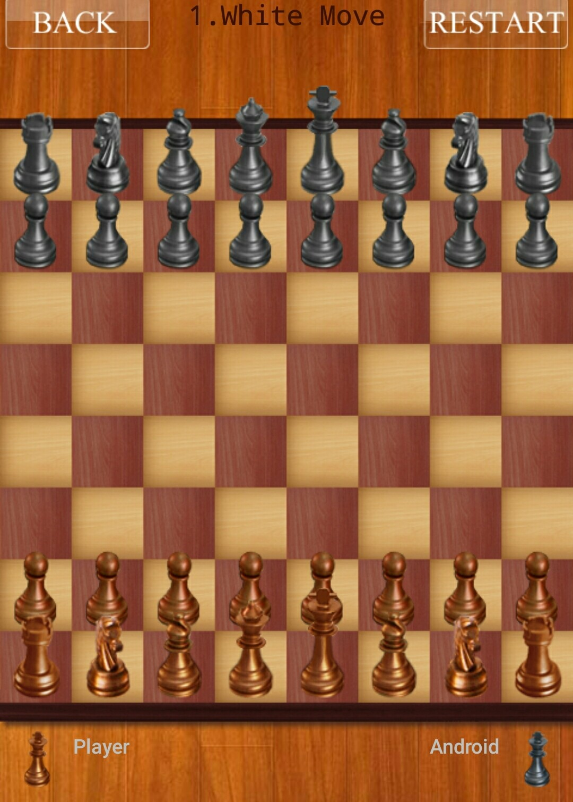
He is good at chess, but he doesn't do well in sports and he believes
王不走，部下怎么会跟上.

Slide 8
Let’s see his end

Slide 9
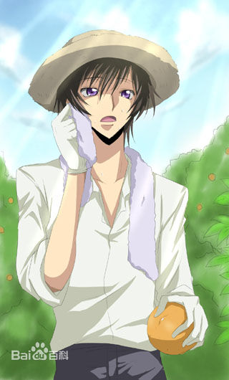
He has become
code from geass by killing the other code—his dad finally
Endless
He went to have privacy withC.C

Slide 10
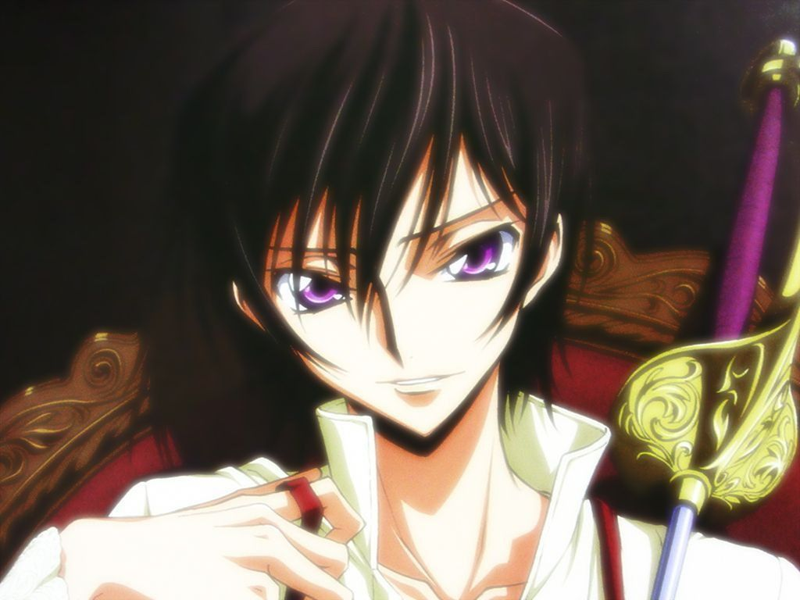
Conclusion
This tells us
Peace
warn war lll
He broke the world and rebuilt a peaful word by his life.He is great.

