Slide 1
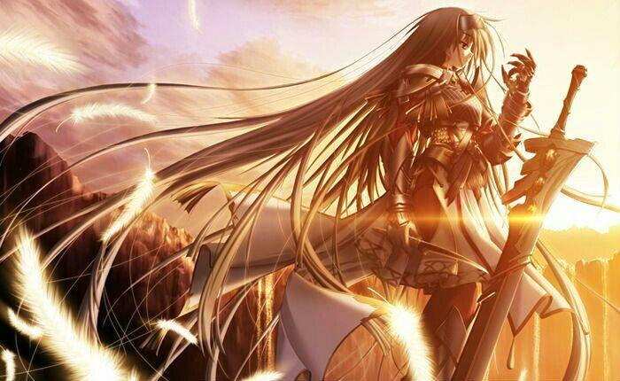
Believe

Slide 2
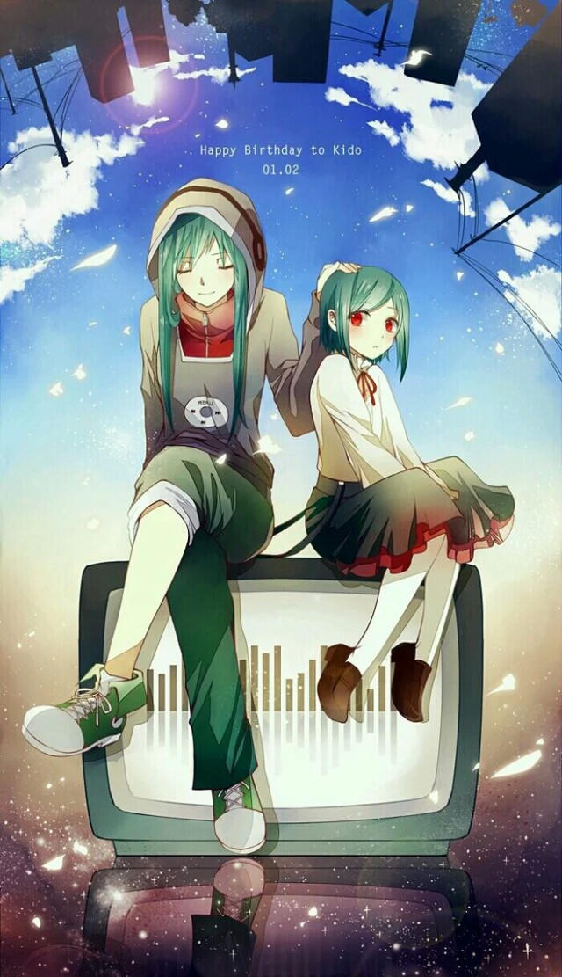

Do you believe youselves?

Slide 3
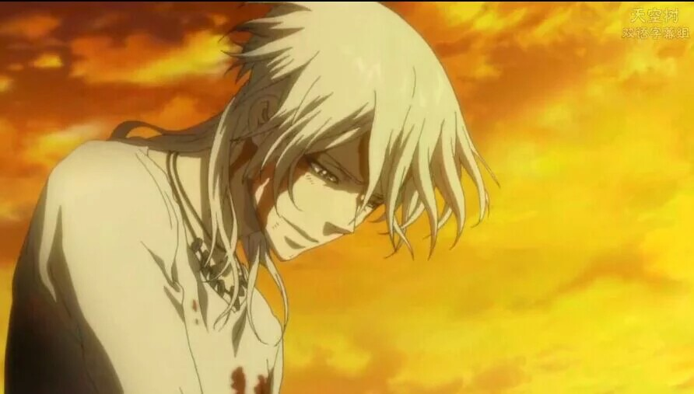
If we don't belive ourselves,we will fail

Slide 4
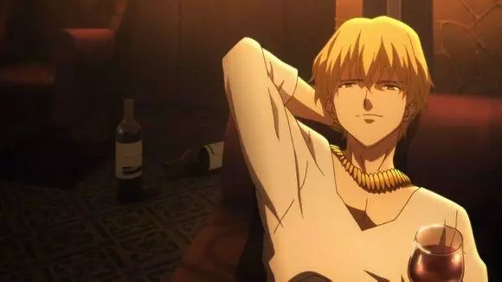
Archer

Slide 5
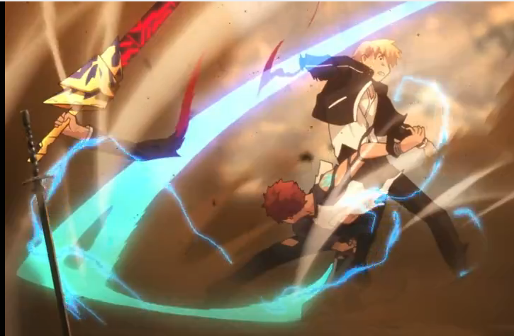
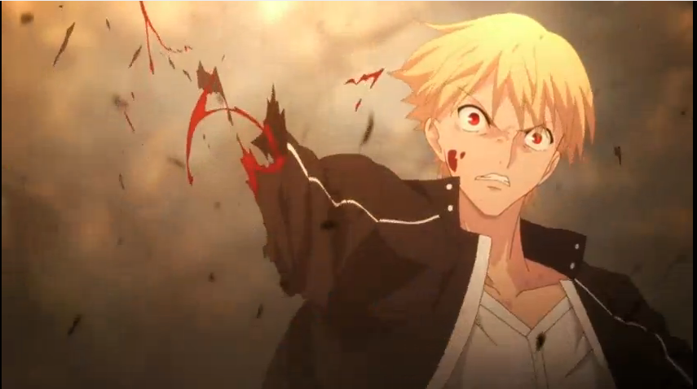

Slide 6
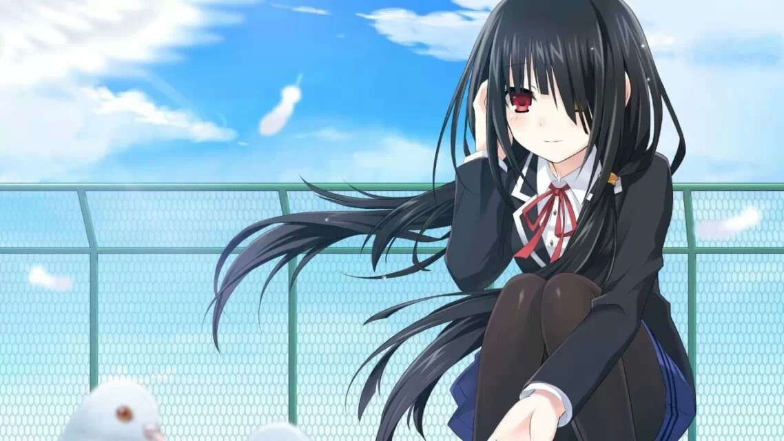
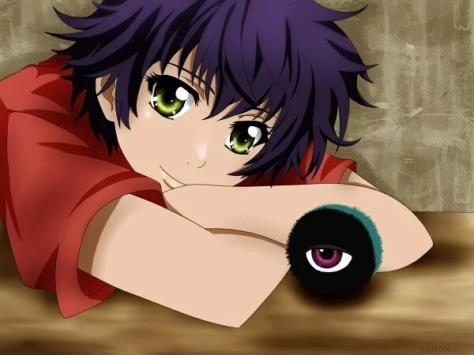
Maybe you will say it's only animation,so let's see a real story.

Slide 7
http://m.iqiyi.com/w_19rsg4x5j1.html?msrc=6_55_97&bd_source_light=2104633

Slide 8
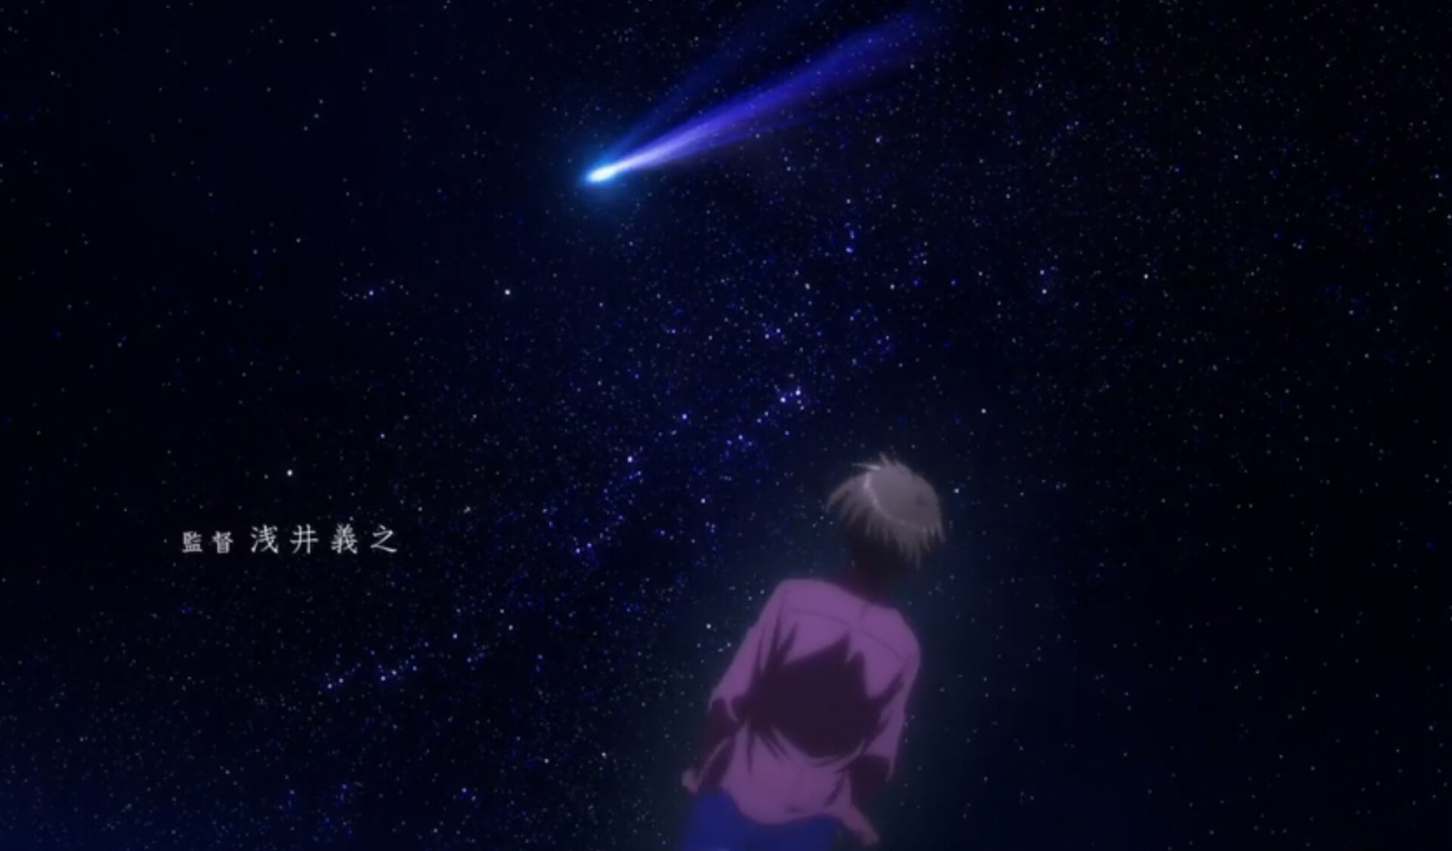
In a world,we should believe ourselves.Then we'll have strength we need and make magic

