Slide 1
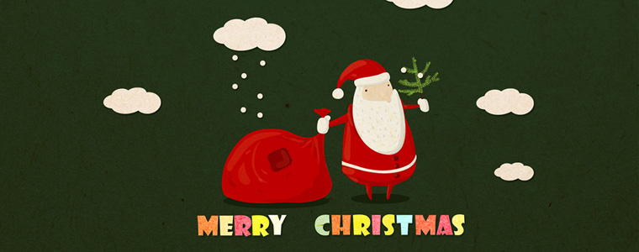

Slide 2
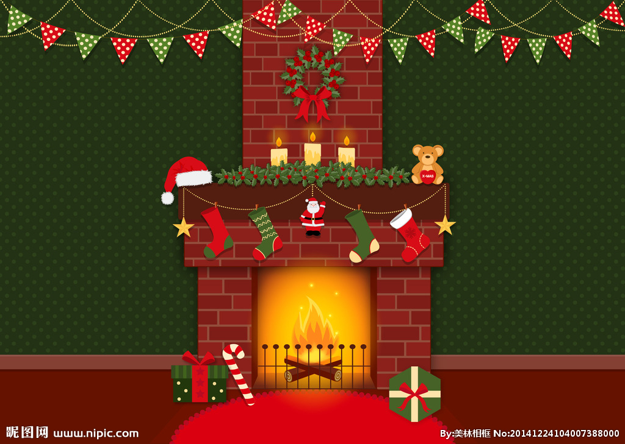

Slide 3
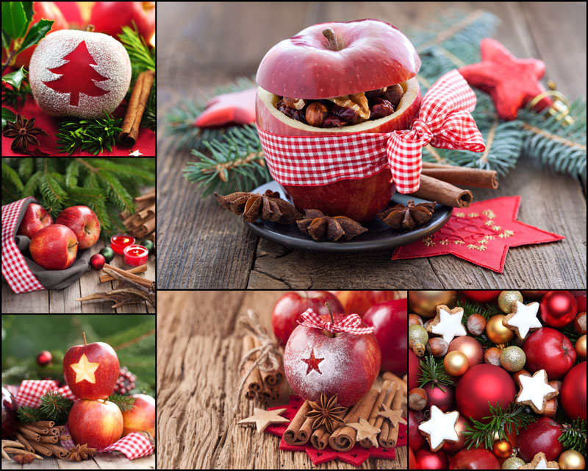

Slide 4
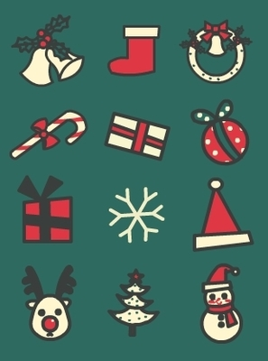
Christmas gifts
Little bell
Christmas hat
candy cane
snowman
Christmas tree

Slide 5
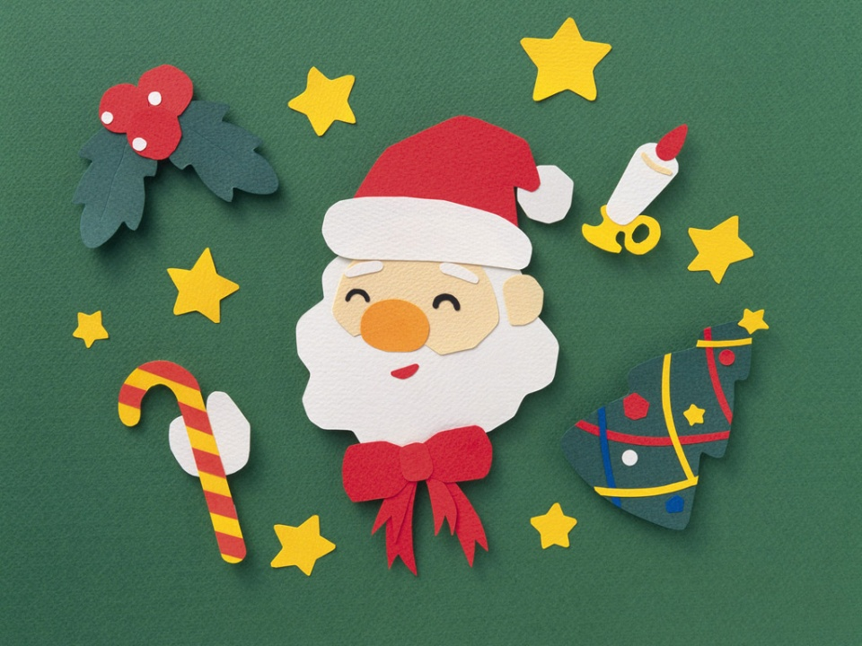
Santa

Slide 6

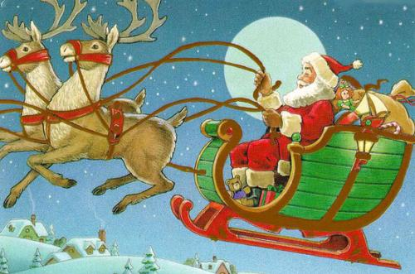
reindeer
Full of gifts
sleigh
chimney

Slide 7


Slide 8
Thanks for listening!

Slide 9
http://www.tudou.com/programs/view/Mc4ytveKW1A/

