Slide 1

SpongeBob Squarepants

Slide 2

Introduction
One of the most famous cartoon
Has been on TV since 1999
Stories of SpongeBob and his friends
Humorous、educational and full of imagination

Slide 3


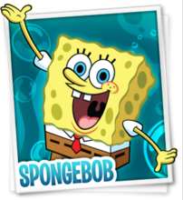
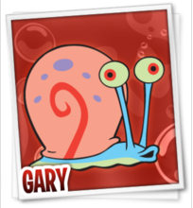
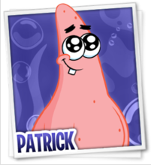
Main Characters
Lives in a pineapple under the sea
The cook of a fast-food restaurant
Has a pet snail called Gary
Always is positive and also causes many troubles
Has an extraordinary talent in music and art
Has a low IQ and a strong body
Lives under a huge stone next to SpongeBob
Lazy and childishness (孩子气)
The best friend of SpongeBob

Slide 4
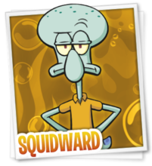
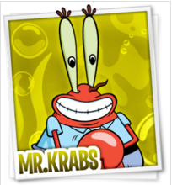
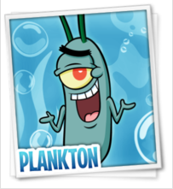
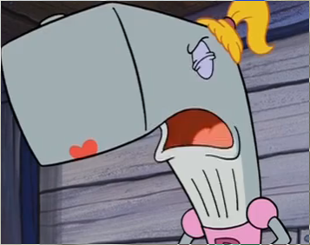
Main Characters
Easy to be angry and thinks he is the best in the world
Lives between SpongeBob and Patrick
Hates SpongeBob and Patrick but sometimes feels bored without them
Very selfish and greedy for money
Daughter is a whale called Jenny
Owns a fast-food restaurant named The Krusty Krab
Competitor in business is Plankton

Slide 5
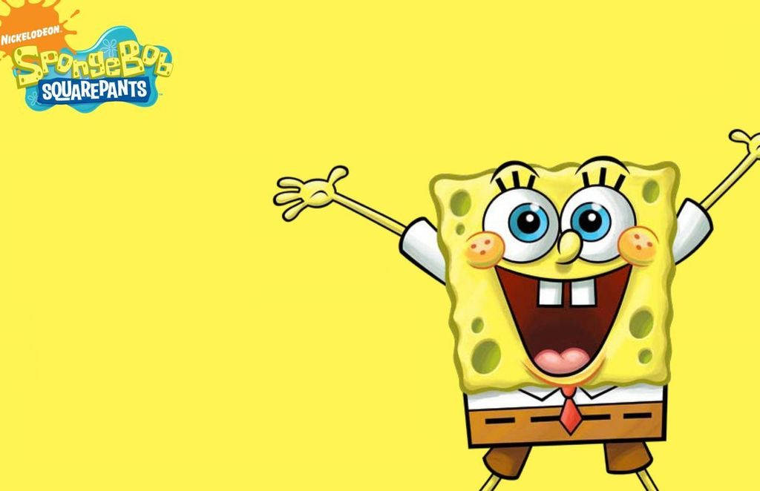
Now let’s watch a period of the first set .

Slide 6
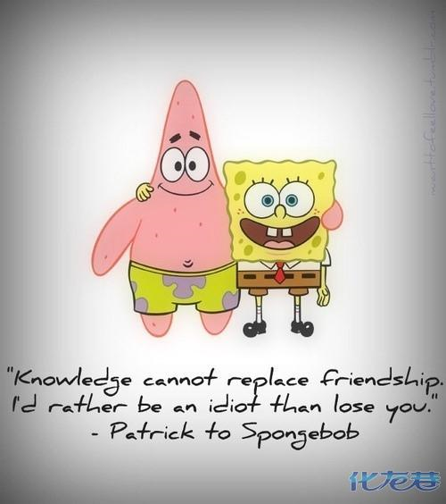

Slide 7
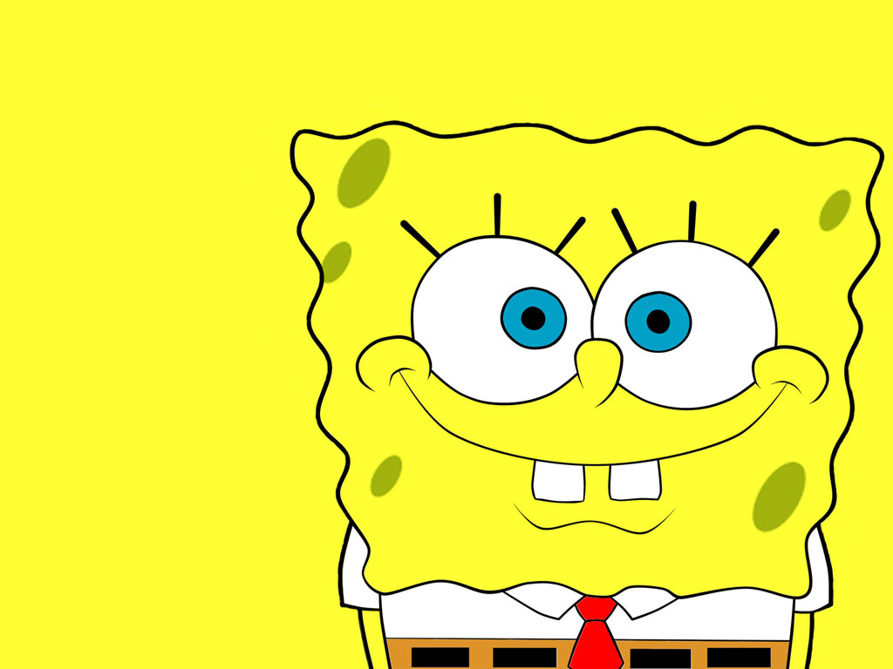

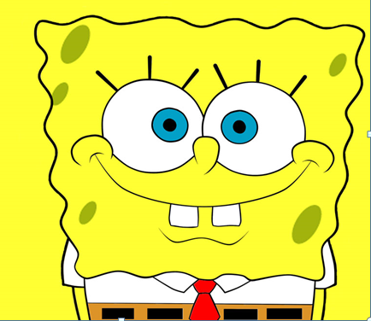
Thanks for watching!

