Slide 1


Slide 2

the sun

Slide 3
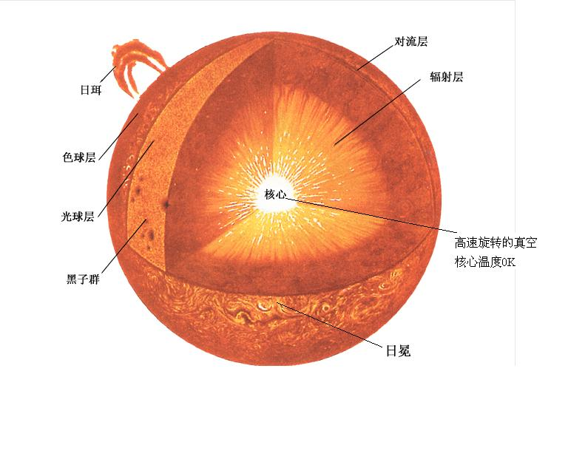

Slide 4
..\宇宙解码.How.The.Universe.Works.S01E04.2010.Stars.BD.MiniSD-TLF.mkv

Slide 5
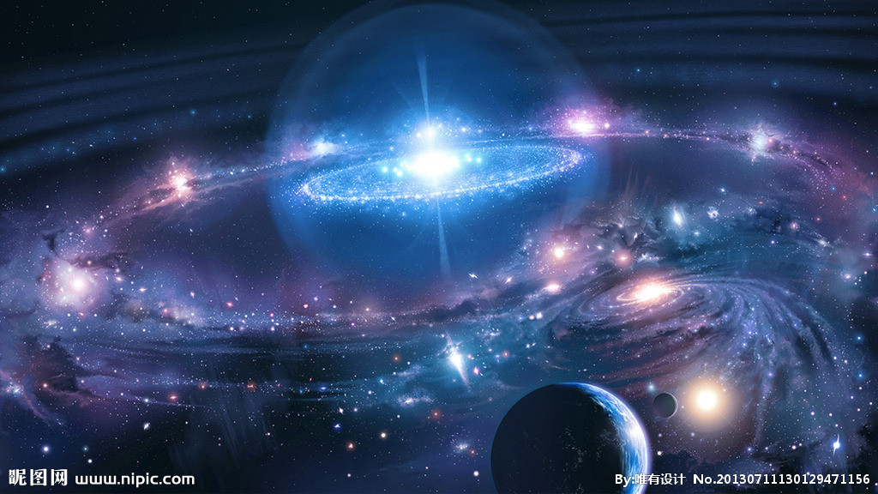
The universe is endless

