Slide 1


Slide 2
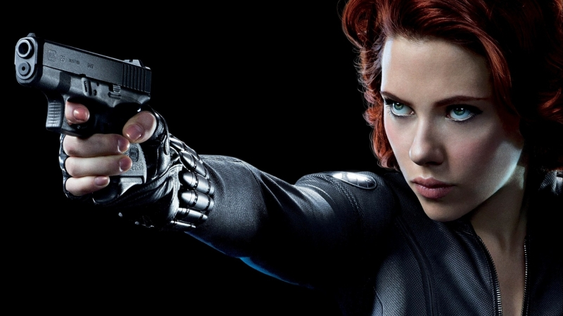
Black Widow

Slide 3
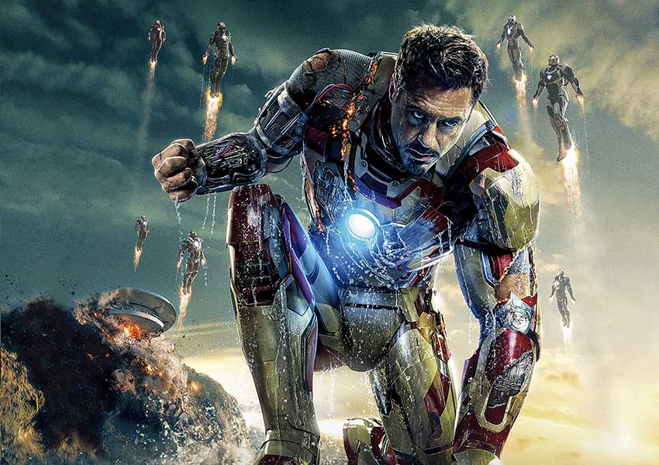
Iron Man

Slide 4
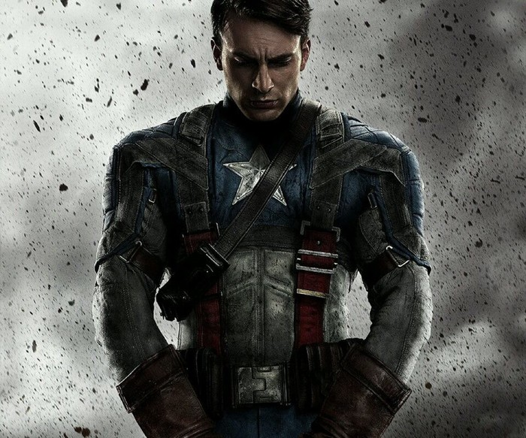
Captain America

Slide 5
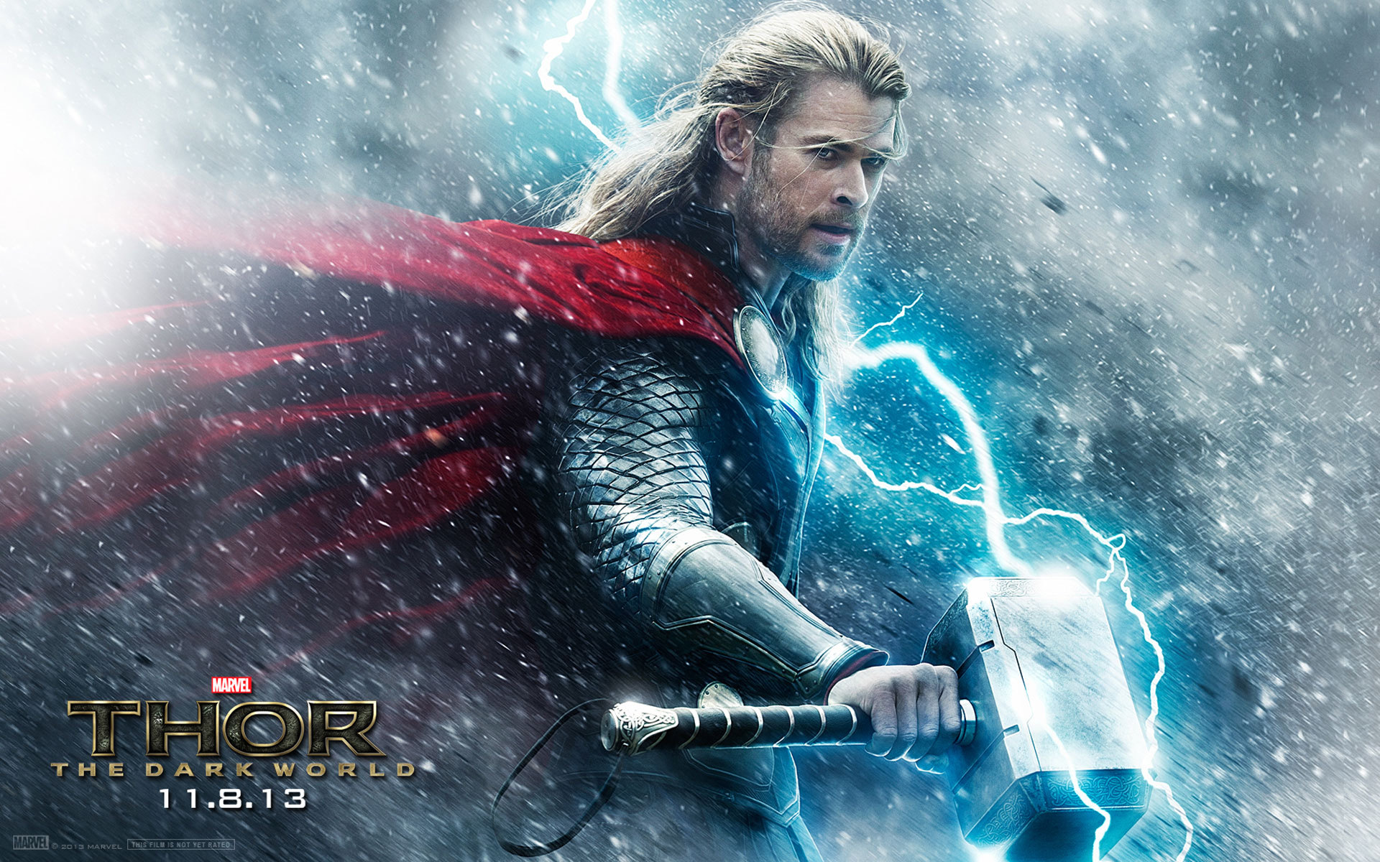

Slide 6


Slide 7
THANK YOU FOR LISTENING.
http://www.bilibili.com/video/av2483004/
Notes:
模板来自于 http://docer.wps.cn

