Slide 1


Slide 2
Movie
By Eric

Slide 3
1. The history of movie
2. My favourite movie

Slide 4
The great inventions in the world always come originally from something interesting , and so are the movies.
Once upon a time , two men in a hotel in California had a debate . The topic of the debate was “if a horse always has one horseshoe on the ground even when it is running .” Their debate didn’t reach an agreement. So they went to a stud-farm to see the horse running, but the horse ran so fast that they could not see it clearly.

Slide 5
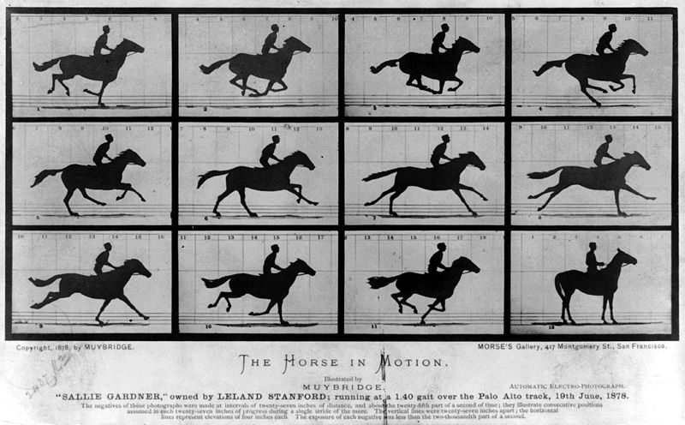
A cameraman from England had an idea. He put 24 cameras on one side of the track . On the other side , he set 24 wooden poles and tied lines between each camera and each wooden pole . When the horse ran along the track . It broke lines and the cameras took photos of the horse . The pictures showed that the horse was always put one of its horseshoe on the ground.
The debate was over then, but the photos were kept. Once the cameraman showed the photos frequently by accident , he found that the “horse” moved.
In 1887, Edison invented the first projector.

Slide 6
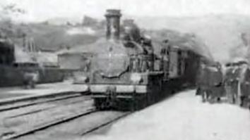
On December 28th 1895 , the Lumiere(卢米埃尔) Brothers produced the first movie——<The arrival of a train>. So , people call that day as the birth of the movie.
As time passed, more and more movies were produced , and the movies with sound and the moives with colour were produced in 1927 and 1935.
The film developed into an art form gradually.

Slide 7
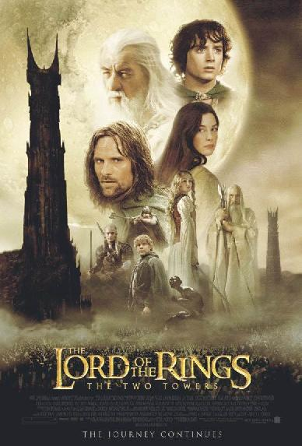
The first digital film was produced in 1966 in America. As the appearance of the digital films , movies have moved into a new world. Many special effects could be done which couldn’t exist in the old movies . The series of movies<The Lord Of The Rings> are the most famous digital films.

Slide 8

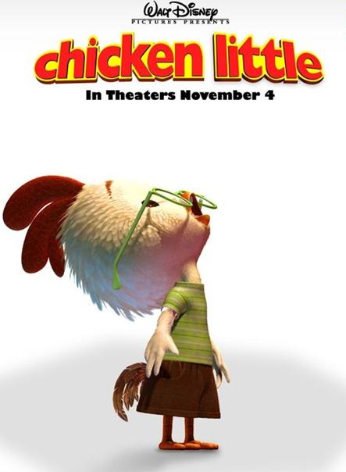

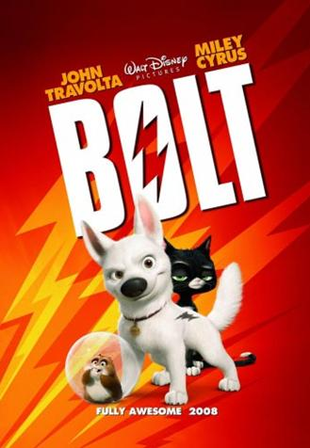
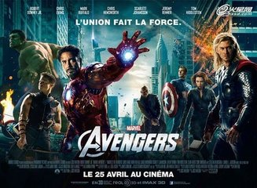
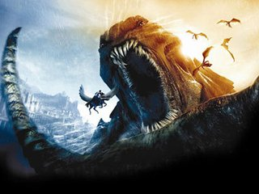

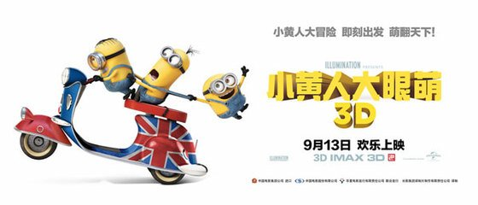
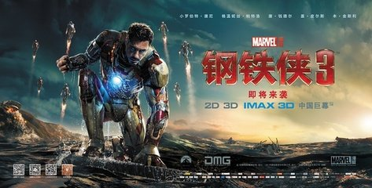
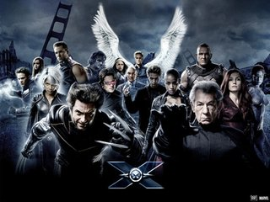
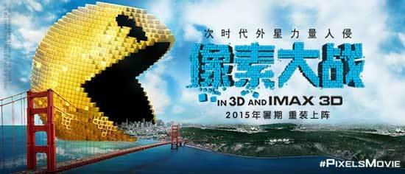
When we talk about movies , our first respond is 3D movies. This kind of movies were first shown in 2005.
It shows people a more reality and more exciting experience .

Slide 9
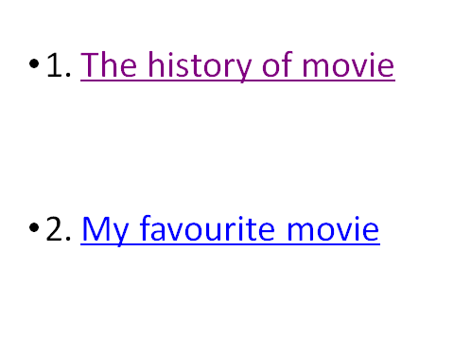

Slide 10


