Slide 1
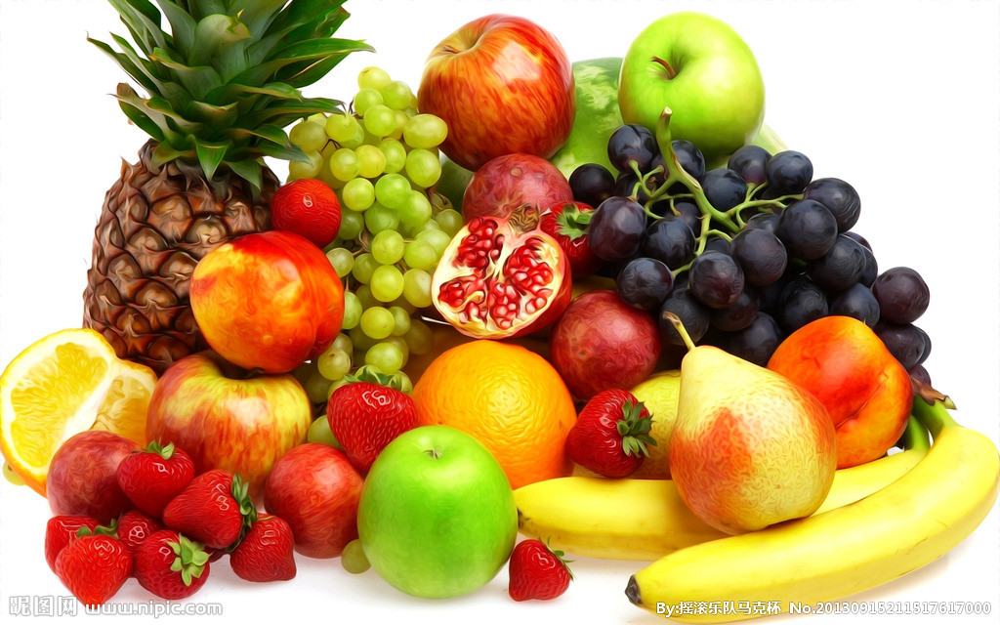
The advantage of eating fruits

Slide 2

Question
Why should we eat fruit
Everyday?

Slide 3
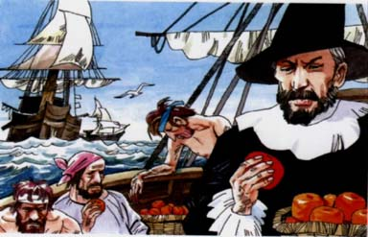
Hundreds of years before , sailors who often travelled on the sea suffered from scurvy(坏血病）
Sailors who had this illness always bleeding from mouth or even bleeding from skin. And
Died in pain at last. Everyone was worried about this kind of strange disease but had no
Idea to solve this problem.
Finally, a doctor who worked on ship found the reason of this kind of disease. The reason
is sailors always were away from land, they seldom went to shop on land to buy fresh
fruit .He tried to let the sailors eat fresh orange everyday. As expected, their bodies
became healthy again.

Slide 4

So here are some fruits that
can be good for our health.

Slide 5
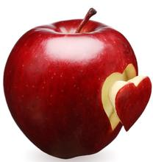
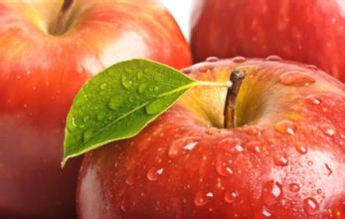
Apple
Apple can promote our bodies produce
Acetylcholine(乙酰胆碱),which can make
our cells in brain connect with each other
faster. It means we can think quickly.

Slide 6
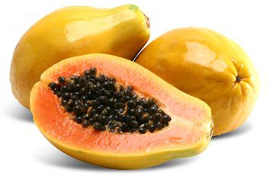



Papaya
Papaya can promote digestion(消化） of us. it is
easy to digest, too. It make us feel relax after we
eat it. Papaya also has an ability of improving our
look.

Slide 7
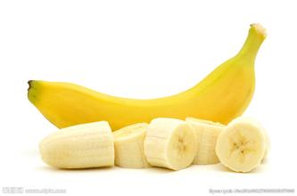

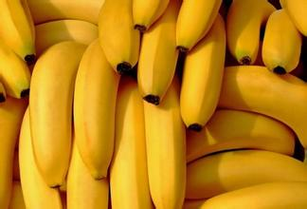
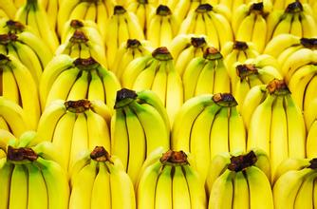
Banana
As you know, eating banana is not only a healthy
thing, but also a interesting thing.

Slide 8
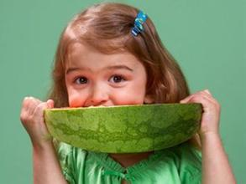




Summary
Eating fruits everyday is important for us. By eating enough fruits everyday, we will have
enough power and plenty of energy to face the heavy school work

Slide 9
THE END

