Slide 1
presentation
·This is the second time for me to do the presentation.
·Please kindly give your advice!(请多指教)

Slide 2
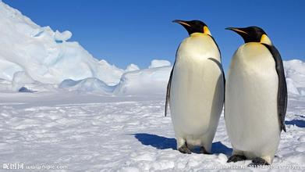
-----------BY cao jing
Penguin

Slide 3
First Of All
Introduction

Slide 4
Penguin(the name of the animal)
Penguins are one of the oldest Waterfowls(游禽),which have a beautiful name of “the boat of the seas ”. Also, they are the largest birds, this kind of which are unable to fly. However ,at least, they have the ability of gliding(滑翔).
They are likely to settle down in Antarctica before the Earth is fully covered with ice and snow. They have lived in the Earth for a long time and developed a series of their own civilization.
There are 18 types of penguins in the world, and most of them live in Antarctica.

Slide 5
Penguins can still live in the icy environment , whose temperature is below -60°C.
On the ground, they live as if they were western gentlemen wearing tailcoat(燕尾服) .
In the sea, the small wings of the penguins change into a pair of power paddles, and the speed will maybe reach 25-30 an hour. Meanwhile, they could swim as many as 160km a day.
They usually feed on krill(磷虾), sepia(乌贼), little fish and so on.

Slide 6
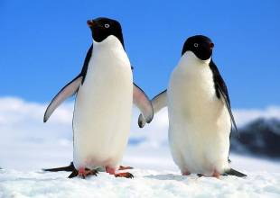
particularly
Penguins are generous and humorous. They look arrogant(高傲的), but if human beings come close to them, they will not escape confusedly. Instead, they keep doing what they are doing or going to do. In addition , their amusing behavior will always make you laugh.

Slide 7

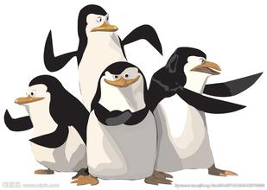

About Entertainment
You maybe certainly think of………
Or………
What about a movie?

Slide 8
A video before ending~
(A cute Emperor Penguin baby)
http://www.bilibili.com/video/av3452423/

Slide 9
In The End

Slide 10
Thank you for you listening!

