Slide 1
A Trip To HK And Macao

Slide 2
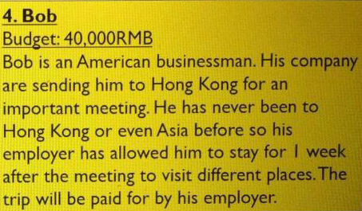

Slide 3
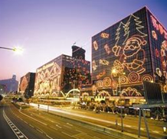
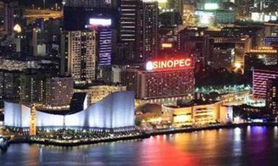
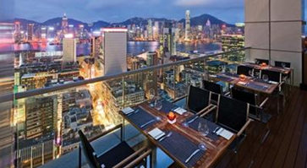
Hong Kong
Hotel：Gangqing Hotel(Including Breakfast RMB1827/day , 3days)（RMB2101 including tax）
Address：Tsim Sha Tsui, Hong Kong

Slide 4
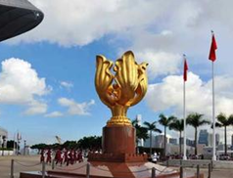
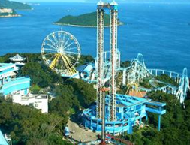
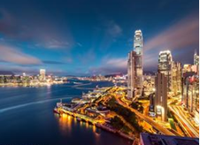
The first day：（chartered car：RMB600）
1. To Tsim Sha Tsui，check the hotel
transport： chartered car
2.Golden Bauhinia Square，(flag-raising ceremony7:50-8:03)
transport ： chartered car
3.Ocean Park
transport： chartered car
Price：RMB280
4.Victoria Harbor
transport ： chartered car
Price：RMB188
5.Back To Hotel
#In Total：RMB1068

Slide 5
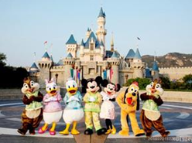
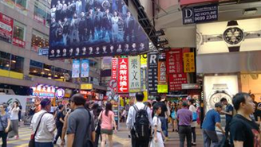
The second day：(no car)
1.Disneyland
transport：subway，price：HKD4.7
ticket：RMB450
2.Shopping in Mong Kok
transport：subway ，price：HKD4.7
3.Back To The Hotel
transport：subway price：HKD4.5
#In total：RMB462

Slide 6
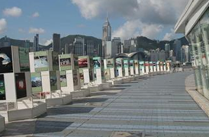
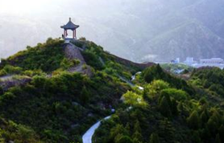
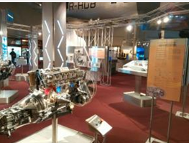
The third day：(chartered car ：RMB600)
1Avenue of Stars
On foot
2.The Peak
transport： chartered car
Price： RMB60
3.Central
transport： chartered car
4.The Hong Kong Science Museum
transport： chartered car
Price ：RMB25
#In total：RMB685

Slide 7
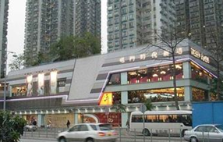
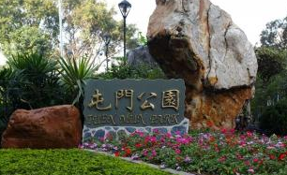
*The fourth day ：（no car）
1.Tuen Mun Park
transport：subway，price ：HKD5.4
2.Tuen Mun Square
3.To Macao
transport：subway ，price：HKD6.5
Steamer ticket：RMB145
#In total：RMB155

Slide 8
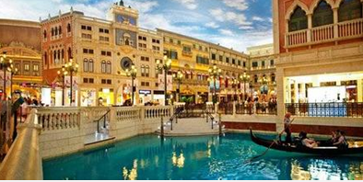
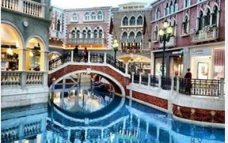
Macao
Hotel：Venetian Macao Resort Hotel RMB3558/day

Slide 9
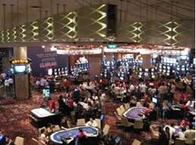
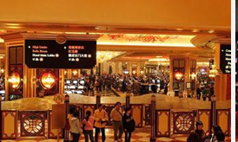
*The fifth day
1.Gamble inside the hotel
2. Eat at Guanye Street
By bus

Slide 10
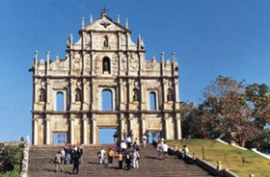
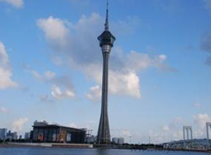
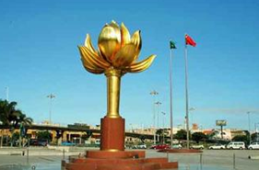
*The sixth day
1.Ruins of St.paul
By taxi（RMB50） price：RMB15
2.Macao Tower
By bus（RMB7）
4.Lotus Square
By bus（RMB5）
#In total：RMB82

Slide 11
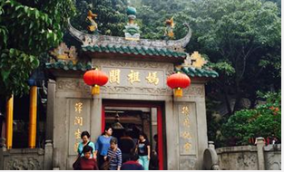
The seventh day
1.A-Ma Temple
By bus RMB5
2.Macao International Airport
The whole cost：RMB19429

Slide 12
Thank you!

