Slide 1
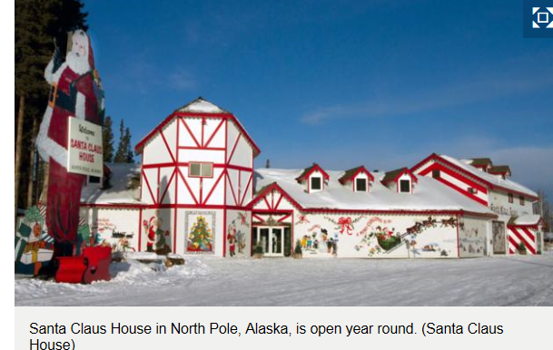

Slide 2
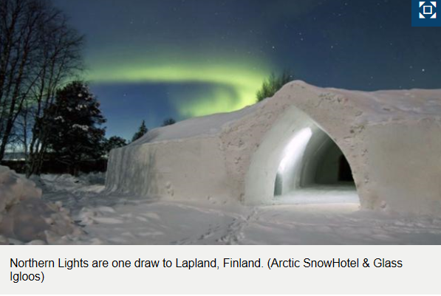

Slide 3
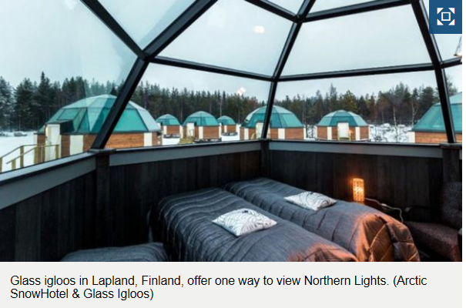

Slide 4
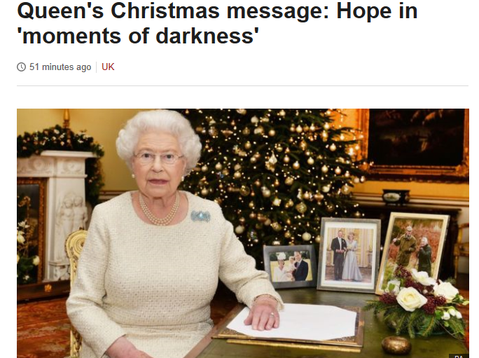

Slide 5
The Queen will speak of finding hope in "moments of darkness", during her annual Christmas Day address.
It comes after a year which has seen a number of terror attacks, such as the killing of 39 people at a Tunisian resort and mass shootings in Paris.
The Queen will describe the festive period as "a time to remember all that we have to be thankful for".

Slide 6
Her Majesty will say during her broadcast:
"It is true that the world has had to confront moments of darkness this year,
but the Gospel of John contains a verse of great hope, often read at Christmas carol services:
'The light shines in the darkness, and the darkness has not overcome it'."

Slide 7
https://mp.weixin.qq.com/s?__biz=MjM5MjcwODg0MA==&mid=402837861&idx=2&sn=74b71f0eb8fb5903e2a9283b6a9e6bd5&scene=0&key=62bb001fdbc364e544e2d44deb7afbe73942f5c91a59720514d7ff793fd3446f272812694c730d51cc9ad6754125dceb&ascene=1&uin=MTU3Njc4MTY4MA%3D%3D&devicetype=iPhone+OS9.2&version=16030811&nettype=WIFI&fontScale=106&pass_ticket=9qN9osbeQKf2iJ0AByu3MHe1wU768Wj%2Ba6lSlZfAHlAR7w%2FZmBB2R4b7bZ6vAwut#comment

Slide 8
http://mp.weixin.qq.com/s?__biz=MjM5MjcwODg0MA==&mid=402817685&idx=2&sn=603f627cbdde50f76053ca7c0541ad56&scene=0#wechat_redirect

