Slide 1
Teens Oct 30th

Slide 2
http://video.mtime.com/53759/?mid=206223

Slide 3
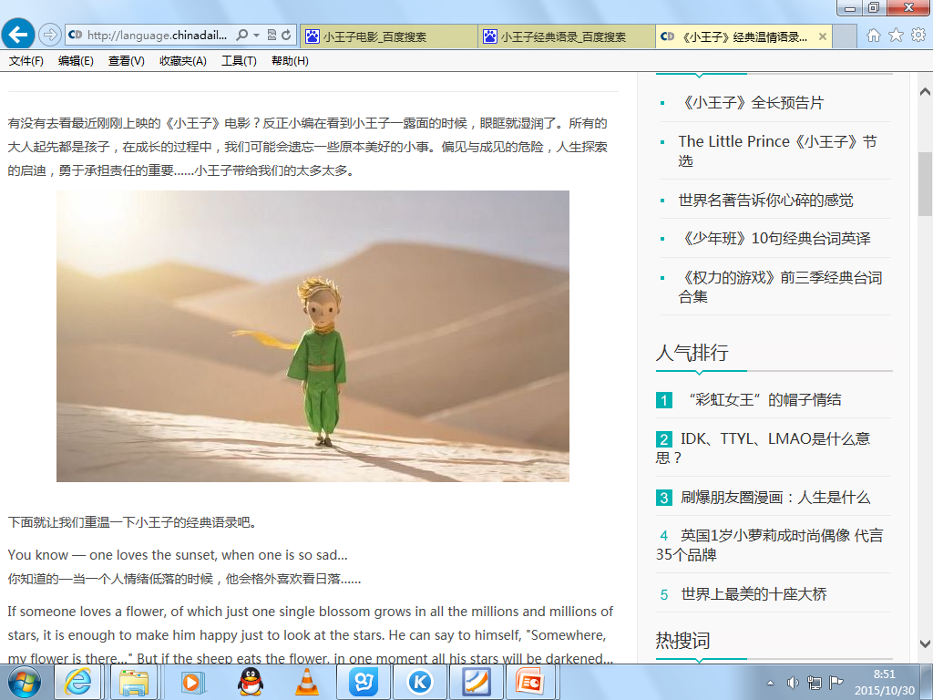
You know — one loves the sunset, when one is so sad…

Slide 4
It is the time you have wasted for your rose that makes your rose so important.
The most beautiful things in the world cannot be seen or touched, they are felt with the heart.

Slide 5
All men have the stars, but they are not the same things for different people.
For some, who are travelers, the stars are guides. For others they are no more than little lights in the sky…
But all these stars are silent. You – you alone – will have the stars as no one else has them…

Slide 6
To me, you are still nothing more than a little boy who is just like a hundred thousand other little boys. And I have no need of you.
And you, on your part, have no need of me. To you, I am nothing more than a fox like a hundred thousand other foxes.
But if you tame me, then we shall need each other. To me, you will be unique in all the world. To you, I shall be unique in all the world.

