Slide 1
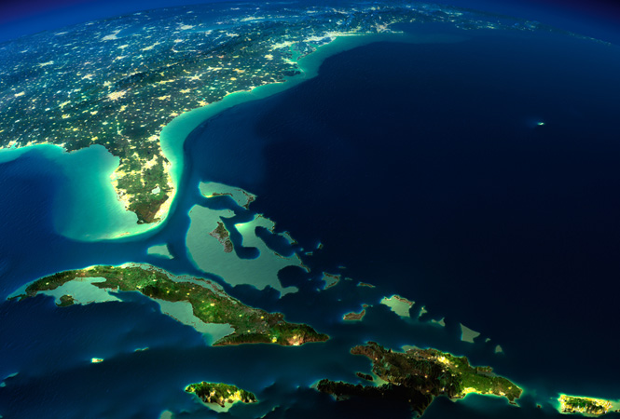
Bermuda Triangle

Slide 2
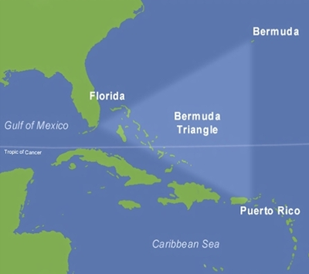
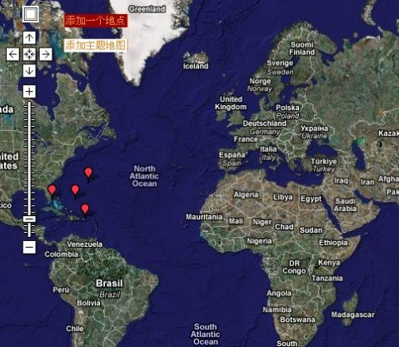
The so-called Bermuda Triangle, refers to the North from Bermuda, the West Island to Miami（迈阿密）, Florida（佛罗里达洲）, south of Puerto Rico（波多黎各岛） a triangular area.

Slide 3
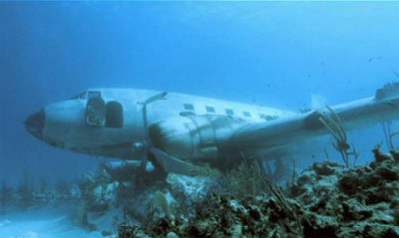
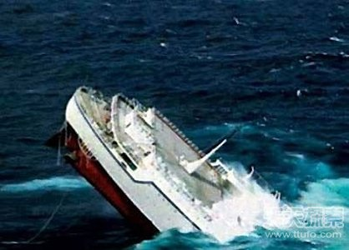
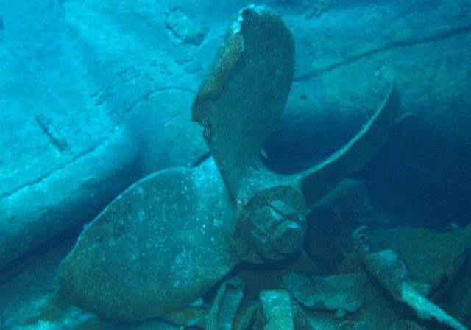
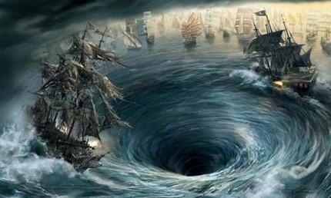
D
E
A
T
H

Slide 4
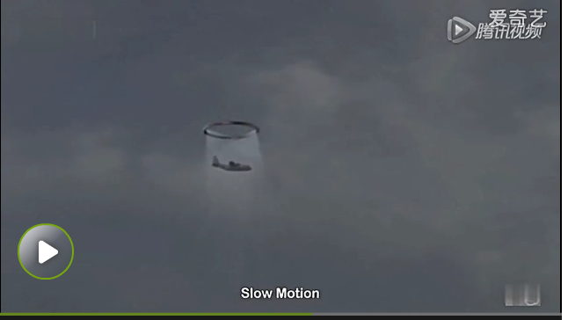

Slide 5
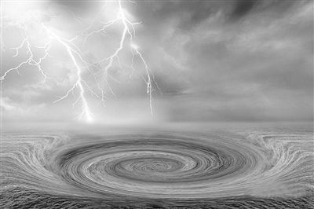
There has been such a strange thing in the Bermuda Triangle, a ship of the Soviet （前苏联） submarinea minute ago in Bermuda waters navigation, a minute after floating on the surface of the water actually in the Indian Ocean（印度洋）. It spanning almost half a world voyage, a submarine and 93 crews all of a sudden the aging of five to twenty years(衰老五至二十岁）.

Slide 6
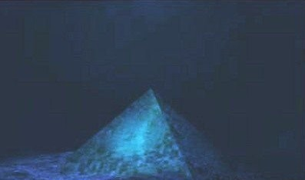
In 1954 in the Caribbean, 2 driver was piloting the balloon like other fifty entries for the balloon overseas competition. And the weather was fine, vision was clear. Suddenly, as many people seen, the balloon suddenly disappeared. In 1990, the balloon which had disappeared for 36 years suddenly land on the sea in Cuba and North American .
The two pilots just felt a slight tingling sensation in the body, like a weak current flows through the body.Then everything has changed.

Slide 7
http://v.youku.com/v_show/id_XMzI1ODYxMTA4.html?from=s1.8-1-1.2

Slide 8
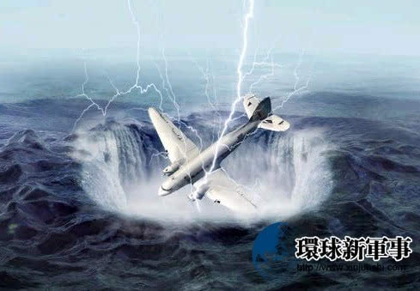
Reason
1. black hole
2.run on rock
3.whirlpoor(漩涡)
……

Slide 9
AT LAST

Slide 10
THANK YOU!

