Slide 1
Buildings

Slide 2
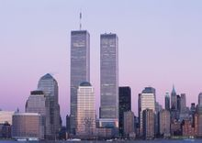

Slide 3
One World Trade Center
The latest addition to New York's skyline, the One World Trade Center, is the tallest skyscraper in the Western Hemisphere. Construction began in April 2006 and the final component of the building's spire installed five years later in 2013, making it the fourth tallest skyscraper in the world.

Slide 4
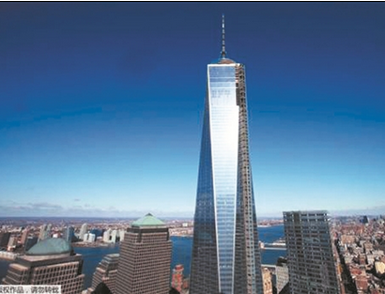

Slide 5
Petronas Towers
Standing at 170 metres above ground, the Petronas Towers are twin skyscrapers in Kuala Lumpur, Malaysia. The buildings, which held the titled of tallest in the world between 1998-2004, are an iconic landmark of the capital city.

Slide 6
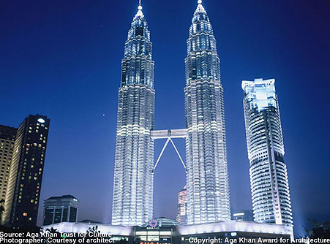

Slide 7
Leaning Tower of Pisa
The Leaning Tower of Pisa is one of the most remarkable architectural structures in Europe. Most famous for its tilt, the tower began to lean during construction after soft ground on one side was unable to properly support the structure's weight.

Slide 8
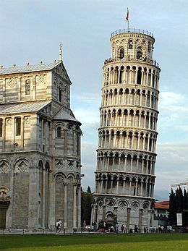

Slide 9
Sydney Opera House
Sydney Opera House is widely regarded as one of the greatest architectural works of the 20th century. The innovative design came from architect Jørn Utzon, who was relatively unknown until January 29, 1957 when his entry to the 'International competition for a national opera house at Bennelong Point, Sydney' was announced the winner.

Slide 10
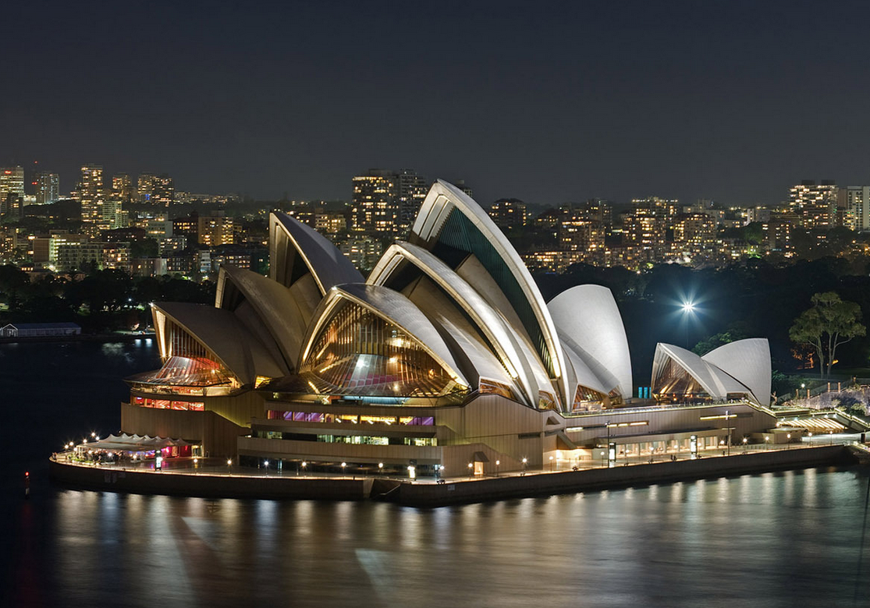

Slide 11
Burj Khalifa
Last on our list – but by no means the least – is the world's tallest building Burj Khalifa. The mammoth skyscraper and magnificent centerpiece of Downtown Dubai stands at a whopping 828.9 metres high.

Slide 12
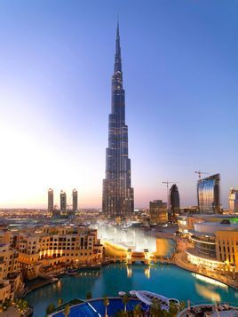

Slide 13
conclusion
There are various of buildings in the world, and all of them are beautiful. We should stare at them and protect them.

