Slide 1
Companies fight fake news
&Internet giant——Facebook

Slide 2
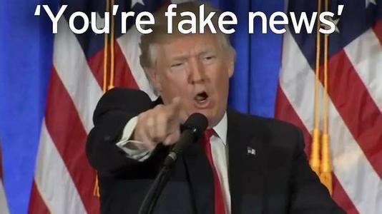
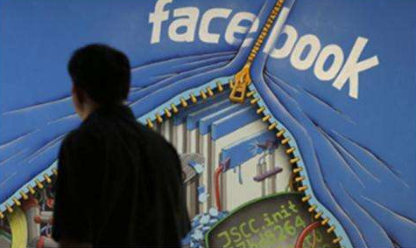
During the 2016 American presidential election ,fake news spread quickly on social media.

Slide 3
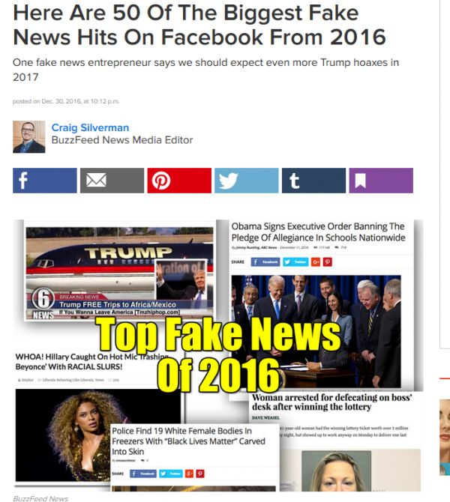
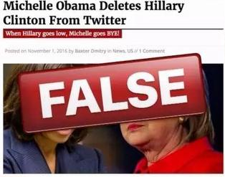
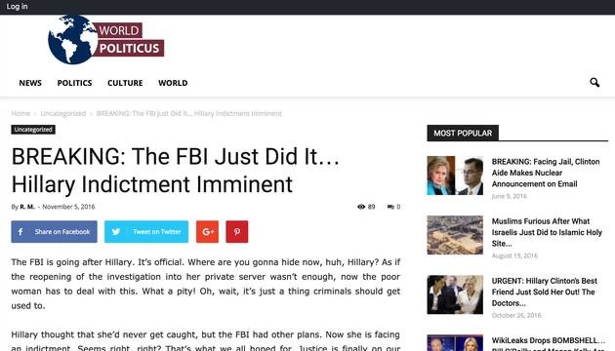
Actually, Sundar Pichai, Chief Executive Officer at Google, admitted that these factually inaccurate and outright false articles could have affected the outcome of the US presidential election.
In addition to that, Google’s CEO admitted that there have been several cases of fake news related to the US presidential election which Google didn’t handle right.

Slide 4

Facebook
Facebook (FB) is an American for-profit corporation and online social media and social networking service based in Menlo Park, California. The Facebook website was launched on February 4, 2004, by Mark Zuckerberg, along with fellow Harvard College students and roommates.
Facebook may be accessed by a large range of desktops, laptops, tablet computers, and smartphones over the Internet and mobile networks.

Slide 5
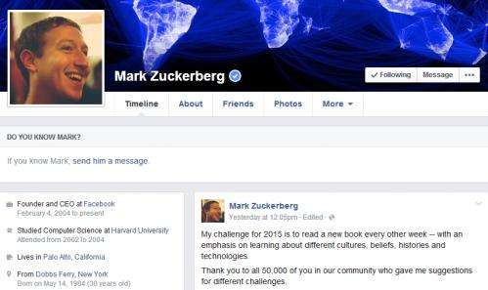
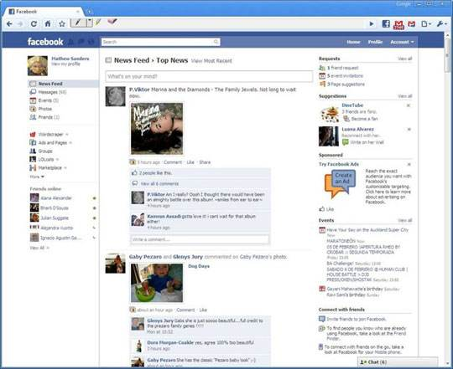
After registering to use the site, users can create a user profile indicating their name, occupation, schools attended and so on. Users can add other users as "friends", exchange messages, post status updates and digital photos, share digital videos and links, use various software applications ("apps"), and receive notifications when others update their profiles or make posts.

Slide 6
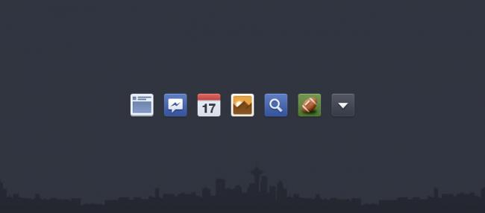
Thank you

