Slide 1
Presentation
Words and expressions
BE

Slide 2
假定你是李华，想毕业后去美国的大学学习。你在网上了解到了Prof. Green，给他写一封e-mail，表示对他的研究领域及课题感兴趣，并请他指导如何选择他所在大学的专业（major）。
注意：
词数100左右；
可适当增加细节，以使行文连贯；
邮件的开头与结尾已为你写好。
Dear Prof. Green,
I am Li Hua, a high school student from China. ___________________
Yours,
Li Hua

Slide 3
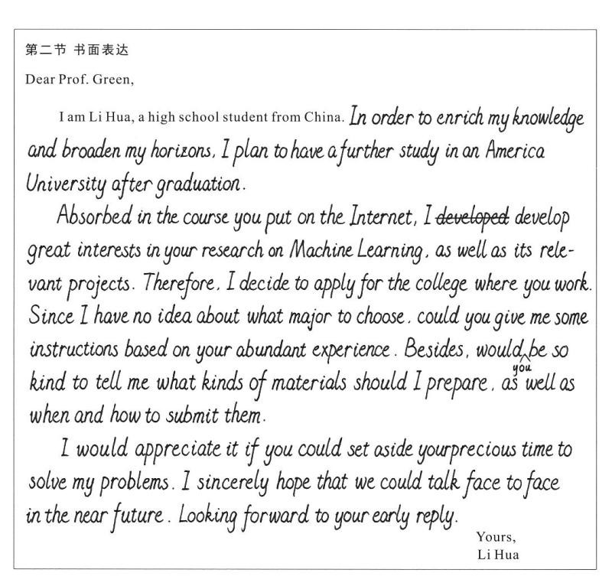

Slide 4
24.5分 考号：0303209090
Dear Prof. Green,
I am Li Hua, a high school student from China. I am interested in your academic field and research project, and I am writing to ask you for help to instruct me to apply for the major in your university.
Since I will graduate from my high school soon. I would like to study in the US to further my study and broaden my horizons. As a top student, I am an advanced English learner and have a good command of academic skills, which enables me to adapt the life in the foreign university quickly. Most importantly, I have a preference for your academic field and I am eager to major in it. However, it is not familiar to me to apply for the major, and I sincerely hope that you could do me a favor.
I would appreciate it if you could give me constructive suggestions. I am looking forward to your reply.
Yours
Li Hua

Slide 5
Assignment
Dictation
BE 89-92

