Slide 1
First wealth is health. 健康是人生第一财富。 —— Emerson 爱默生
Please remember:

Slide 2
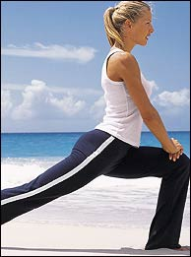
What’s a healthy person?
A truly healthy person should be healthy in both _____ and ______.
body
mind
A healthy life should include ________ and ______ health.
physical
mental

Slide 3
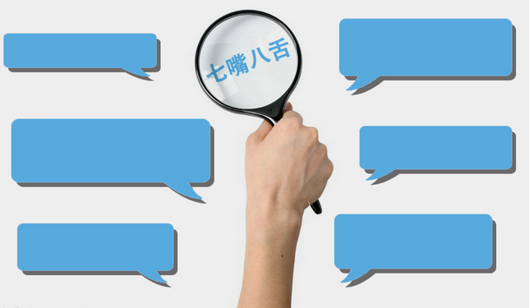
Discussion
What may do harm to our health? Why?
cigarette smoking;
alcohol drinking;
drug taking;
eating too much;
stress or too much pressure etc.

Slide 4
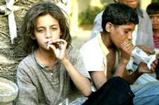
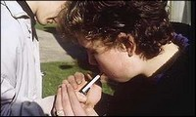
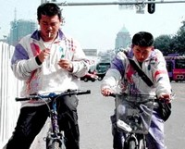
Why do you think some adolescents
start smoking?
feel lonely and boring
release their pressure
friends around can smoke
……

Slide 5
As to smoking, different people have different opinions. Some people are in favor of smoking. In their opinion, they regard smoking as an effective way to relax themselves. Besides, they think smoking is a useful tool to communicate with others. What’s more, they even consider it a symbol of smartness and maturity.
However, other people are against smoking. They think smoking does great harm to the health of smokers and those who are forced to be second-smokers. What’s worse, smoking pollutes the environment.
From my point of view, I’m firmly against smoking because not only is smoking harmful to out health but also it is a waste of money. In addition, those who like smoking may form some bad habits, which is dangerous.
In a word, it’s time for us to stop smoking.

Slide 6
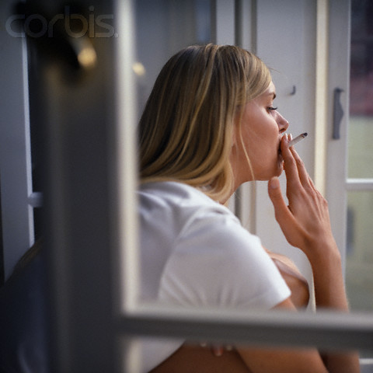
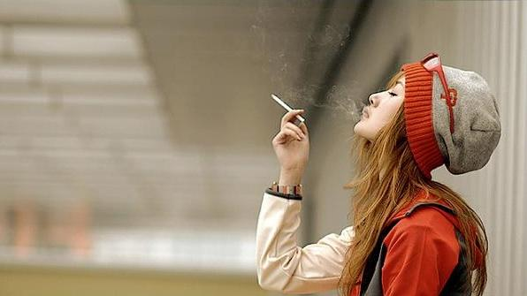
Can you list any harmful effects of smoking?

Slide 7
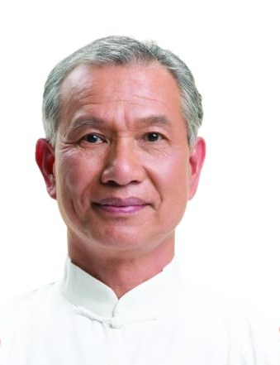

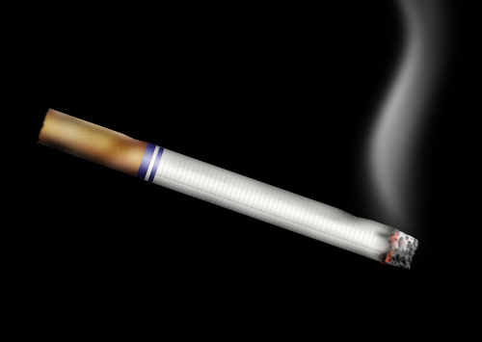
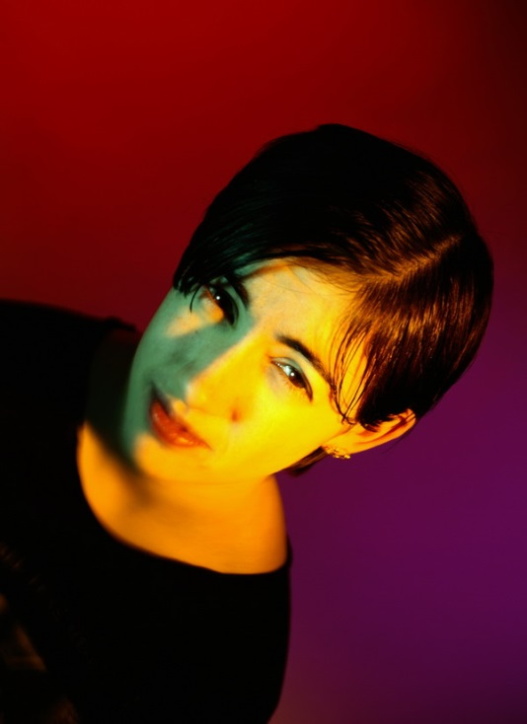
Advice from Grandad

Slide 8
What’s the main idea of the passage?
James’ grandfather wrote to him to give him some advice and encourage him to quit smoking.

Slide 9
Scan the text and get the main idea of each paragraph
Para. 1
Para. 2
Para. 3
Para. 4
Para. 5
Grandad’s healthy life.
The reason for writing the letter.
Three ways one becomes addicted to cigarettes.
The harmful effects of smoking.
Grandad's hope and his advice

Slide 10
Paragraph 1&2 The reason for writing the letter
Does James’ grandpa live a heathy life?
2. What is James’ life like now?

Slide 11
Para3 Ways to become addicted
 | WAYS | DETAIL
1
2
3
…be accustomed to having nicotine…
physically
…over and over again…automatically
habitually
…feel happier, more relaxed …
mentally

Slide 12
Para 4 The harmful effects of smoking
Choose the effects caused by smoking and put “yes” or “no” before them.
Yes
do terrible damage to hearts and lungs
No
affect your eyesight
Yes
difficult to become pregnant
Yes
affect non-smokers’ health
No
It is easy to get a great pain in the neck
Yes
smell terrible
Yes
the ends of the fingers turn yellow
Yes
unable to enjoy sports
No
settle disagreements with violence

Slide 13
Para 4 The harmful effects of smoking
damage
1. do terrible _______to your heart and lungs or make pregnancy ________.
difficult
2. affect the health of ___________.
non-smokers
smell
3. _______terrible.
yellow
4. The ends of the fingers turn_________.
unable
5. be _______to enjoy sports.

Slide 14
Para5 Grandad’s hope
He does hope James can quit smoking and live as long and healthy a life as he has.
as beautiful a girl as
e.g. Mary is __________________(一样漂亮）Daisy.
as good a player as
Ding Ning is _________________(同样优秀的运动员）Li Xiaoxia.

Slide 15
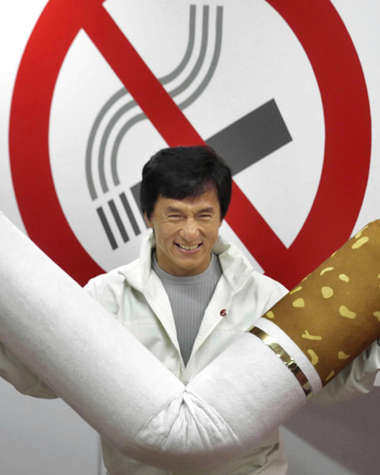
Read How can I stop smoking(Page19) and answer:
Suggestions for quitting smoking:
______________
______________
______________
______________
______________
______________
Prepare yourself
Be determined
Break the habit
Relax
Get help if you need it
Keep trying

Slide 16


Read How can I stop smoking (P19) again and fill in the blanks:
Choose a day that is not _________ to quit smoking.
Make a list of all the __________ you will get from
stopping smoking. ___________ all your cigarettes.
_________ the list of benefits when you feel like
smoking. Develop some other habits to keep yourself
_____. If you feel nervous or stressed, try some
___________ exercises like deep breathing. You can
stop smoking with a _______ or join a group. If
necessary, ask a doctor or _________ for help. The
most important is to keep _______. Don’t feel _______
if you smoke again. Just ___ again.
stressful
benefits
Throw away
Reread
busy
relaxation
friend
chemist
trying
ashamed
try

