Slide 1
useful words and expressions
animation 动画片 2. minimum wage最低工资
3. apply to 适用于 4.respectively 分别地
5. dedication投入 6. biography传记
7. stereotype陈规 8. phenomenon现象
9. shrink收缩 10. significant重要的
11. dominate主导 12.literature文学

Slide 2
1. What are the advantages and disadvantages of setting minimum wage?
advantages | disadvantages
protecting worker’s rights(Para. 8)
leading to higher costs to do business and making the employment rate lower(Para. 12)
increasing people’s income and improving their lives(Para.10)
harmful for those who wouldn’t get hired (Para. 13)
helping domestic demand and making people buy more(Para. 10)

Slide 3
2. Which country’s hourly minimum wage ranks the third in 2014 all over the world?
France
3. What is the biggest challenge for Chinese overseas students ? What can they do to solve it?
To fit into local social circles is the biggest challenge.
They can take part in local sports activities and trips spent with native speakers friends, as well as in internships and community service.

Slide 4
4. Why is flu dangerous for seniors?
Because their immune system gets weaker as they age.
5.In what ways is Olivia Hallisey’s research better than the previous methods?
Differences | Present Ebola tests | Hallisey’s method
Time
Cost
Storage
12 hours
In just 30 minutes
$1.000
$25
In a refrigerator
No need to put in a refrigerator

Slide 5
Translation:
Shanghai and Guangdong ranks second and third, with 2020 yuan and 1895 yuan respectively. ( Page 2)
上海和广州分别以2020元和1895元排名第二和第三。
Facing the forces of life and death, we are as unimportant as drops of water in an ocean, only there to be pushed back and forth. (Page 3)
面对生离死别，我们就像海洋中的一滴水一样微不足道，任由风浪拍打。

Slide 6
Presentation
Celebrity dinners
Older people need flu protection

Slide 7
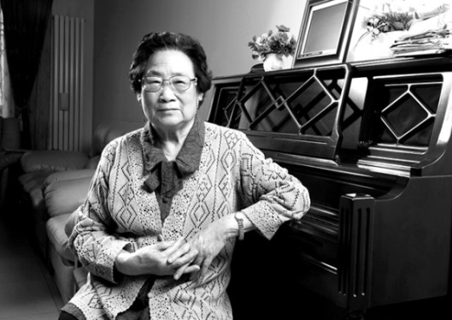
I wish I could have dinner with Chinese scientist Tu Youyou. She won the Nobel Prize in physiology or medicine amongst a trio for discovering parasite therapies(寄生虫疗法) on October 5. The three scientists found therapies that have revolutionized the treatment of some of the most devastating parasitic diseases. Tu is awarded this world-renowned prize for her contribution to reducing the death rate of malaria, minimizing patients’ suffering and promoting mankind’s health. Over dinner I would congratulate her and ask about her secrets to success.

Slide 8
Summary
Minimum wage goes up
Part 1 (Para.1-5) minimum wage; increase
Part 2 (Para.6-10) benefits
Part 3 (Para.11-13) disadvantages
Part 4 (Para.14-16 ) the government

Slide 9
Summary
Why people see double

Slide 10
Part 1 (Para.1-4) doppelanger
Part 2 (Para.5-12) genes perception lifestyle

Slide 11
Presentation
Celebrity dinners
older people need flu protection

