Slide 1



Unit2 Poems

Slide 2
Ode to the west wind
If winter comes,
can spring be far behind?

Slide 3
The furthest distance in the world
The furthest distance in the world，
Is not between life and death.
But when I stand in front of you，
Yet you don't know
that I love you.
世界上最遥远的距离 不是生与死 而是 我就站在你面前 你却不知道我爱你

Slide 4
If you shed tears when you miss the sun, you also miss the stars.
Let life be beautiful like summer flowers and death like autumn leaves.
如果你因失去了太阳而流泪，那么你也失去了群星。
使生如夏花之绚烂，死如秋叶之静美。

Slide 5
THE ROAD NOT TAKEN
Two roads diverged in a wood,
and I -- I took the one less traveled by,
And that has made all the difference!
林地里岔开了两条路，而我－－－ 我就走上了那条少人走过的， 那带来的一切可又那么的不同！

Slide 6

Reading
A Few Simple Forms of English Poems

Slide 7
Answer the questions.
How many forms of poems are mentioned in the text? What are they?
Nursery rhymes
Cinquain
Five kinds of poems
List poems
Tang poems
Haiku

Slide 8
Forms of Poems | Characteristics
Nursery Rhymes
List Poems
Cinquain
Haiku
Tang Poems
Strong rhythm and rhyme, a lot of repetition, easy to learn and to recite
A flexible line length, repeated phrases and some rhyme
Made up of five lines, convey a strong picture in just a few words.
Made up of 17 syllables; Give a clear picture and create a special feeling in just a few words
The translations have a free form.

Slide 9
1. Which two poems have the same
characteristics ?
2. What are the same characteristics
of poems A and B ?
3. Read and underline the pairs of
rhyming words in poems A and B

Slide 10
Nursery rhyme:
Hush, little baby, don’t say a word,
Papa’s going to buy you a mockingbird.
If that mockingbird won’t sing,
Papa’s going to buy you a diamond ring.
If that diamond ring turns to brass,
Papa’s going to buy you a looking glass.
If that looking-glass gets broke,
Papa’s going to buy you a billy-goat
If that billy-goat runs away,
Papa is going to buy you another today.
A

Slide 11

I saw a fish-pond all on fire,
I saw a house bow to a squire,
I saw a person twelve-feet high,
I saw a cottage in the sky,
I saw a balloon made of lead,
I saw a coffin drop down dead,
I saw two sparrows run a race,
I saw two horses making lace,
I saw a girl just like a cat,
I saw a kitten wear a hat,
I saw a man who saw these too,
And said though strange they all were true.
B
List poem
(清单诗)
Notes:
本资料来自于资源最齐全的２１世纪教育网www.21cnjy.com

Slide 12
Shall I compare thee to a summer's day?
Thou art more lovely and more temperate:
Rough winds do shake the darling buds of May,
And summer's lease hath all too short a date;
When you are old and grey and full of sleep,
And nodding by the fire, take down this book,
And slowly read, and dream of the soft look,
Your eyes had once, and of their shadows deep;
Roses are red,
violets are blue,
sugar is sweet,
and so are you.
ABAB rhyming pattern
ABBA rhyming pattern
ABCB rhyming pattern

Slide 13
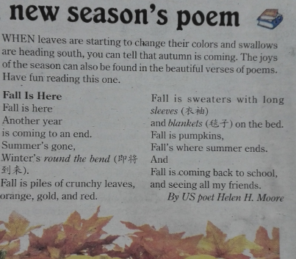
Fall is here
Fall is here
Another year
is coming to an end.
Summer’s gone,
Winter’s round the bend.
Fall is piles of crunchy leaves,
orange, gold , and red.
Fall is sweaters with long sleeves
and blankets on the bed.
Fall is pumpkins,
Fall’s where summer ends.
And
Fall is coming back to school,
and seeing all my friends.

Slide 14
Winter is here
Winter is here
Another year
is coming to an end.
Fall’s gone,
can spring be far behind?
Winter is frozen lakes and snow mountains,
silver, grey, and white.
Winter is heavy coats with warm hats,
and fireplace in the room.
Winter is dumplings,
Winter’s where fall ends.
And
Winter is coming back home,
and seeing all my friends.

Slide 15
Cinquain
D
Brother
Beautiful, athletic,
Teasing, shouting, laughing
Friend and enemy too
Mine
What’s the main idea of poem D?
Poem D is a description of a lovely brother.

Slide 16
E
Summer
Sleepy, salty
Drying, drooping, dreading
Week in, week out
Endless
What’s the main idea of poem E?
Poem D is a description of hot and
boring summer.

Slide 17
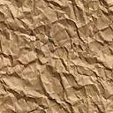
Haiku (俳句诗 )
17 syllables
F
A fallen blossom
is coming back to the branch.
look, a butterfly!
(by Moritake)
落花枝に
かへると见れば
胡蝶かな
落下的花朵
回到了树枝上。
瞧啊，是个蝴蝶！
雪とけて
村いっぱいの
子供かな
雪儿融化了,
整个村庄充满着
欢乐的儿童。
G
Snow having melted,
The whole village is brimful
of happy children
(by Issa)

Slide 18
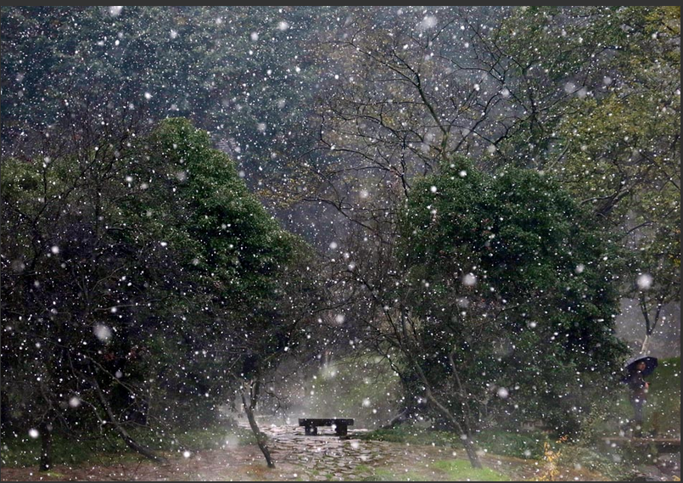
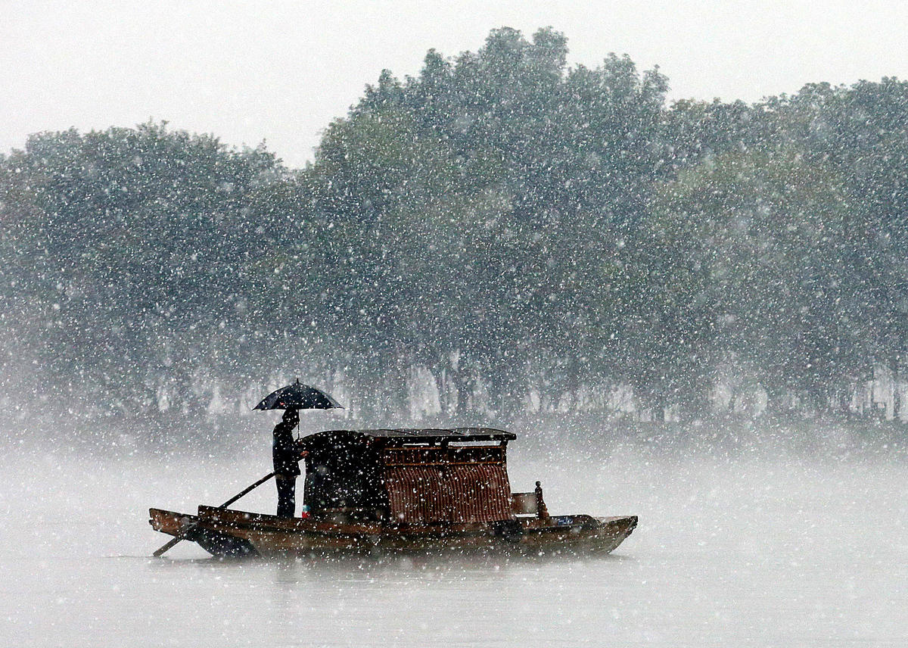
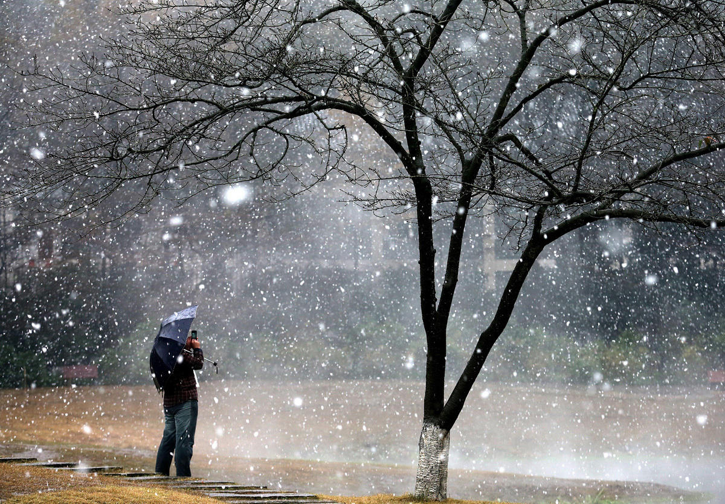
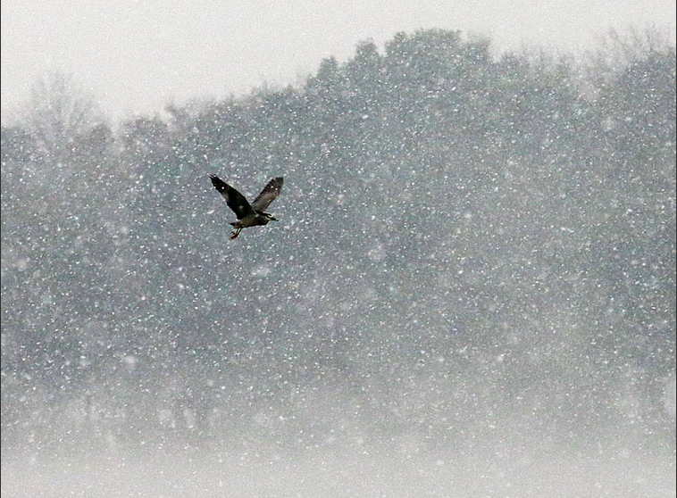

Slide 19
许渊冲 译
Fishing in snow
From hill to hill no bird in flight;
From path to path no man in sight.
A lonely fisherman afloat.
Is fishing snow in lonely boat.
Burton Watson 译
River snow
From a thousand hills, bird flights have vanished;
on ten thousand paths, human traces wiped out:
lone boat, an old man in straw cape and hat,
fishing alone in the cold river snow.

Slide 20
Writing task：
Write a cinquain named “Snow”
Snow
Soft, White
Falling , flying, dancing
covering everything it touches,
blanket

Slide 21

Homework
Choose your favorite form of poems and write one on your own. We’ll share our own poems next class.

