Slide 1


Scanning
Reading Comprehension V
Use the information in the passage to fill in
the table below.
Distance from east to west coast
Oceans on east and west coasts
Population
Where most Canadians live
Location of largest fresh water supply
Key point about Vancouver
Key point about Calgary
Key point about Thunder Bay

Slide 2
Distance from east to west coast | 5,500 km
Oceans on east and west coasts | Atlantic Ocean—east; Pacific Ocean—west
Population | slightly over 30 million
Where most Canadians live | within a few hundred kilometres of the USA border
Location of largest fresh water supply | the Great Lakes

Slide 3
Key point about Vancouver | Canada’s warmest part / Canada’s most beautiful city / some of the oldest and most beautiful forests in the world
Key point about Calgary | famous for the Calgary Stampede
Key point about Thunder Bay | busy port city at the top of the Great Lakes

Slide 4

Scanning
Reading Comprehension VI
Underline the main places mentioned
in the text.
Montreal, Atlantic coast, Vancouver, Rocky Mountains, Calgary, Thunder Bay, Lake Superior and Toronto.
Draw the travalling route of the two girls at the map on page 33.

Slide 5
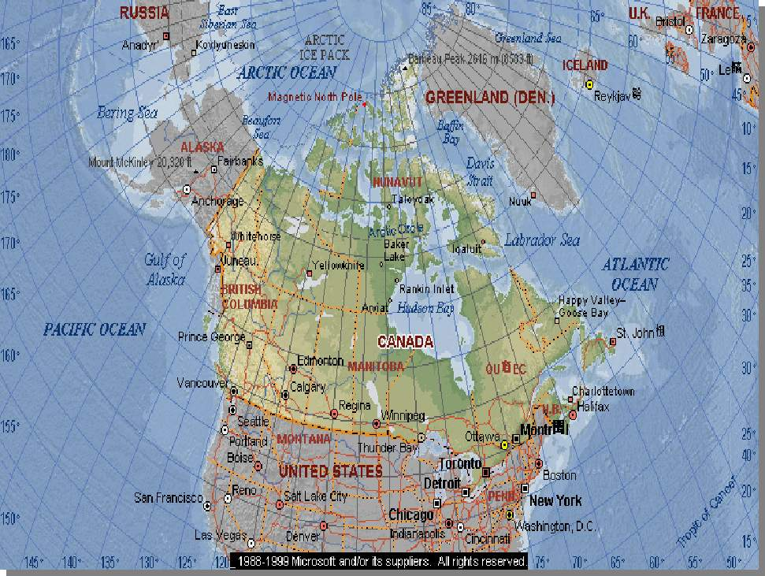
What did they see there?
Calgary
Vancouver
Toronto
Thunder Bay

Slide 6
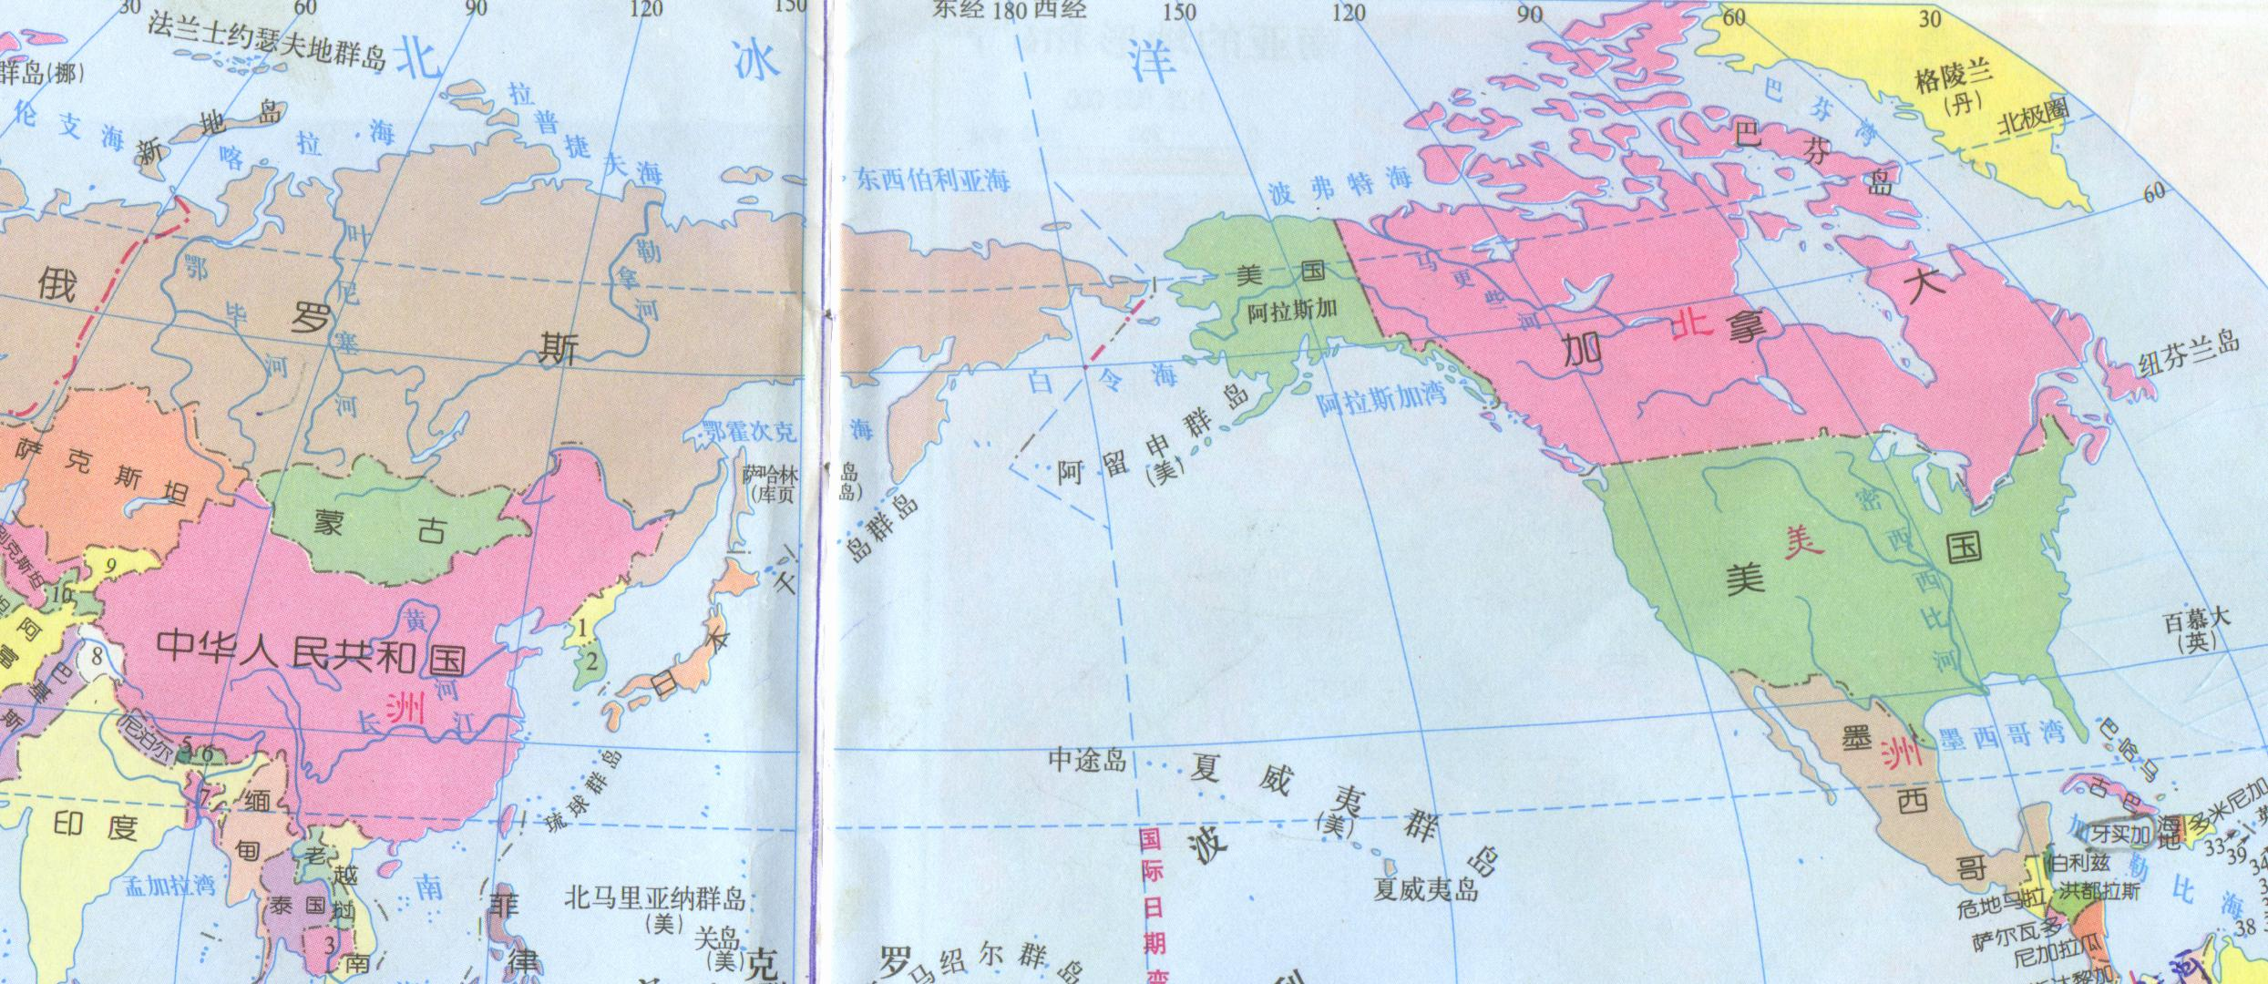
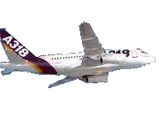
Draw the traveling route of the
two girls.

Slide 7
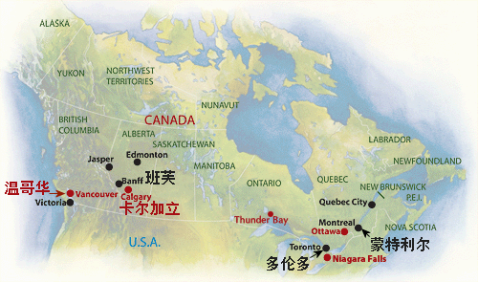
Vancouver
Calgary
Thunder Bay
Toronto

Slide 8
Rocky Mountains
.
.
.
Calgary
.
.
Thunder Bay
Vancouver
Toronto
Lake Superior

