Slide 1
Readers

Slide 2
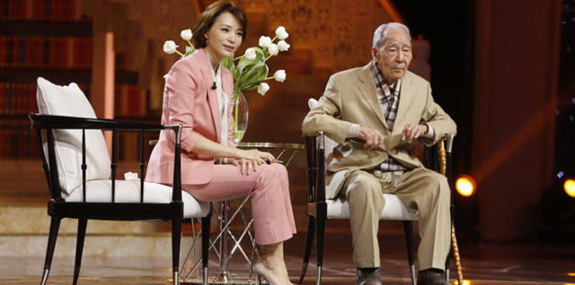

Slide 3
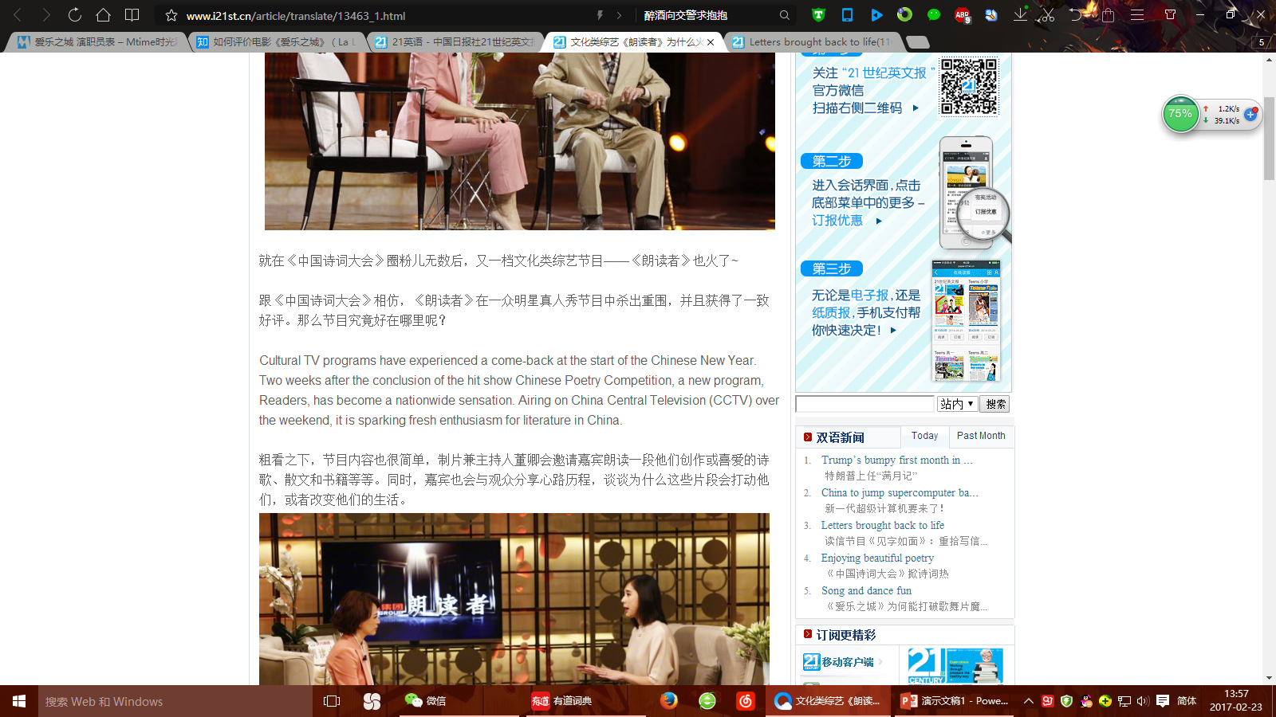

Slide 4
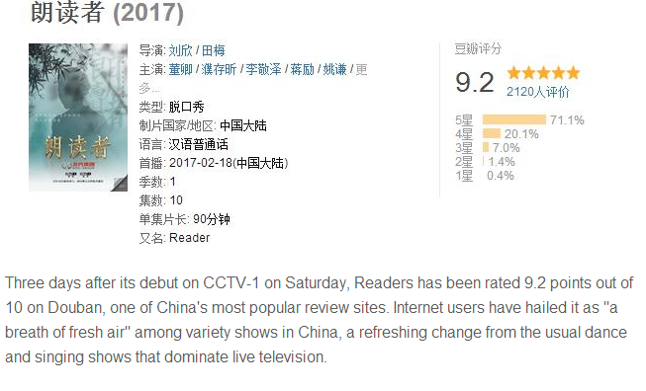

Slide 5

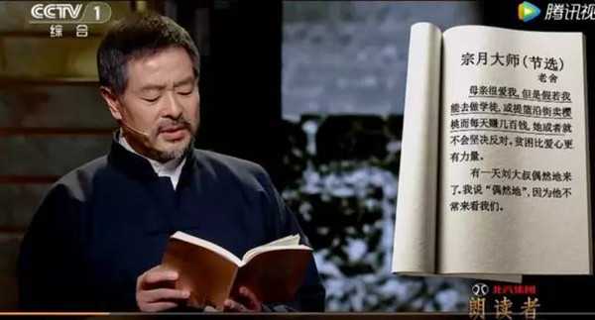

Slide 6
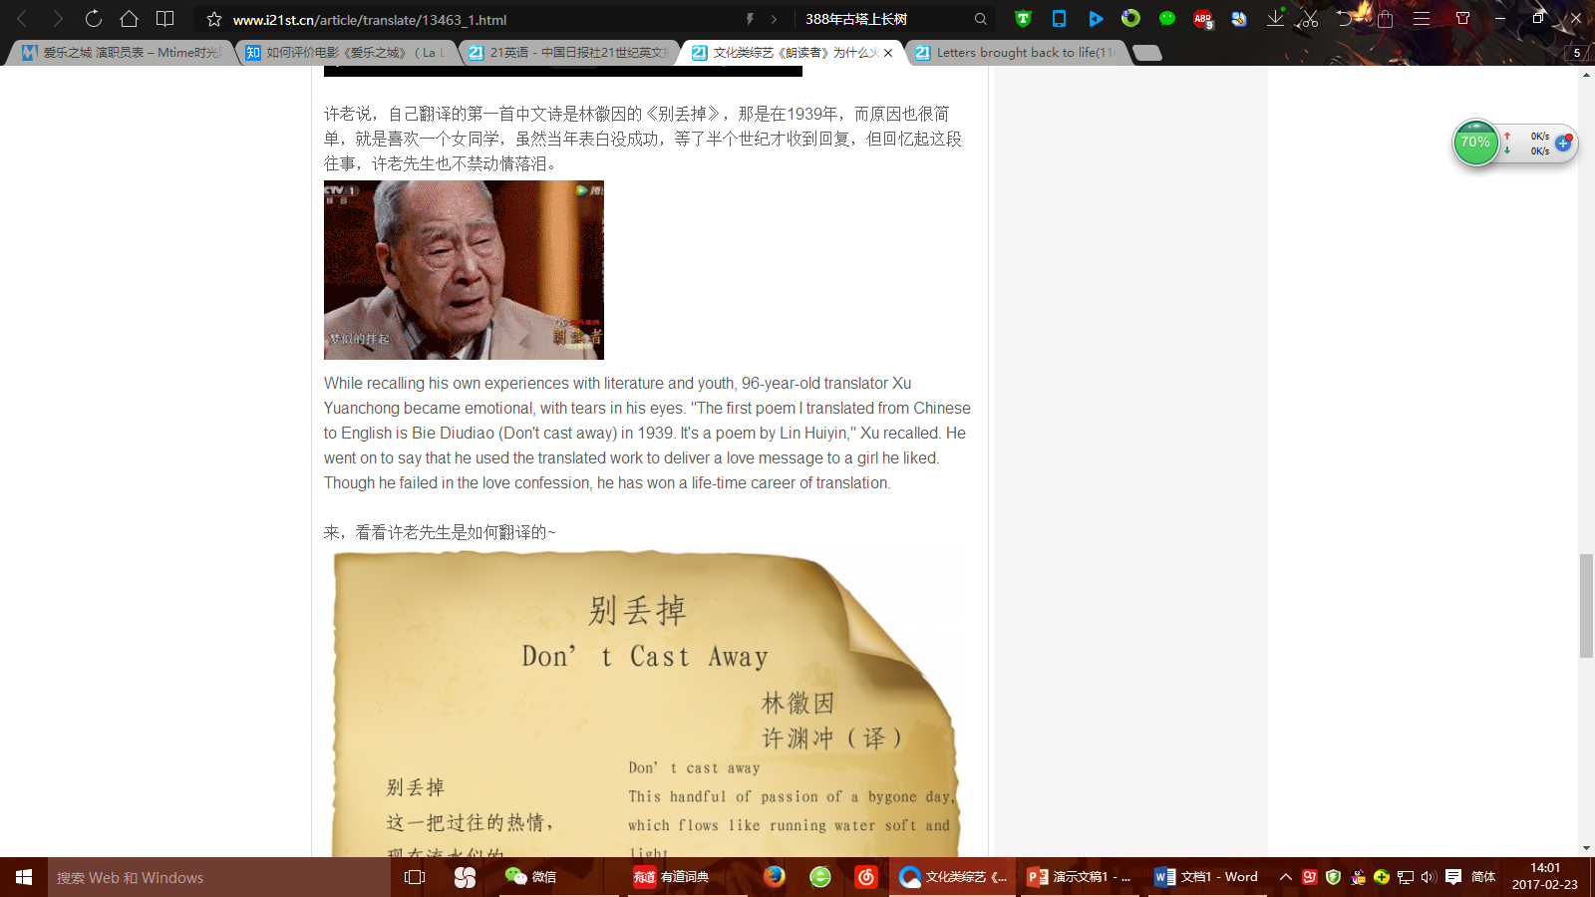

Slide 7
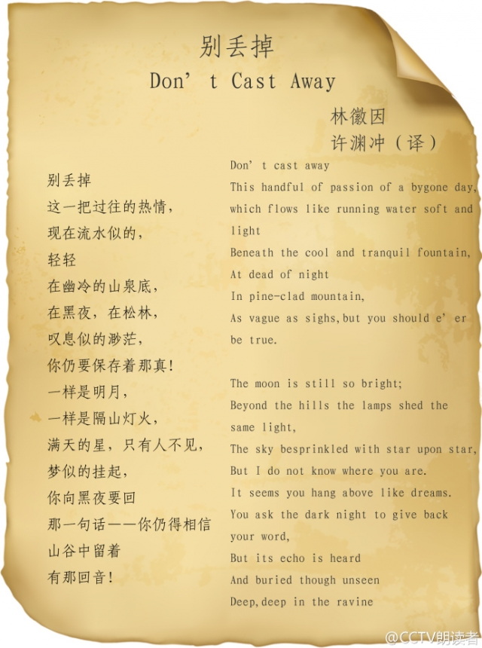

Slide 8
https://v.qq.com/x/cover/t4kwphef334j0uo/g0022an65jg.html

Slide 9
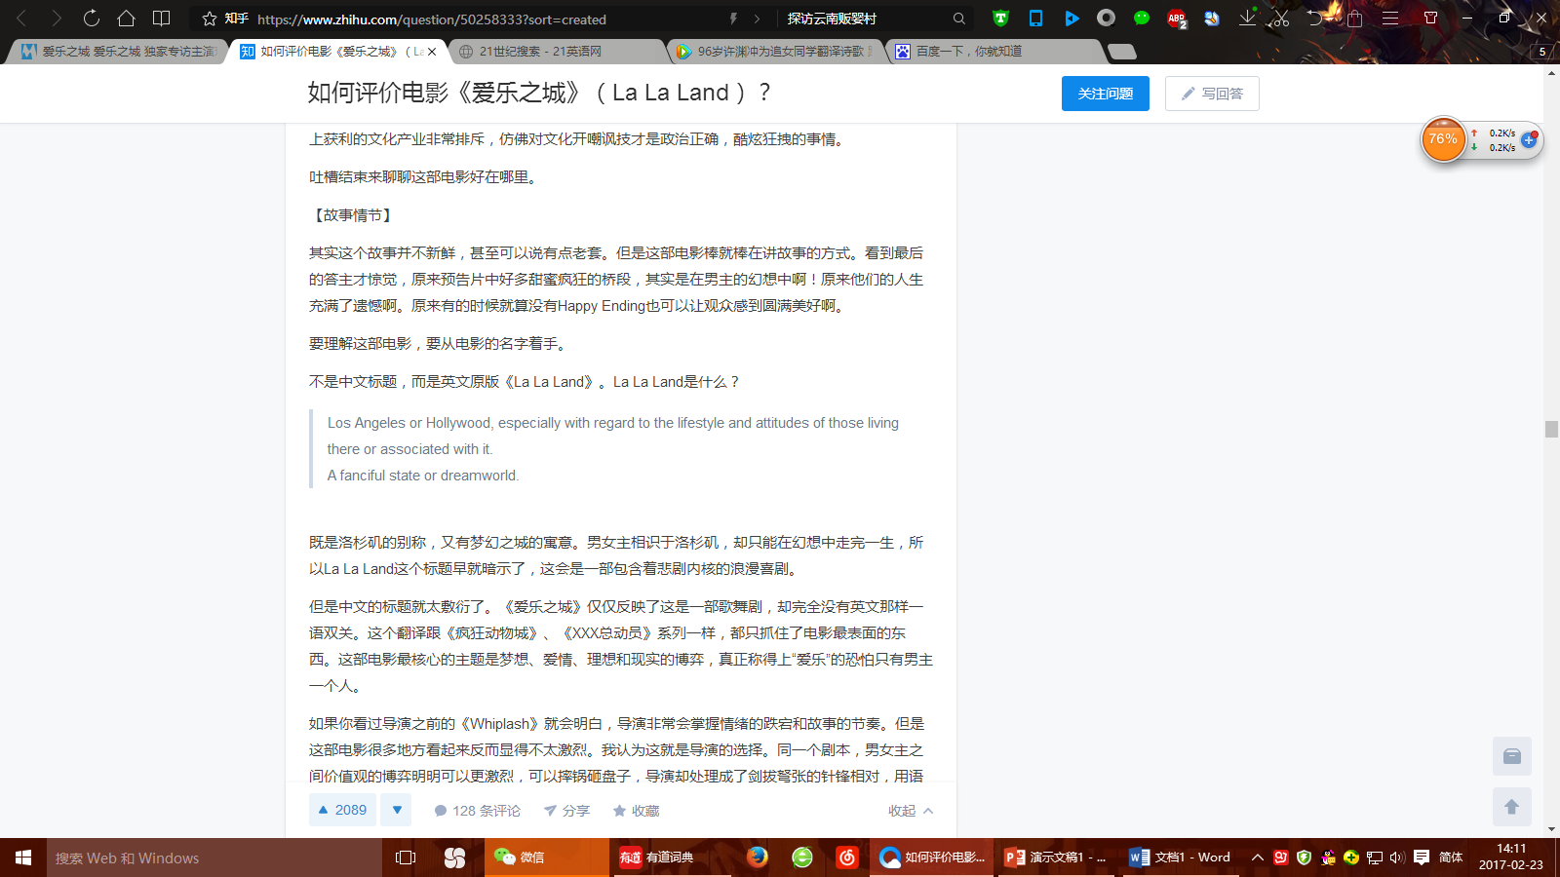

Slide 10
La La land
“I practiced some of those piano pieces four hours a day for three months. I should never want to hear them again, but I’m still moved by them.”

