Slide 1
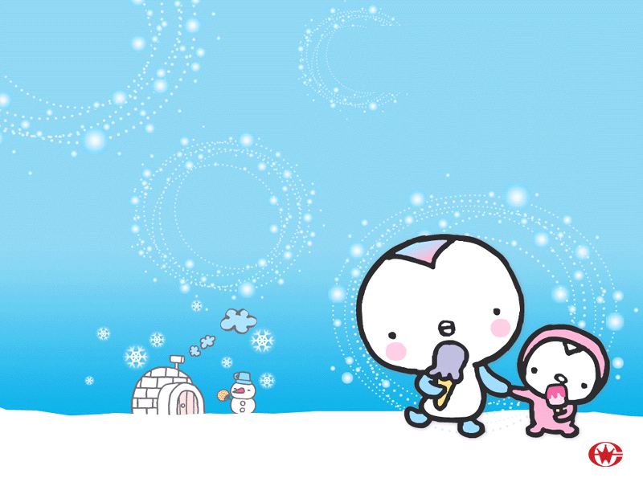
虚 拟 语 气

Slide 2
概念：谓语v用不同的形式表示说话人的不同意图，这种形式称为语气。语气分三种：
1.陈述语气：用来陈述一个事实，或提出一种看法，有肯定、否定、疑问、感叹等形式。
He is late for class. What fun!
He is not interested in classical music.
2.祈使语气：用来表示请求、邀请、命令、警告或劝告等（动词常用原形）
Don’t be late！
3.虚拟语气：表示说话人所说的不是事实，而是一种假设、愿望、怀疑或推测。

Slide 3
一、虚拟语气在 if非真实条件句中
 | 虚拟条件从句(If) | 主 句
与现在事实相反的假设
与过去事实相反的假设
与将来事实相反的假设
主语+did/were
主语+should / would/
could / might + do
主语+ should / would/ could / might +
have done
主语+ had done
主语+
1.did
2.should do
3.were to do
主语+should / would/
could / might + do

Slide 4
1.如果我是你，我会接受他的建议。
If I were you, I would accept his advice.
2.如果明天下雨，我会待在家里。
If it rained/should rain/were to rain tomorrow, I would stay at home.
3.如果你以前好好学习， 你会通过考试的。
If you had studied hard before, you would have passed the exam.

Slide 5
You didn’t let me drive. If we ______ in turn, you ______ so tired.
drove; didn’t get
drove; wouldn’t get
were driving; wouldn’t get
had driven; wouldn’t have got

Slide 6
________ it rain tomorrow, we would have to put off the visit to the Yang Pu Bridge.
Were B. Should
C.Would D. Will

Slide 7
注意：
1.错综时间虚拟语气
当从句主句所表示的行为所发生的时间不一致时，动词的形式要根据它所表示的时间作出相应的调整。
If you ____________(follow)my advice just now, you _________(be)better now.
If you __________(study)hard before, you _______(be)a college student now.
had followed
would be
had studied
would be

Slide 8
If you ______ with George earlier, you _____ so angry now.
talked; would not be
had talked; would not be
would talk; would not be
had talked; would not have been

Slide 9
If we had taken such effective measures much earlier, the river _____ so seriously now.
is not polluted
would not be polluted
had not been polluted
would not have been polluted

Slide 10
2. if从句中，were，had（完成时态标志），should可以放在句首，（用于倒装结构），if必须省略。否定词not不能放在前面。
1.Had I not seen him then(Hadn’t I seen him then), I
wouldn't have been very happy.
2.If I were you, I would accept his advice.
3.If it rained/should rain/were to rain tomorrow, I would stay at home.
Were I you,……
4.If you had studied hard before, you would have passed the exam.
Should it rained tomorrow/ Were it to rain tomorrow,
Had you studied hard before,……

Slide 11
3、含蓄虚拟语气
有时为了表达的需要，在虚拟语气中，并不总是出现if引导的条件句，而通过其它手段来代替条件句。
常用的有介词with，without，but for（倘没有，要不是）；连词or，but；副词otherwise等。
1.I was ill that day. Otherwise, I would have taken part in the sports meeting.
=If I hadn‘t been ill that day, I would have taken part in the sports meeting.

Slide 12
2.He telephoned to inform me of your birthday, or I would have known nothing about it.
3.I should have given you more help, but I was too busy.
4.What would you do with a million dollars?
5.Without / But for your help, we couldn’t have finished the work ahead of time.
=If it had not been for your help, …

Slide 13
Without electricity, human being life ______ quite different today.
is
will be
would have been
would be

Slide 14
But for his help, I ______.
should not have succeeded
have not succeeded
did not succeed
had not succeeded

Slide 15
He hesitated for a moment before kicking the ball, otherwise he _____ a goal.
had scored
scored
would score
would have scored

Slide 16
— Why didn’t you buy it?
— I ______ but I didn’t have the money.
A. would
B. would have
C. had had
D. had bought

Slide 17
二、虚拟语气的其他用法
1.as if / as though（好像）+从句
与现在相反 did/were
与过去相反 had done
与将来相反 would/could/might+ do
He looks as if he were an artist.
He talked about the accident as if he had seen it.
(区分even if/though)

Slide 18
注意：若表示的确有某种可能(尤指天气），也可不用虚拟语气。
Eg. Look! The clouds are gathering.It looks as if it’s going to rain .
When a pencil is partly in a glass of water, it looks as if it ______.
A. breaks
B. has broken
C. were broken
D. had been broken

Slide 19
2.It is (high / about) time (that)
sb did/ sb should（不可省略） + do
该是某人做某事的时候了。
It is high time that you got up/should get up.

Slide 20
I’m getting tired; it’s time we _____ home.
A. go B. are going
C. went D. should be going

Slide 21
3.wish/if only(要是……就好了）+从句
与现在事实相反 did/were
与过去事实相反 had done（或用could have done）
与将来事实相反 could/would/might + do
I wish (that)he________________(visit) us tomorrow.
I wish (that) he_________(visit)us today.
I wish he____________________________(visit) us yesterday.
would /could /might visit
visited
If only you _____________ （listen)to our advice!
If only I _____ (be)a bird!
had visited us/ could have visited us
had listened
were

Slide 22
4.在would rather+宾语从句中
与现在或将来事实相反 did/were
与过去事实相反 had done
即：would rather sb did/ had done
I would rather you ______(come) here tomorrow.
I would rather you __________ (not tell)me the truth.
came
hadn’t told

Slide 23
5.用于表示
建议（advise/ suggest/ propose/recommend）
命令(order/ command)
要求(demand/require/ request/ desire)
坚持要求(insist) 等词相连的从句中需用虚拟语气：
sb （should）+ do
1.I suggested that he (should) go there at once. (宾语从句)
2.My advice is that we (should) tell him the news.
3.I made a suggestion that he------(同位语从句)
4.It is suggested that he------(主语从句)
5.My suggestion was that he-----(表语从句)

Slide 24
区别：
This is the suggestion that/ which he made at the meeting.(定语从句)
The officer gave the order that nothing ____ until the people arrived.
A. didn’t touch
B. touched
C. be touched
D. touch

Slide 25
注意：
suggest:表明，暗示 陈述语气
建议 虚拟语气
Her pale face suggested that she _____（be)ill and that she ________________(send) to hospital immediately.
Insist：坚持说，坚持认为 陈述语气
坚持主张，坚持要求 虚拟语气
He insisted that he ____________(not steal) the money and insisted that he _____________(set) free.
was
(should) be sent
hadn’t stolen
(should) be set

Slide 26
6.主语从句中的虚拟语气（主要是it作形式主语）
It is necessary / important / natural / strange / funny/ surprising/ a pity / a shame/ no wonder/ suggested / advised/recommended / desired 等that sb (should) + do
It is strange that he (should) have treated his parents like that.
It is a pity that Lucy (should) be so careless.
It is suggested that the meeting (should) be put off till next week.
注意：以上句式也可用于陈述语气

Slide 27
It is strange that he didn’t come yesterday.
It is a pity that she can’t sing.
It is strange that the lazy boy _____ pass the exam.
A. has B. should
C. would D. might

