Slide 1

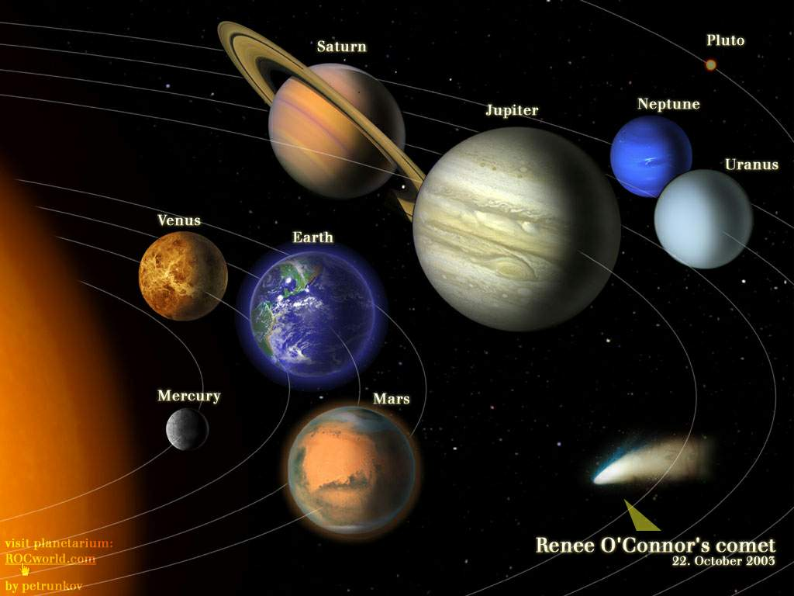
1111
In our solar system eight planets
circle around the sun.

Slide 2
The Solar System
Can you name the eight planets?
地球 ______
木星 ______
火星 ______
水星 ________
海王星 _______
Earth
F. 土星 ________
G. 天王星 _______
H. 金星 ________
Saturn
Jupiter
Uranus
Mars
Venus
Mercury
Neptune

Slide 3

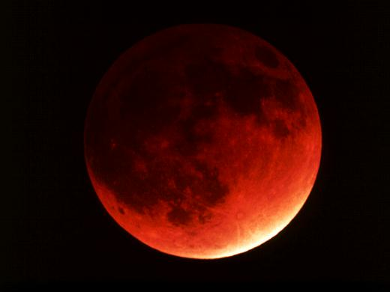
Total lunar eclipse (月全食)

Slide 4
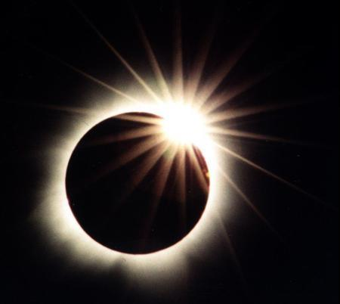
Total solar eclipse (日全食)

Slide 5
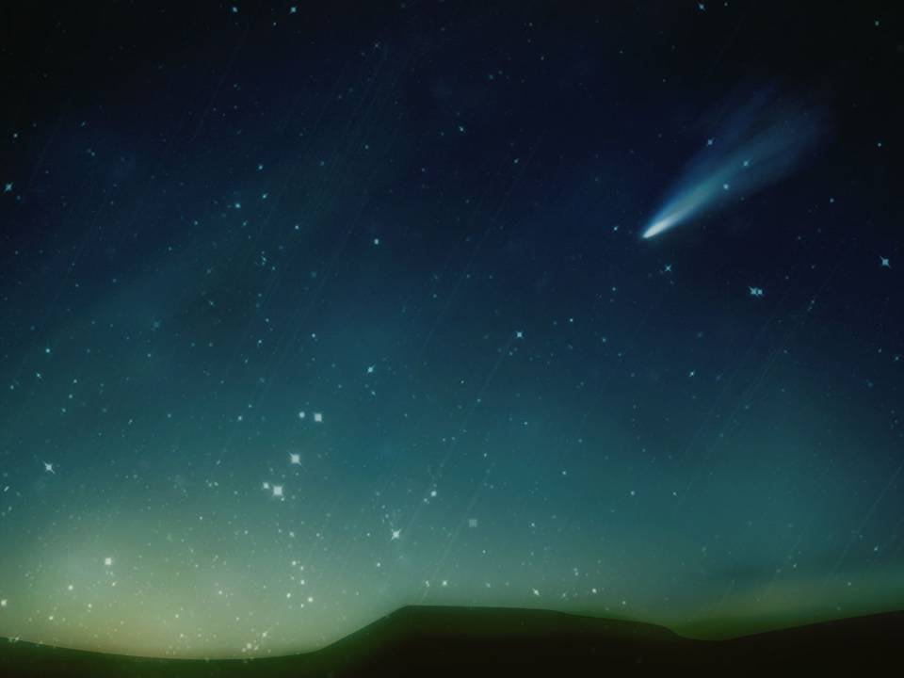
Meteor rain (流星雨)

Slide 6
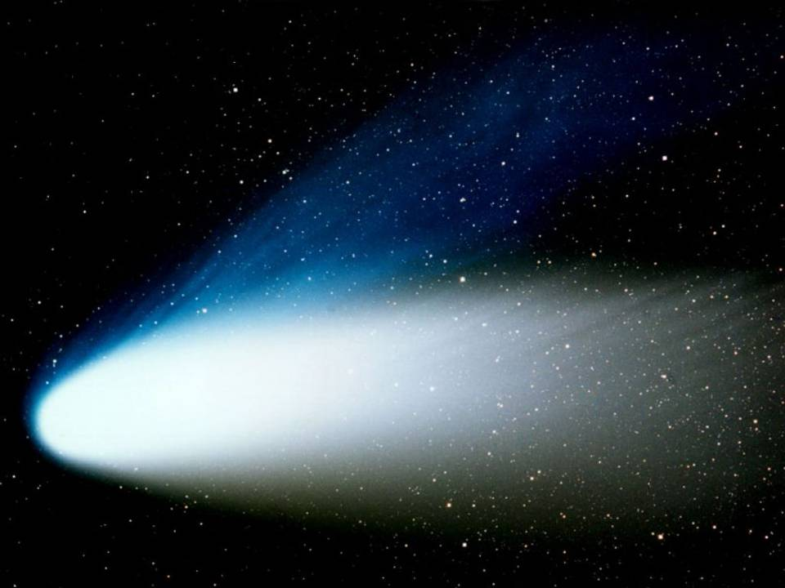
Comet (彗星)

Slide 7
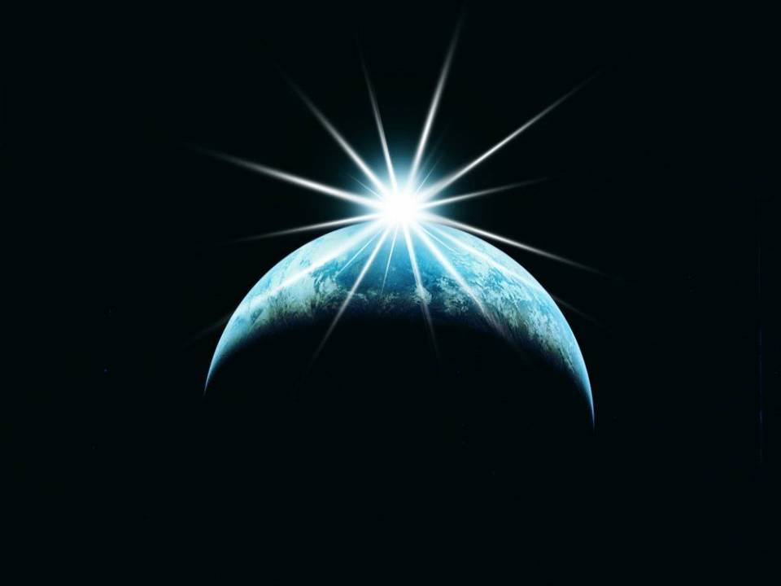

Slide 8
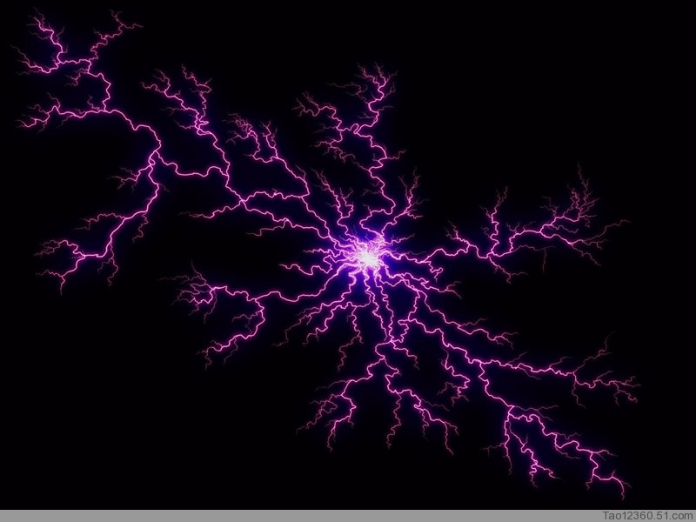

Slide 9
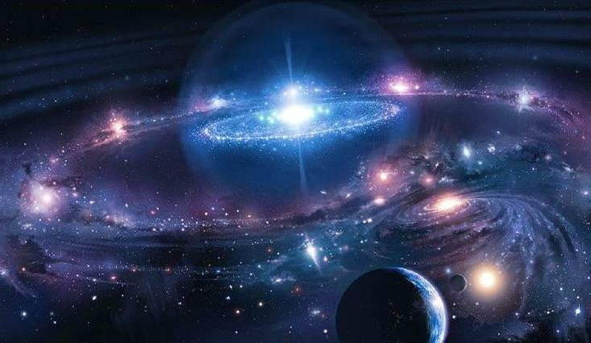
What interests you in astronomy?
Do you know any questions that astronomers are interested in?

Slide 10
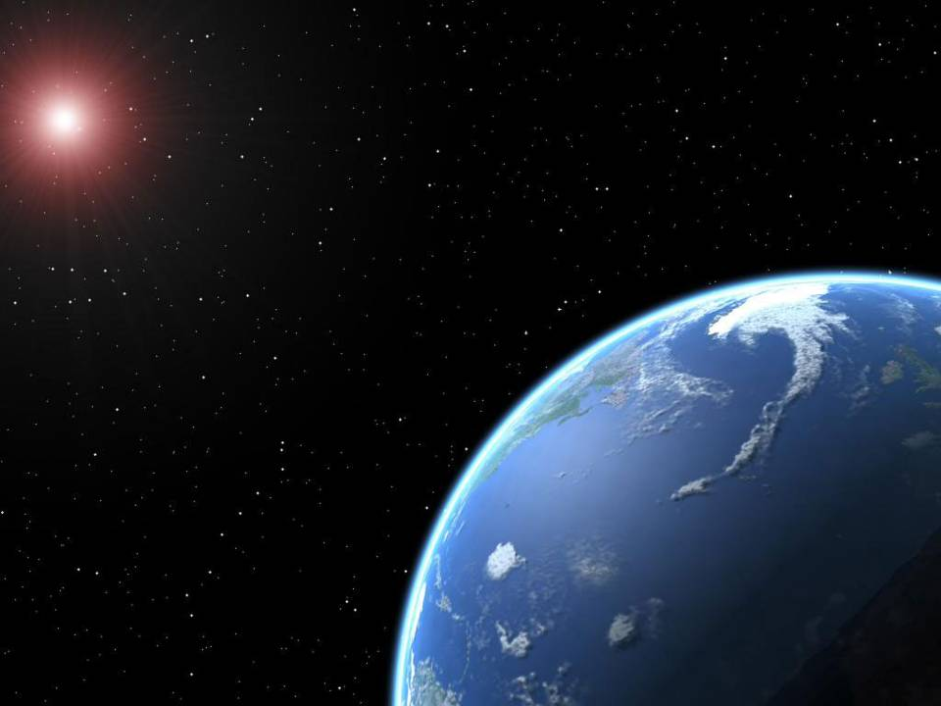
How was the universe formed?
How did life begin on Earth?

Slide 11

Brainstorming
Do you know each religion or
culture has its own ideas about
the origin of the universe or life?

Slide 12
Chinese Legends (传说)
Pangu separates the sky from the earth.
His whole body then turns into all kinds of things in the universe.

Slide 13
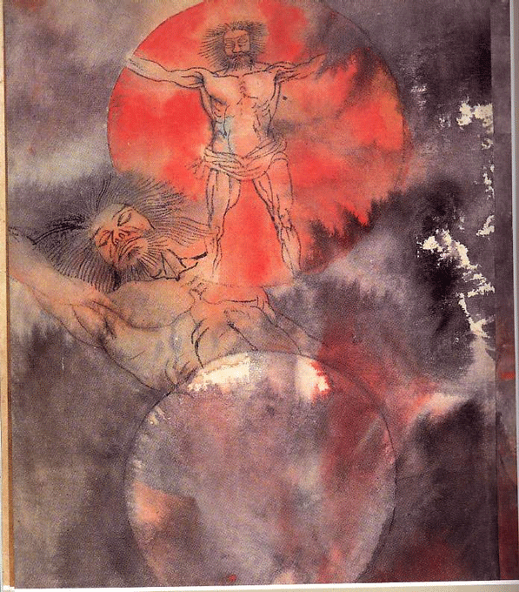
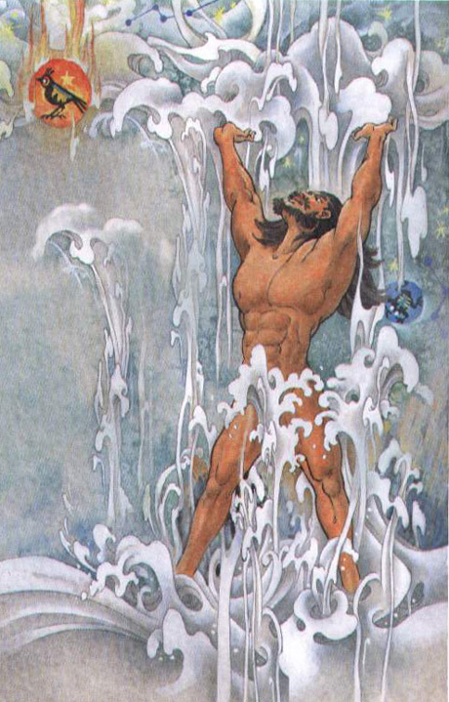

Slide 14
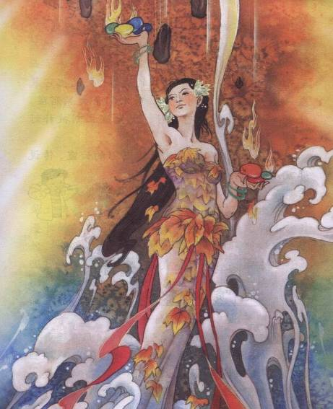

Legend: The Goddess Nvwa mended the heaven and created human beings from the clay (粘土).
女
娲
补
天

Slide 15

Religious Beliefs
According to Bible (圣经), God
created the world and the first man,
Adam (亚当) and the first woman,
Eve (夏娃).
God created the world in seven days.

Slide 16

Day 1: God spoke and separated light from darkness, creating Day and Night.
Day 2: God spoke and separated the water creating sky and ocean.
Day 3: God spoke and created dry land.

Slide 17
Day 4: God spoke and created the sun, the moon and stars.
Day 5: God spoke and created living things in the air and sea.
Day 6: God spoke and created the land animals and the first man.
Day 7: God rested and called this day Holy.

Slide 18
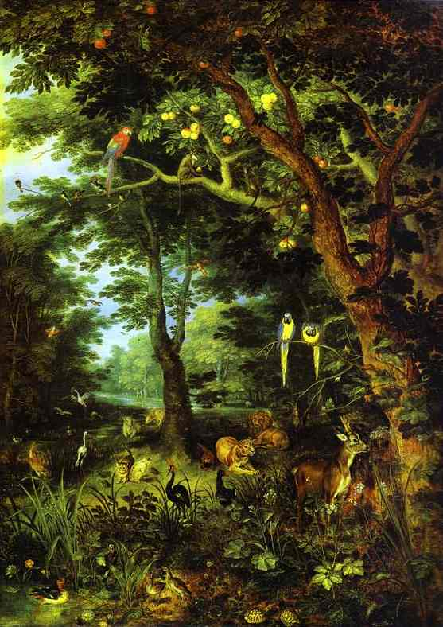
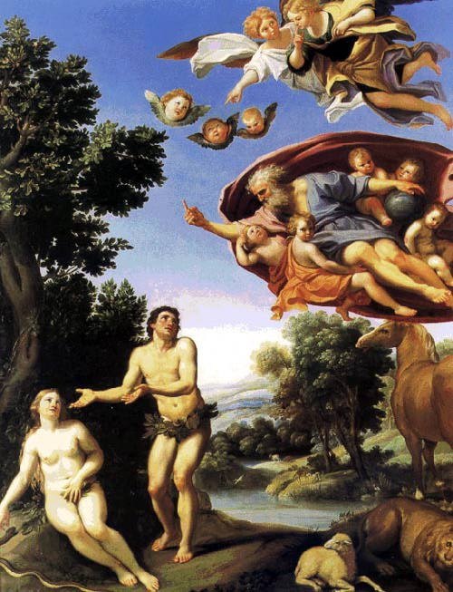

Slide 19
Scientific Theories
Famous scientists such as Newton,
Einstein and Stephen Hawking had their own theory about the origin of
the universe.

Slide 20
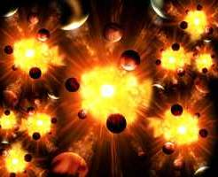
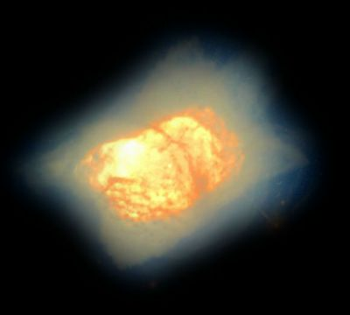
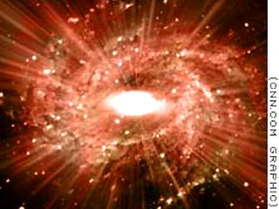
The universe began from the Big Bang.

Slide 21
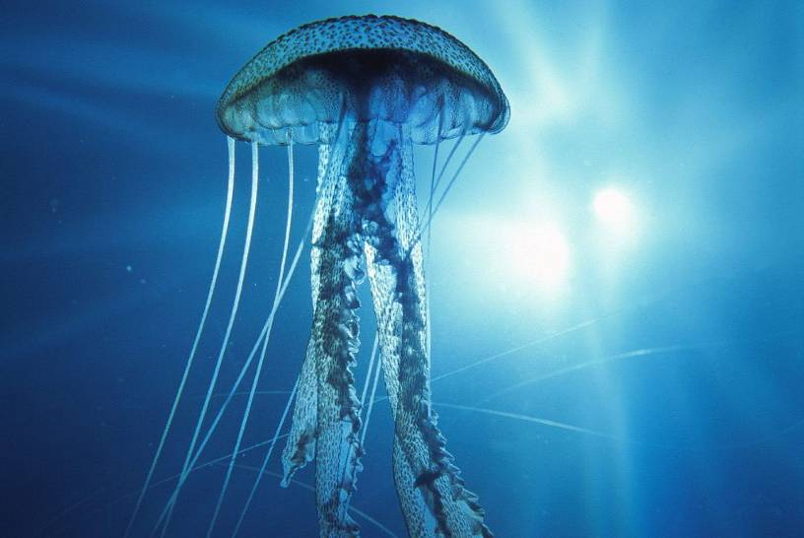
Life first began in the sea on the earth.

Slide 22
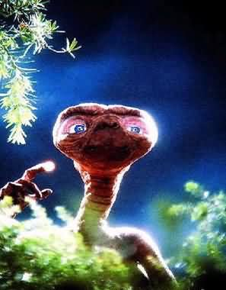
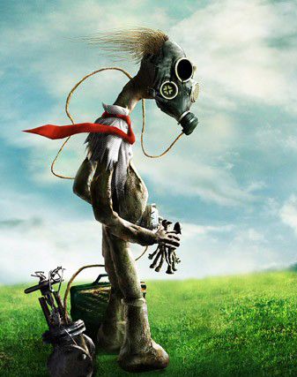
Life was brought to the earth by ET from outer space.

Slide 23
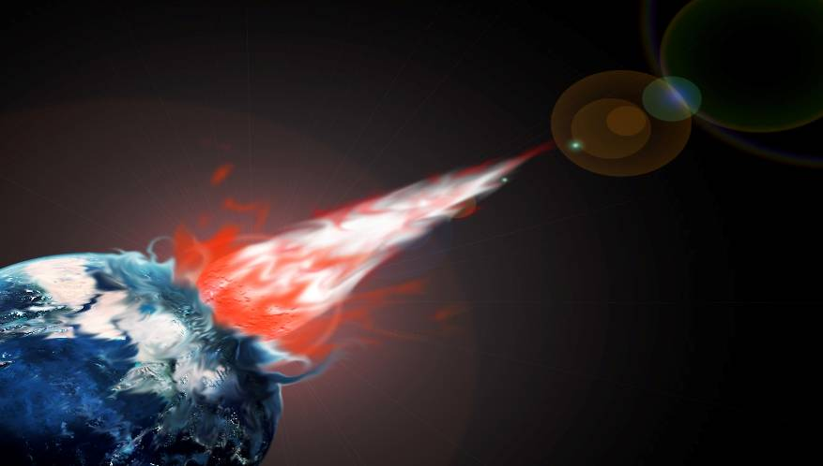
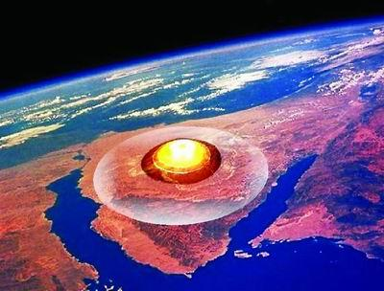
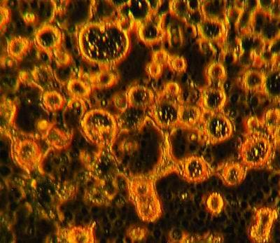
Life came from a comet which hit the earth.

Slide 24
Study of the groups of life (种类/物种)
Look at the pictures and tell the groups.
1. insects 2. plants
3. reptiles (爬行类) 4. shellfish (贝类)
5. amphibians (两栖类)
6. fish 7. mammals (哺乳类)

Slide 25
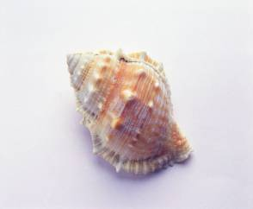
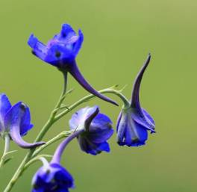
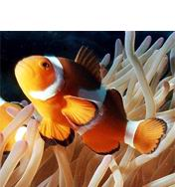
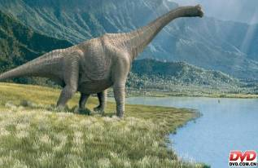
shellfish (贝类)
plants
fish
reptiles (爬行类)

Slide 26
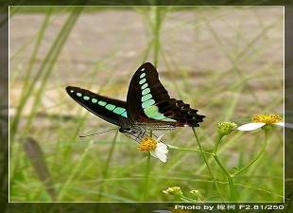
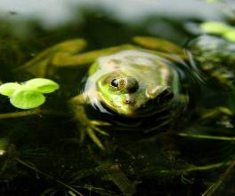
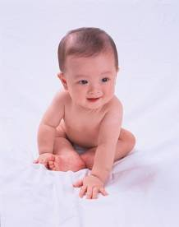
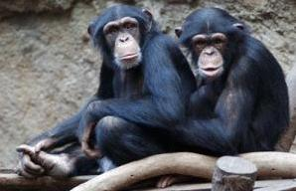
insects
amphibians (两栖类)
mammals

