Slide 1
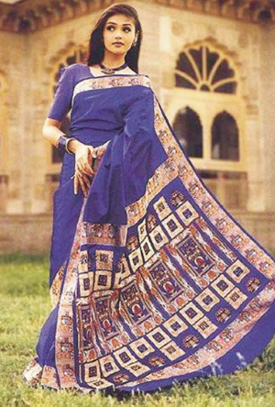
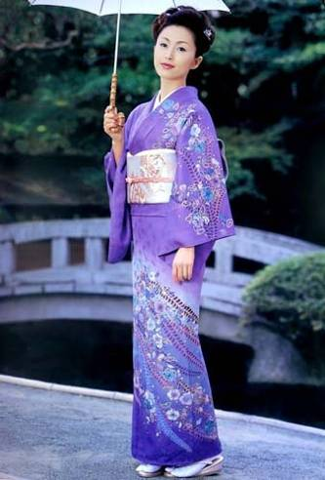
sari
kimono
India
Japan

Slide 2
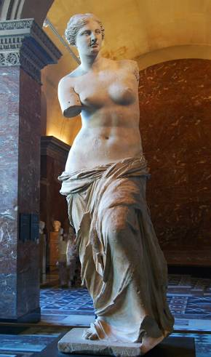
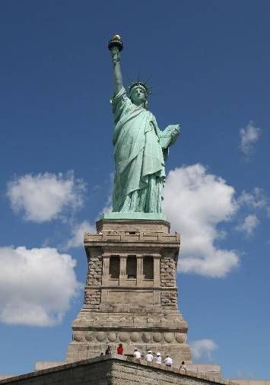
Venus
Statue of Liberty
Greece
America

Slide 3
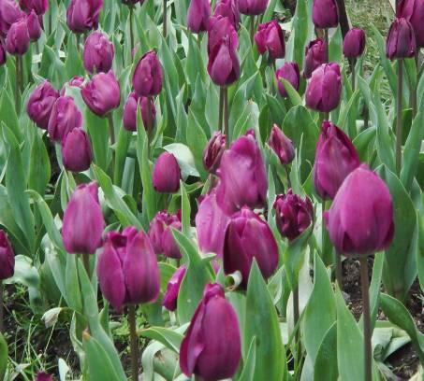
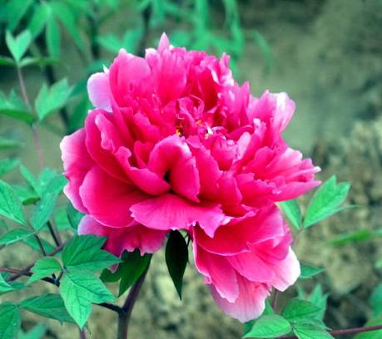
tulip
peony
Holland
China

Slide 4
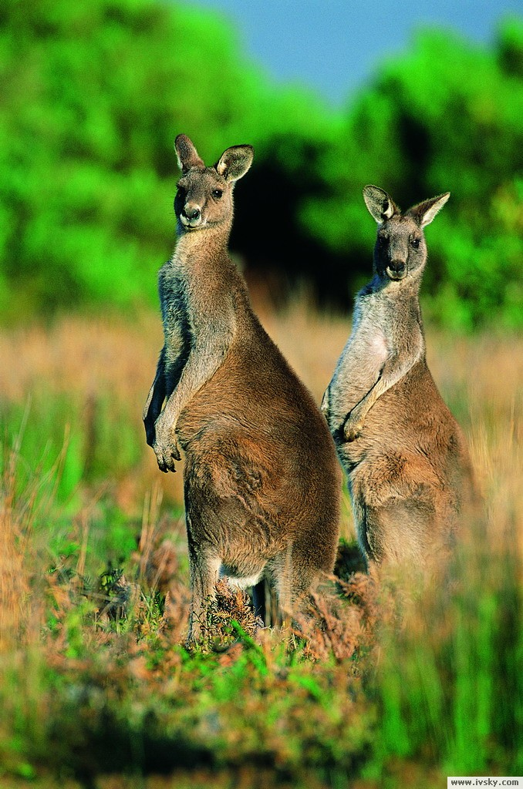
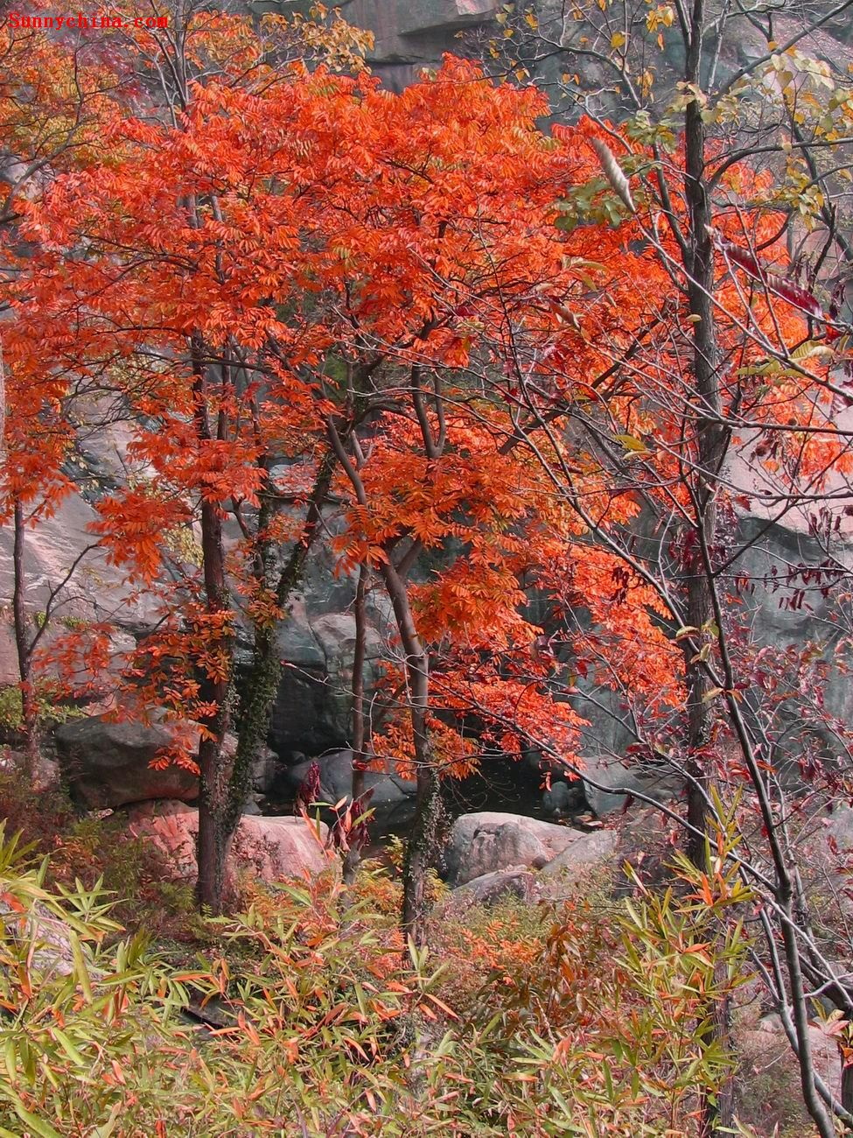
kangaroo
maple leaves
Australia
Canada

Slide 5

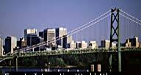
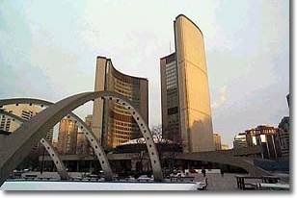
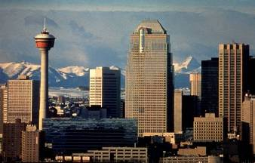
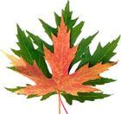
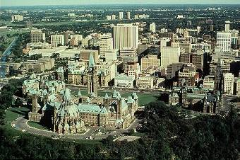
What is the capital of Canada?
A. B.
Vancouver Toronto
C. D.
Calgary Ottawa

Slide 6
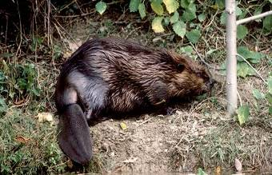
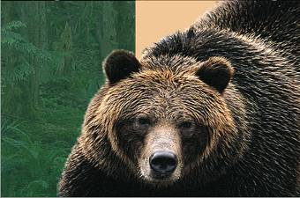
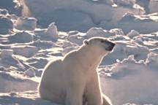
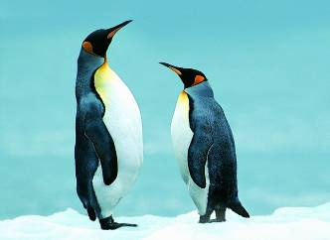
What is the national animal of Canada?
A. B.
Beaver Grizzly bear
C. D.
Polar bear Penguin

Slide 7
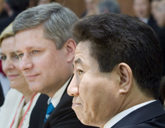

What is the Canadian leader called?
A. President.
B. Prime Minister.
C. Governor.
D. King.
http://v.youku.com/v_show/id_XMTUzNzA1MjAwNA==.html

Slide 8
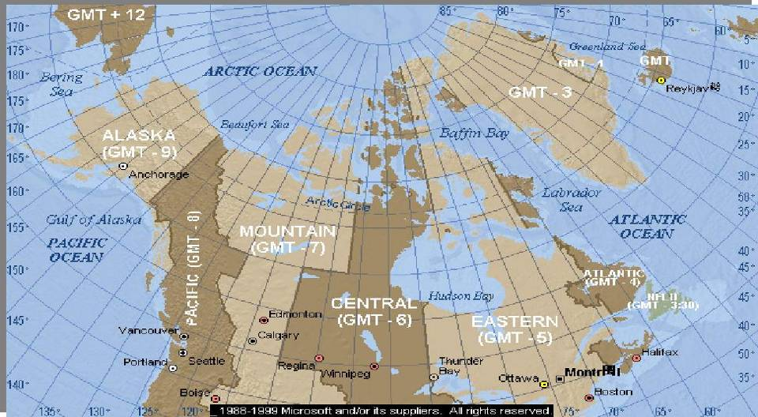

Resources
fresh water
coal
oil
natural gas
forests
fish

Slide 9
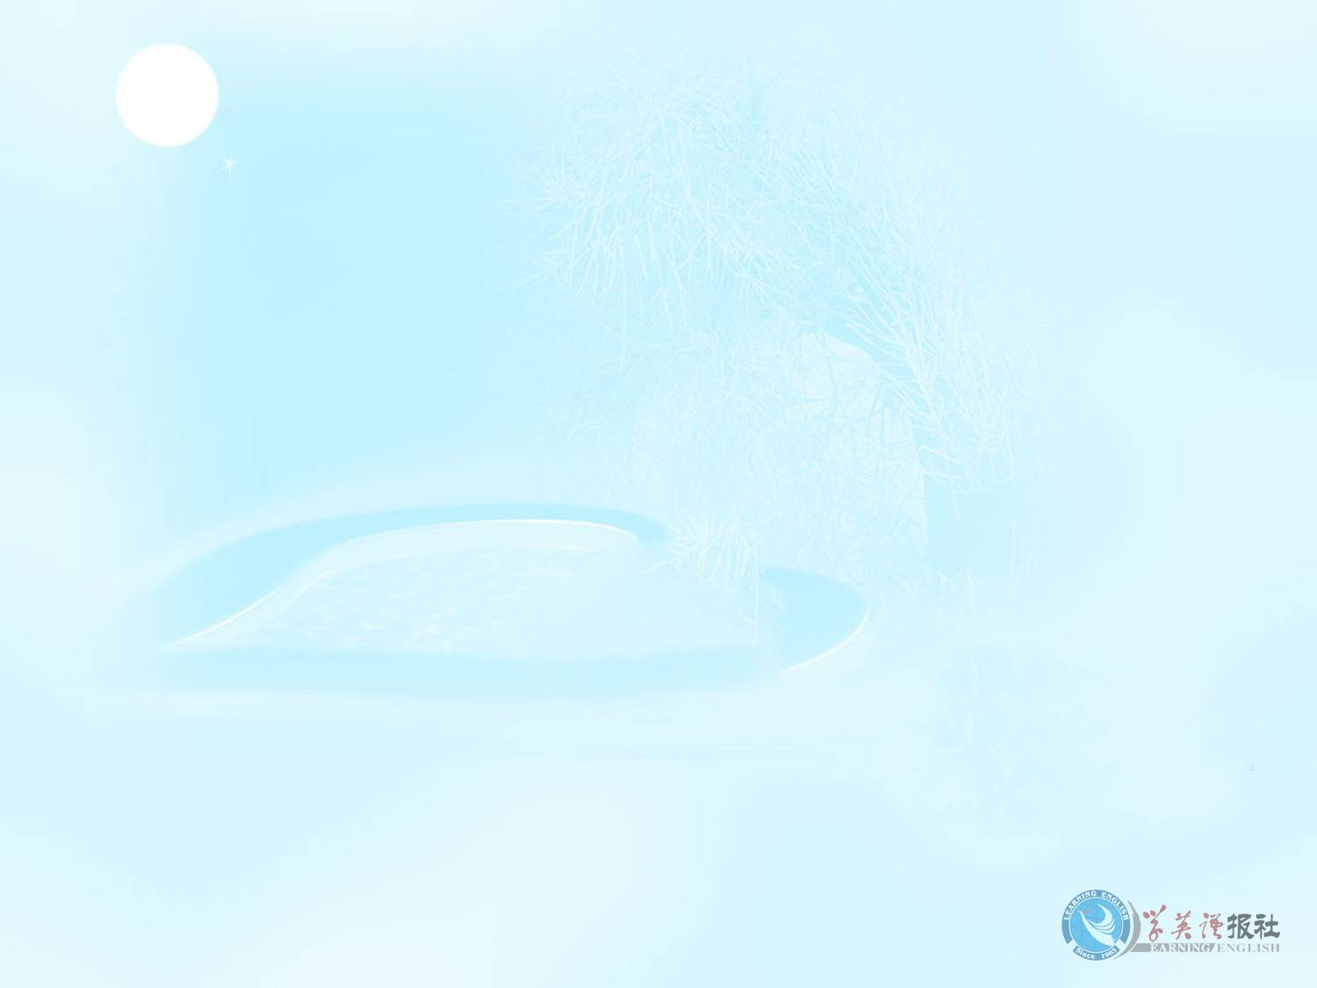
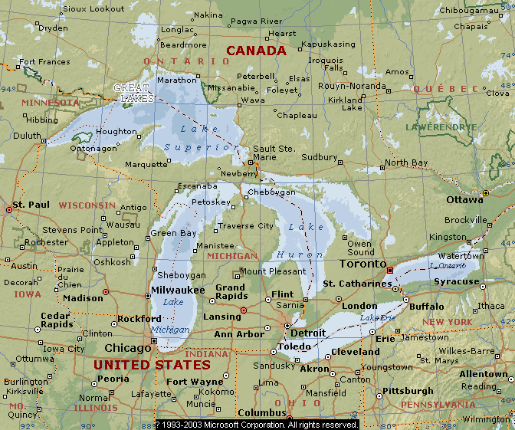
Great Lakes
Lake Superior
Lake Erie
Lake Huron
Lake Ontario
Lake Michigan

Slide 10
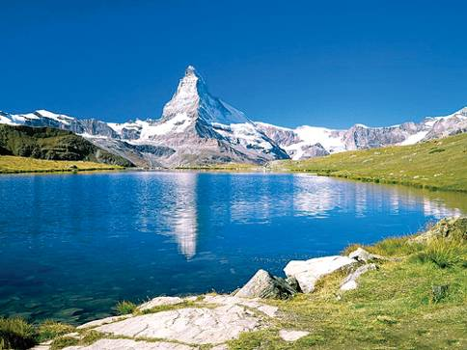
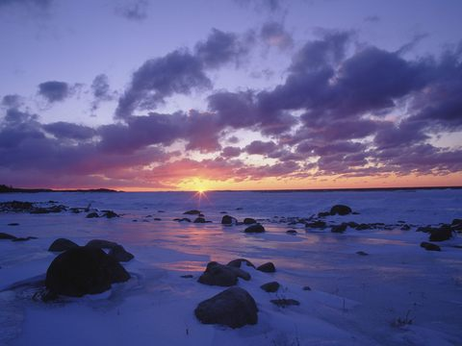
Lake Superior
Lake Michigan

Slide 11
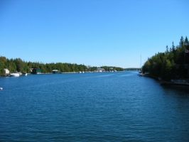
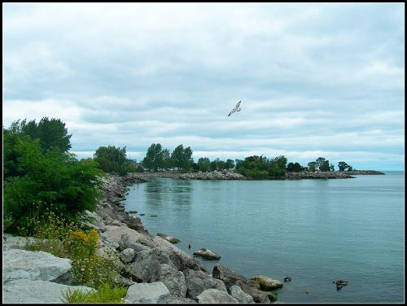
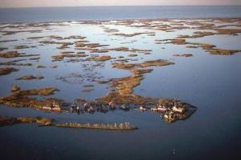
Lake Huron
Lake Ontario
Lake Erie

Slide 12
Distance from east to west coast | 5,500 km
Oceans on east and west coasts | Atlantic Ocean—east; Pacific Ocean—west
Population | slightly over 30 million
Where most Canadians live | within a few hundred kilometres of the USA border
Location of largest fresh water supply | the Great Lakes

Slide 13
Key point about Vancouver | Canada’s warmest part / Canada’s most beautiful city / some of the oldest and most beautiful forests in the world
Key point about Calgary | famous for the Calgary Stampede
Key point about Thunder Bay | busy port city at the top of the Great Lakes

Slide 14
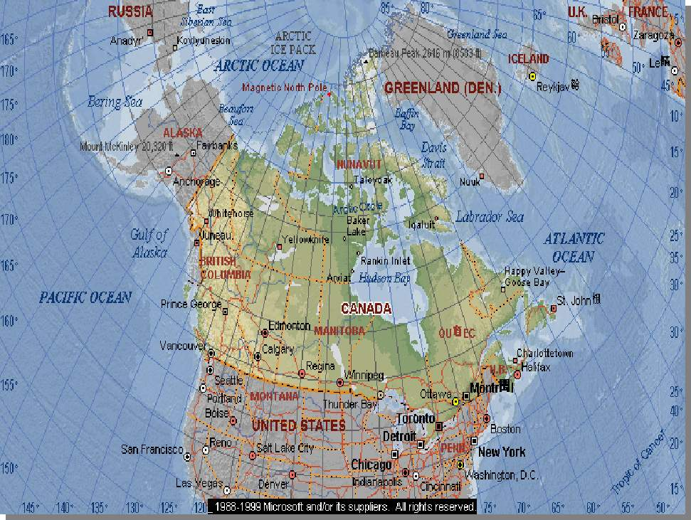
What did they see there?
Calgary
Vancouver
Toronto
Thunder Bay

