Slide 2
假如你是高三1班的班长李华。你班同学Tom生病住院两个星期了， 师生们很牵挂。今天英语老师Mrs. Smith要求探望他，请你代表全班同学写一封慰问信。要点如下：
询问病情
送慰问礼物（幸运星和千纸鹤）
祝愿早日康复
Dear Tom,
……
……
Yours,
Li Hua

Slide 3
Purpose
Inquiry
Gifts
wishes
I am deeply sorry to know that…, and on behalf of all the students in our class, I am writing to express our best wishes to you.
I am shocked to know that … I am writing in the hope that you will feel less depressed when you read my words.
It’s hard for me to believe that…I am writing to you so that you will feel much better after reading…
There is no one in our class but is very concerned about you…and…
This afternoon, our English teacher Mrs. Smith will pay a visit to you so we ask her to bring you a box of lucky stars and paper cranes carefully made by us in the hope that…
be optimistic
recover soon

Slide 4
I am deeply sorry to know that you unfortunately fell ill and have stayed in hospital for two weeks, and on behalf of all the students in our class, I am writing to express our best wishes to you.
Hearing the news, there is no one in our class but is very concerned about your health and we are all wondering whether much improvement has been made after the treatment. This afternoon, our English teacher, Mrs. Smith, will pay a visit to you so we ask her to bring you a box of lucky stars and paper cranes carefully made by us in the hope that they will bring good luck to you. In the meanwhile, we expect that you can be relieved of the pain with our genuine heart.
We all actually miss you very much and cannot wait to help you catch up with the lessons for these days so you don’t have to worry about it. As long as you are optimistic, you are likely to overcome the illness and recover soon.
sincerely,
Li Hua

Slide 5
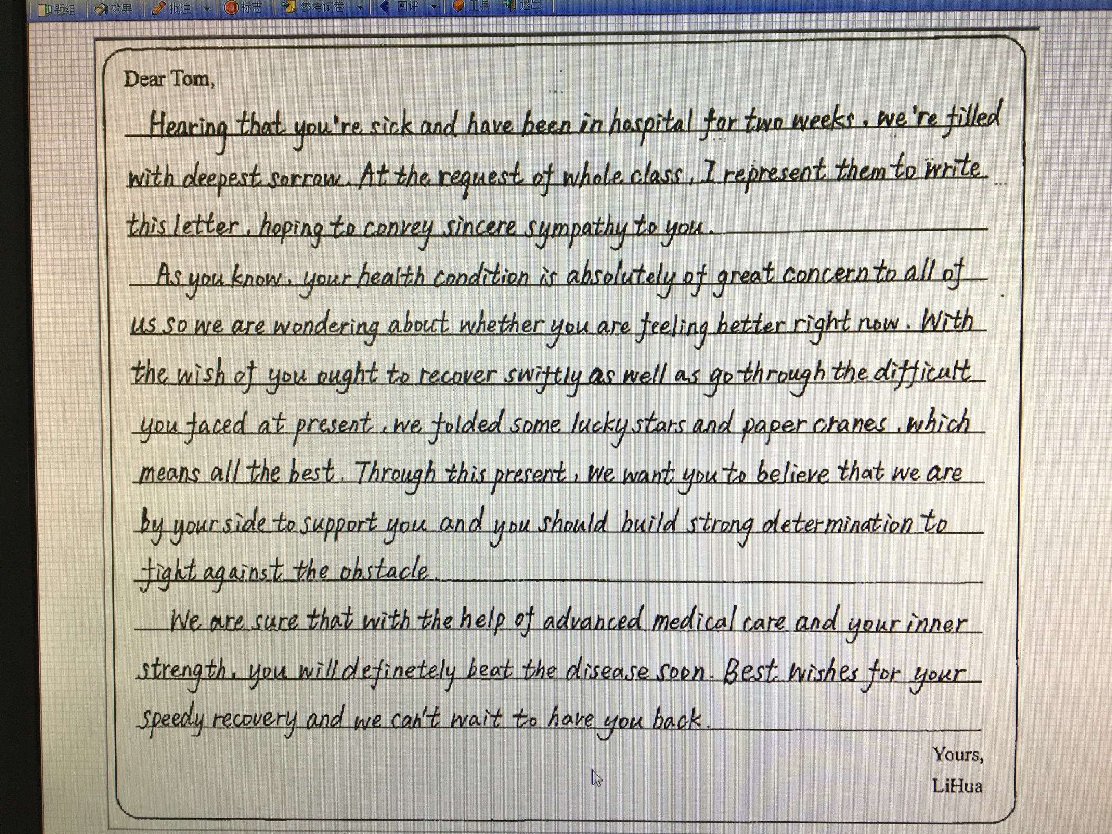

Slide 6
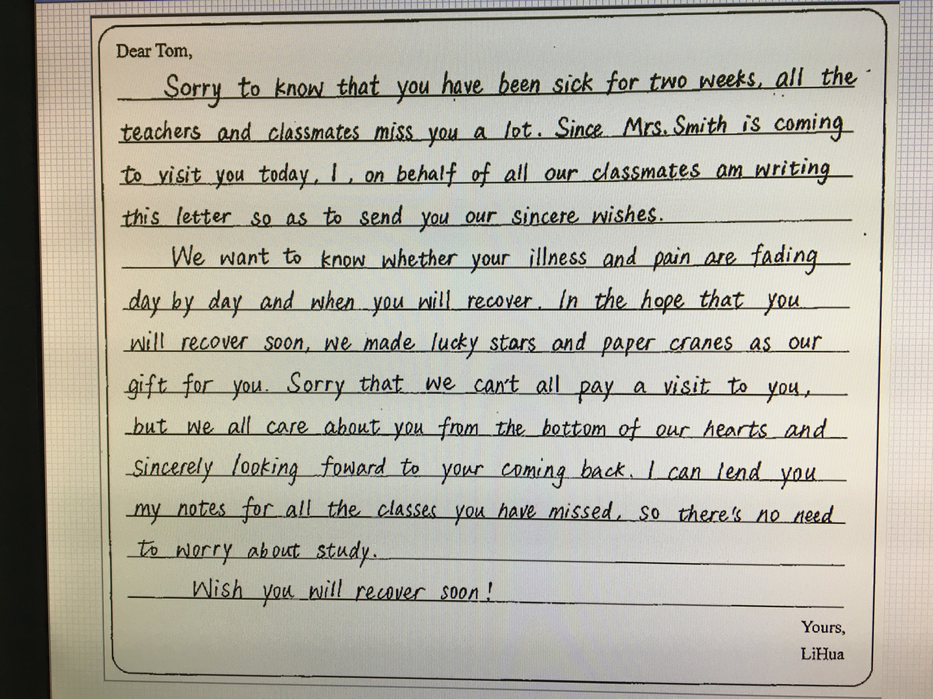

Slide 7
gratitude letter
I am writing to express my genuine gratitude for your helping me … when …
I would like to take this opportunity to express my great appreciation for…
I can’t be more grateful for…so I am writing to convey my sincere thanks to…
I really benefit a lot from your help so please accept my appreciation again.

Slide 8
1. Thank you very much for…
2. I am writing to express my thanks/gratitude for
3. please accept my sincere appreciation/acknowledgements for
4. I am truly grateful to you for…
5. It is really kind of you to…
6. I sincerely appreciate…
7. I wish to express my appreciation for…
8. On behalf of my whole family, I would like to…
9. I sincerely hope that…
10. Without your help/But for your help, I wouldn’t …
11. with the help of sb.
12. thanks to/owing to your encouragement/ inspiration
13. selfless dedication/devotion
14. be patient with sb.
15. be tolerant and generous…

Slide 9
congratulation letter
I am writing to express my genuine congratulations on… hearing the exciting news from …
I cannot find words to express my excitement knowing that… and I am writing to congratulate you on… after years of efforts.
I hope you are encouraged with the success and a promising future is waiting ahead.
I am pleased to share the happiness with you and wish you a brighter future.

Slide 10
congratulations on
realize/ fulfill a dream; a dream comes true
I am happy to hear that…
I am delighted to know that…
I would like to express my congratulations on
I feel pleased for
…is a quite exciting news!
I know this is surely owing to/due to…
you deserve the reward
I hope
please accept
wish you all the best
you are a perfect match
may all your wishes come true
wish you happy every day

